Slide 1

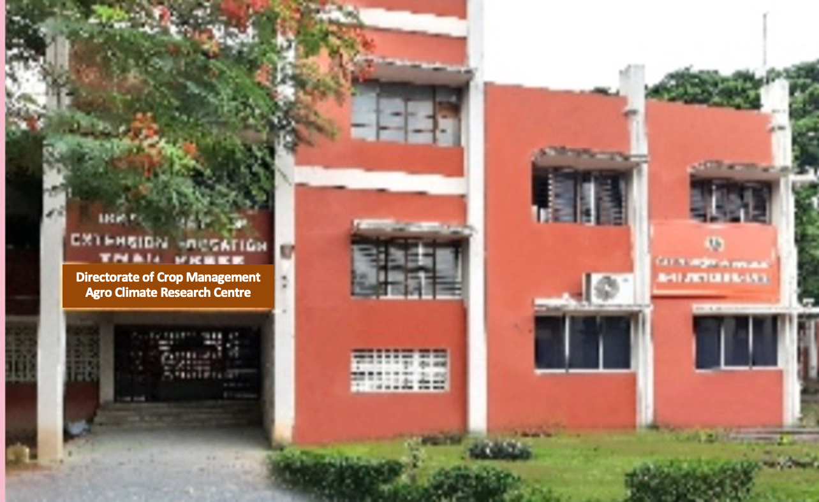
Tamil Nadu Agricultural University
Directorate of Crop Management
Agro Climate Research Centre
Coimbatore – 641 003
Automation of Agromet Services (AAS) To Sustain
Crop Productivity Under Climate Abnormalities
Dr. Ga DHEEBAKARAN, Ph.D.,
Associate Professor (Agronomy)
Agro Climate Research Centre
TNAU, Coimbatore – 641 003

Slide 2
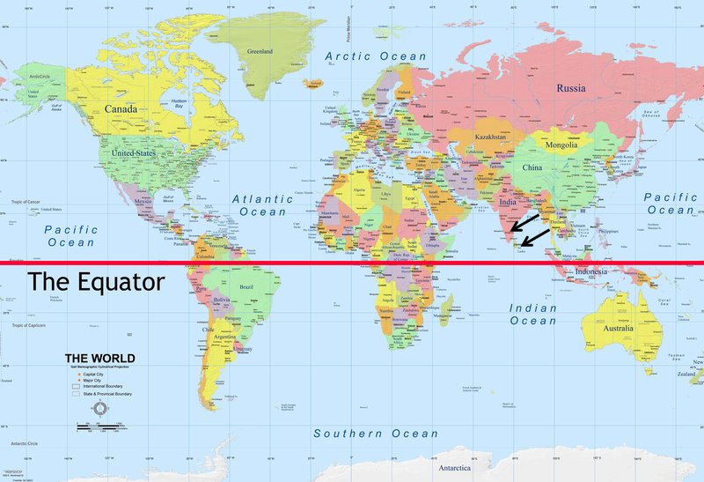

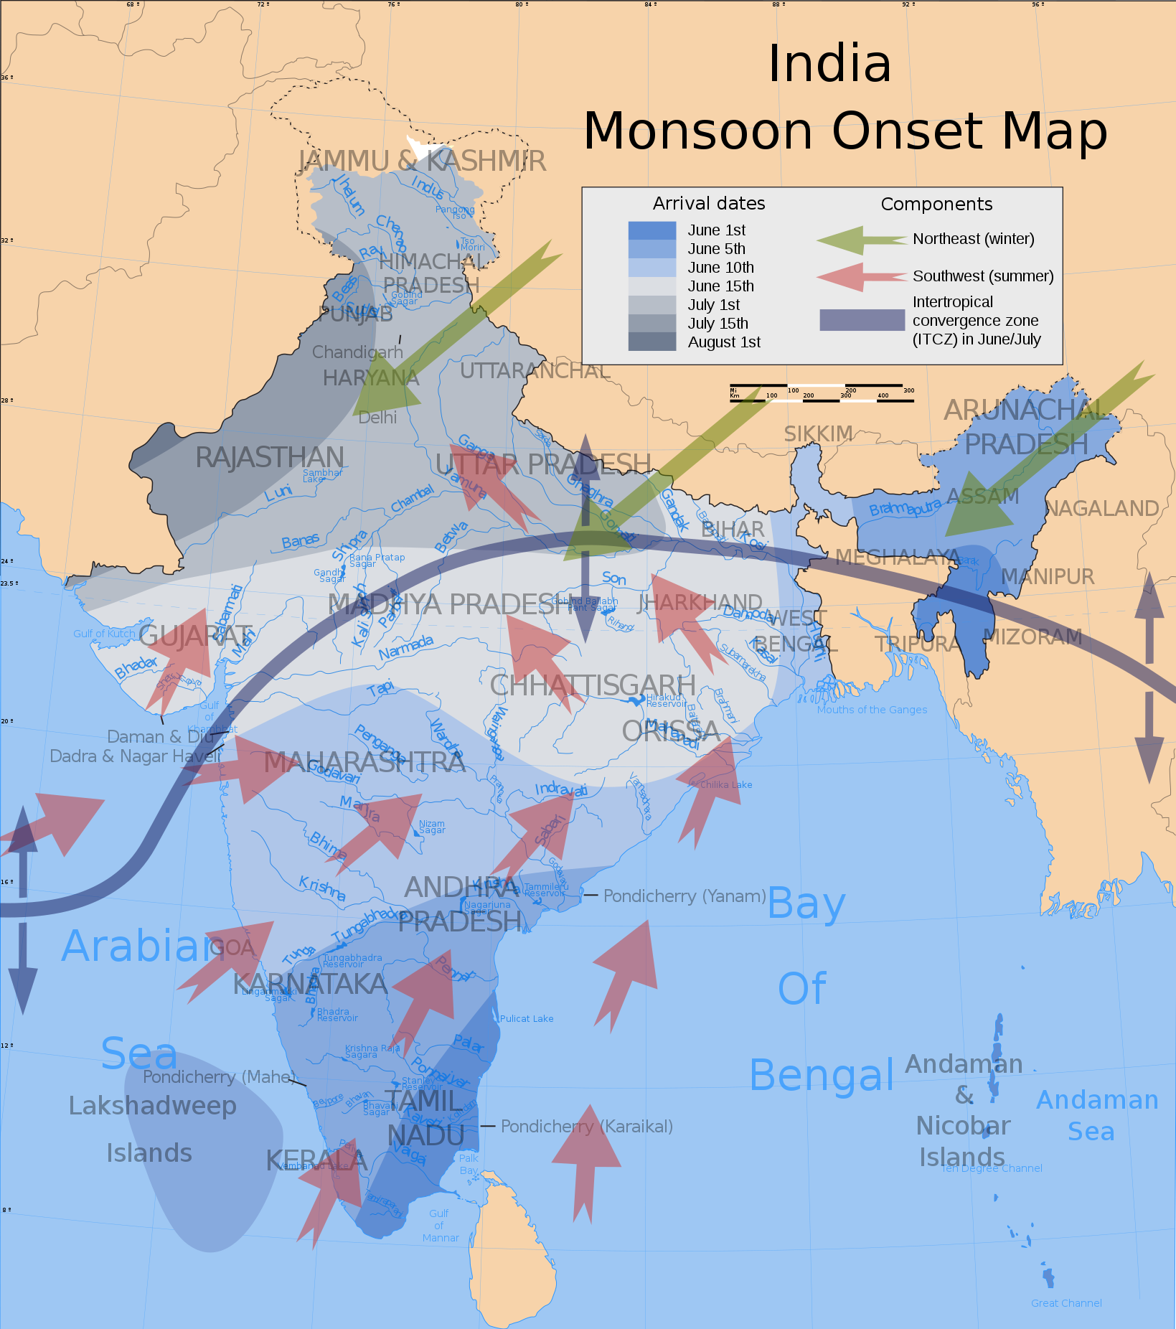
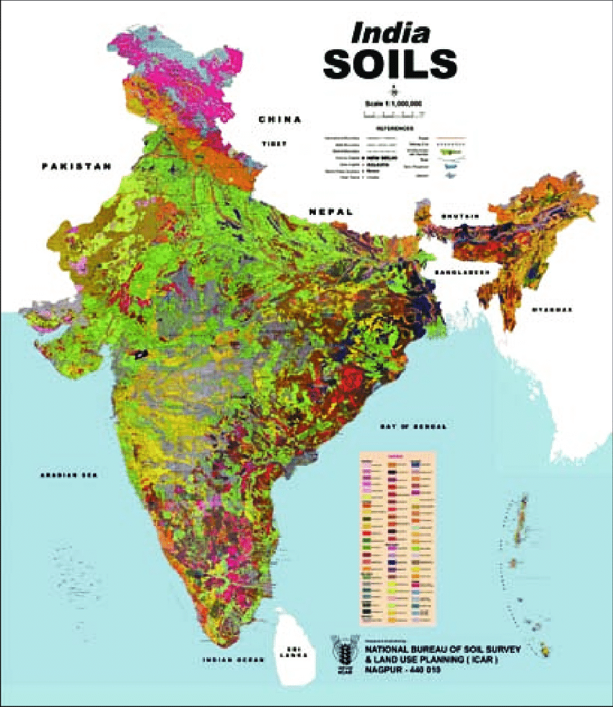
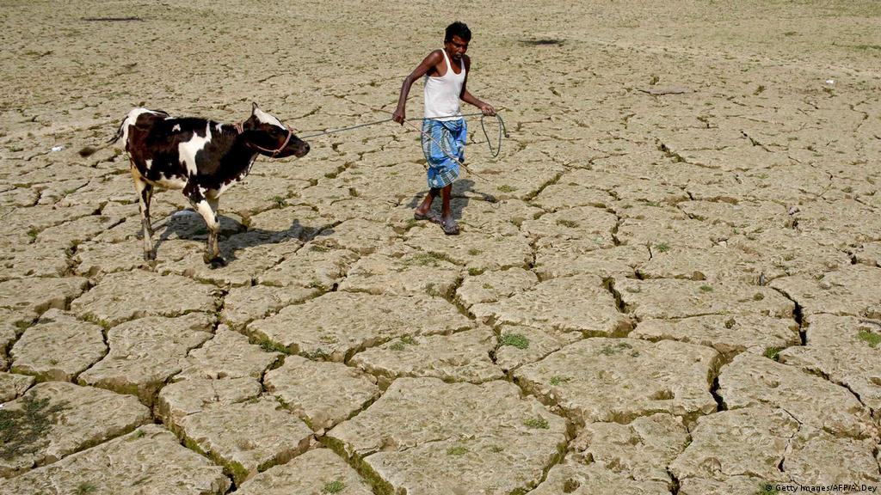
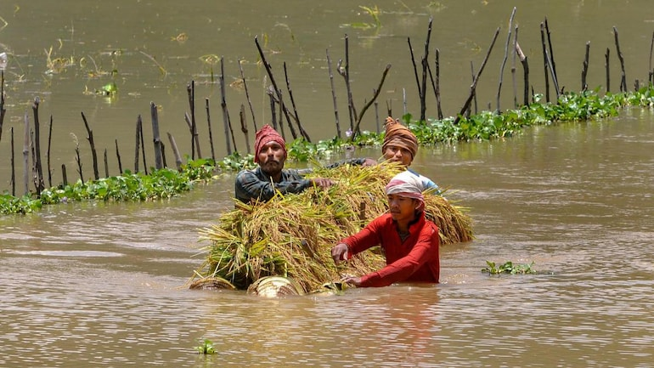

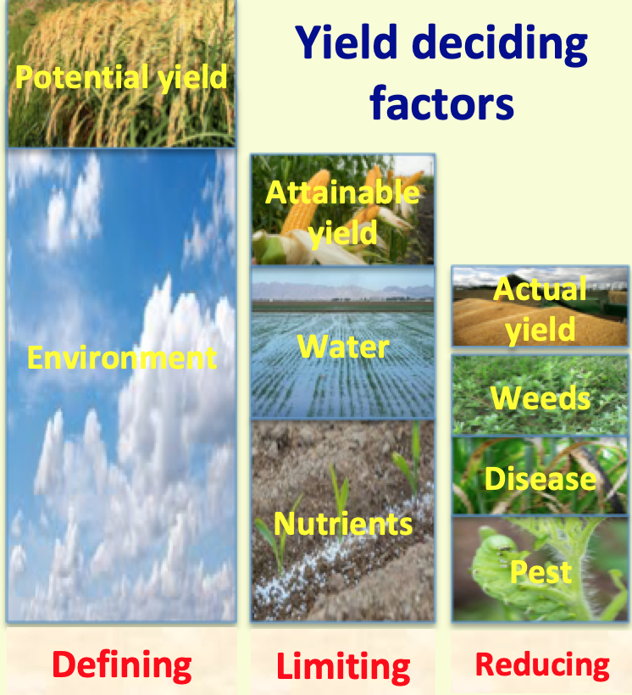

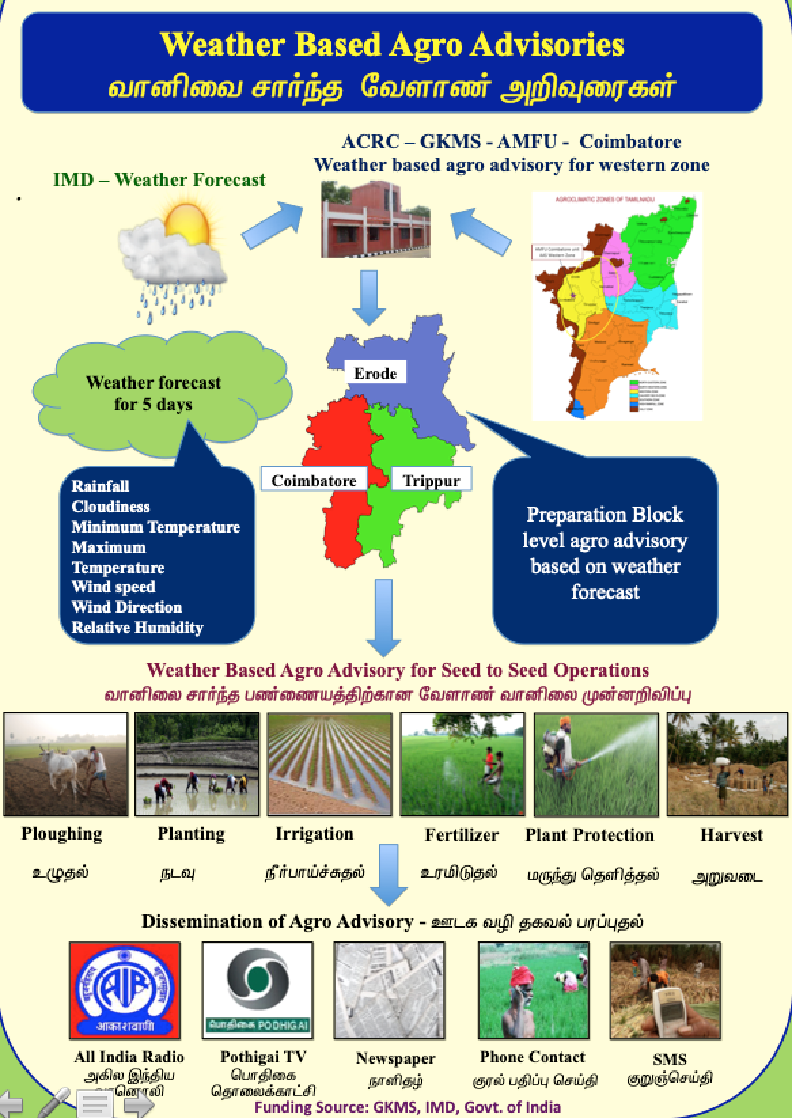
Equatorial nearness of Indian subcontinent favours multiple crop and food security
India has 157mha of farmland with 146 m holdings
Weather is major limiting factor (50% direct & 30% indirect).
Climate change increases the intensity and frequency of weather extremes.
Spatial and temporal shift in LGP, cropping pattern and productivity.
New pest and disease incidences / out breaks
Timely advisories on weather abnormalities may reduce the risk.
Weather wise…
Other wise… Not Wise…
Equatorial nearness
Distinct monsoon & multiple soil
Weather based advisory has greater impact on the farm income and risk reduction.
There is Rs. 1500 – 18000/- increased income for AAS farmers than non AAS farmer.
Reason quoted for higher income is reduction in input loss, in addition to more yield.
Weather

Slide 3
Agromet Service in Collaboration with IMD
Gramin Krishi Mausam Sewa (GKMS – AMFU & DAMU)
9 GKMS &. 11 DAMU
Collaboration with IMD
Weather based agromet advisories to farmers
Twice in a week as SMS thro’ mKisan
About 12.61 lakh farmer in TN receiving SMS
A
C
R
C
Tamil Nadu Agricultural University, Coimbatore 641 003

Slide 4
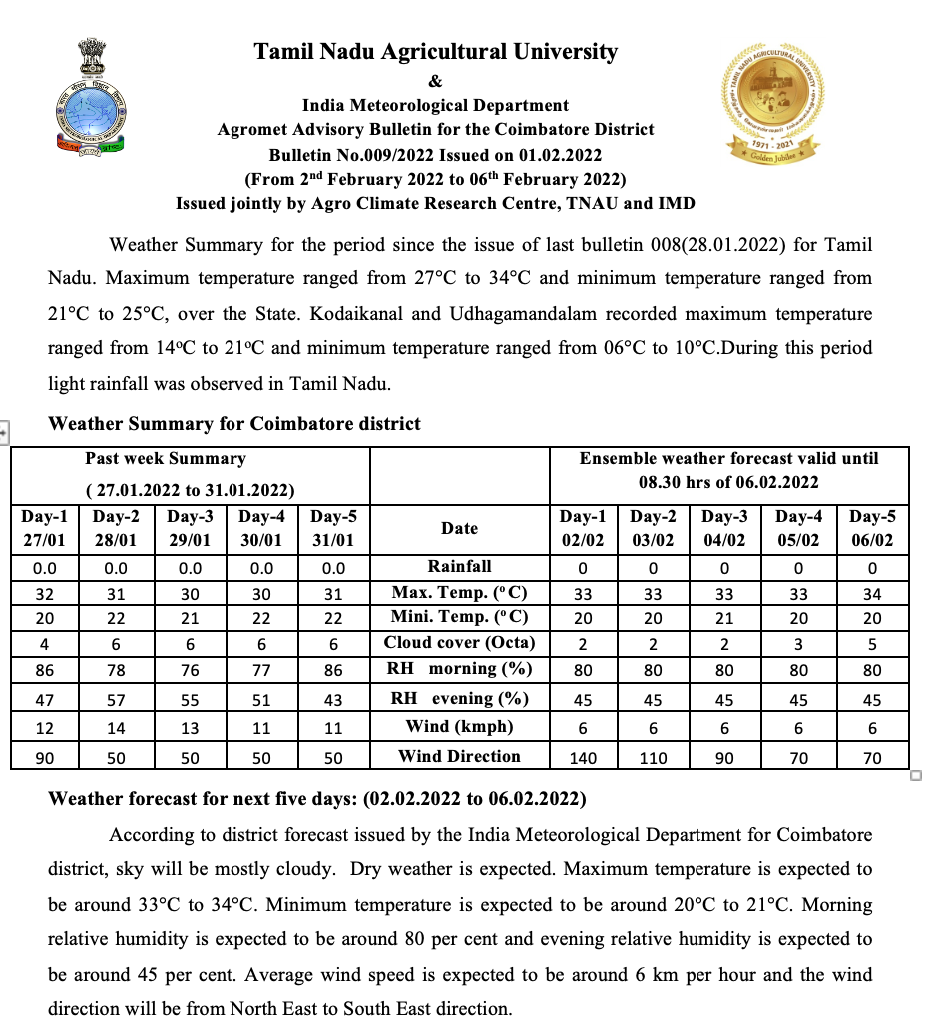
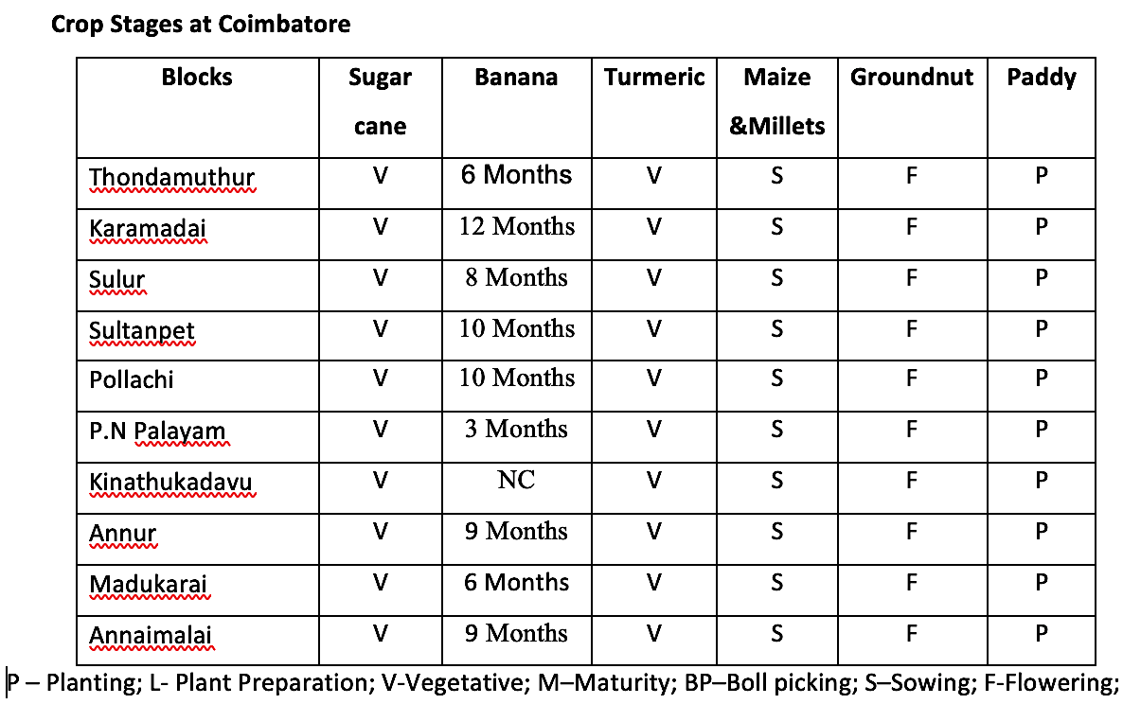

Slide 5
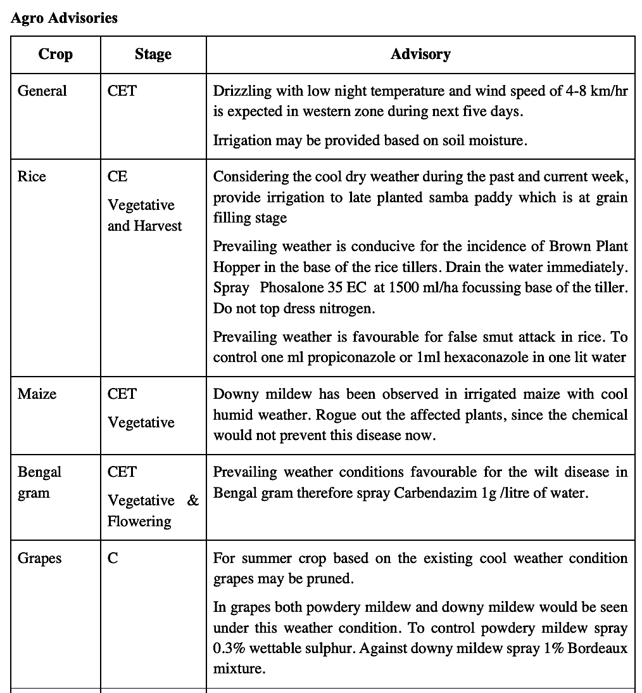
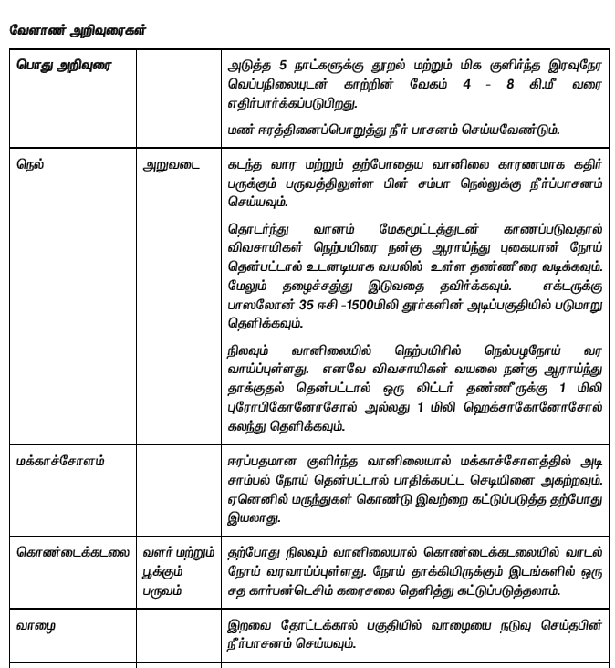
Translate in Tamil with local terms & issue to the farmers

Slide 6
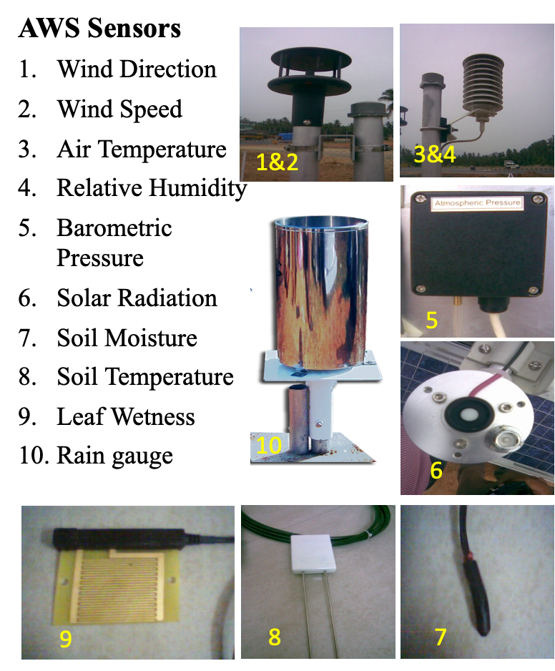
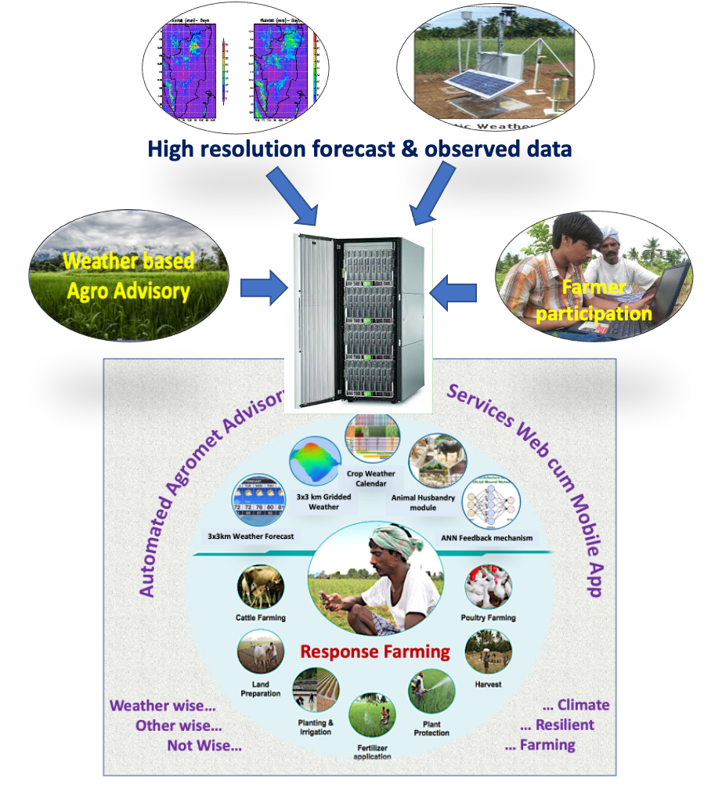
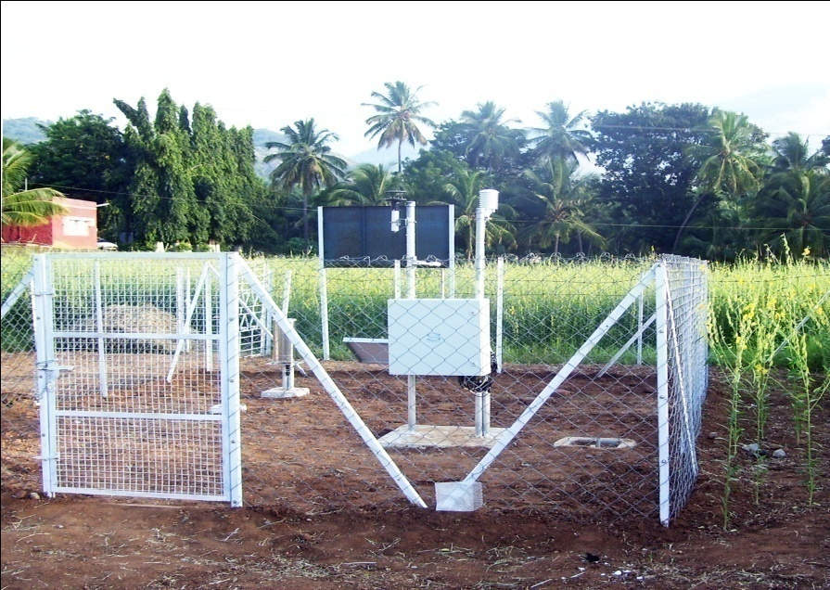
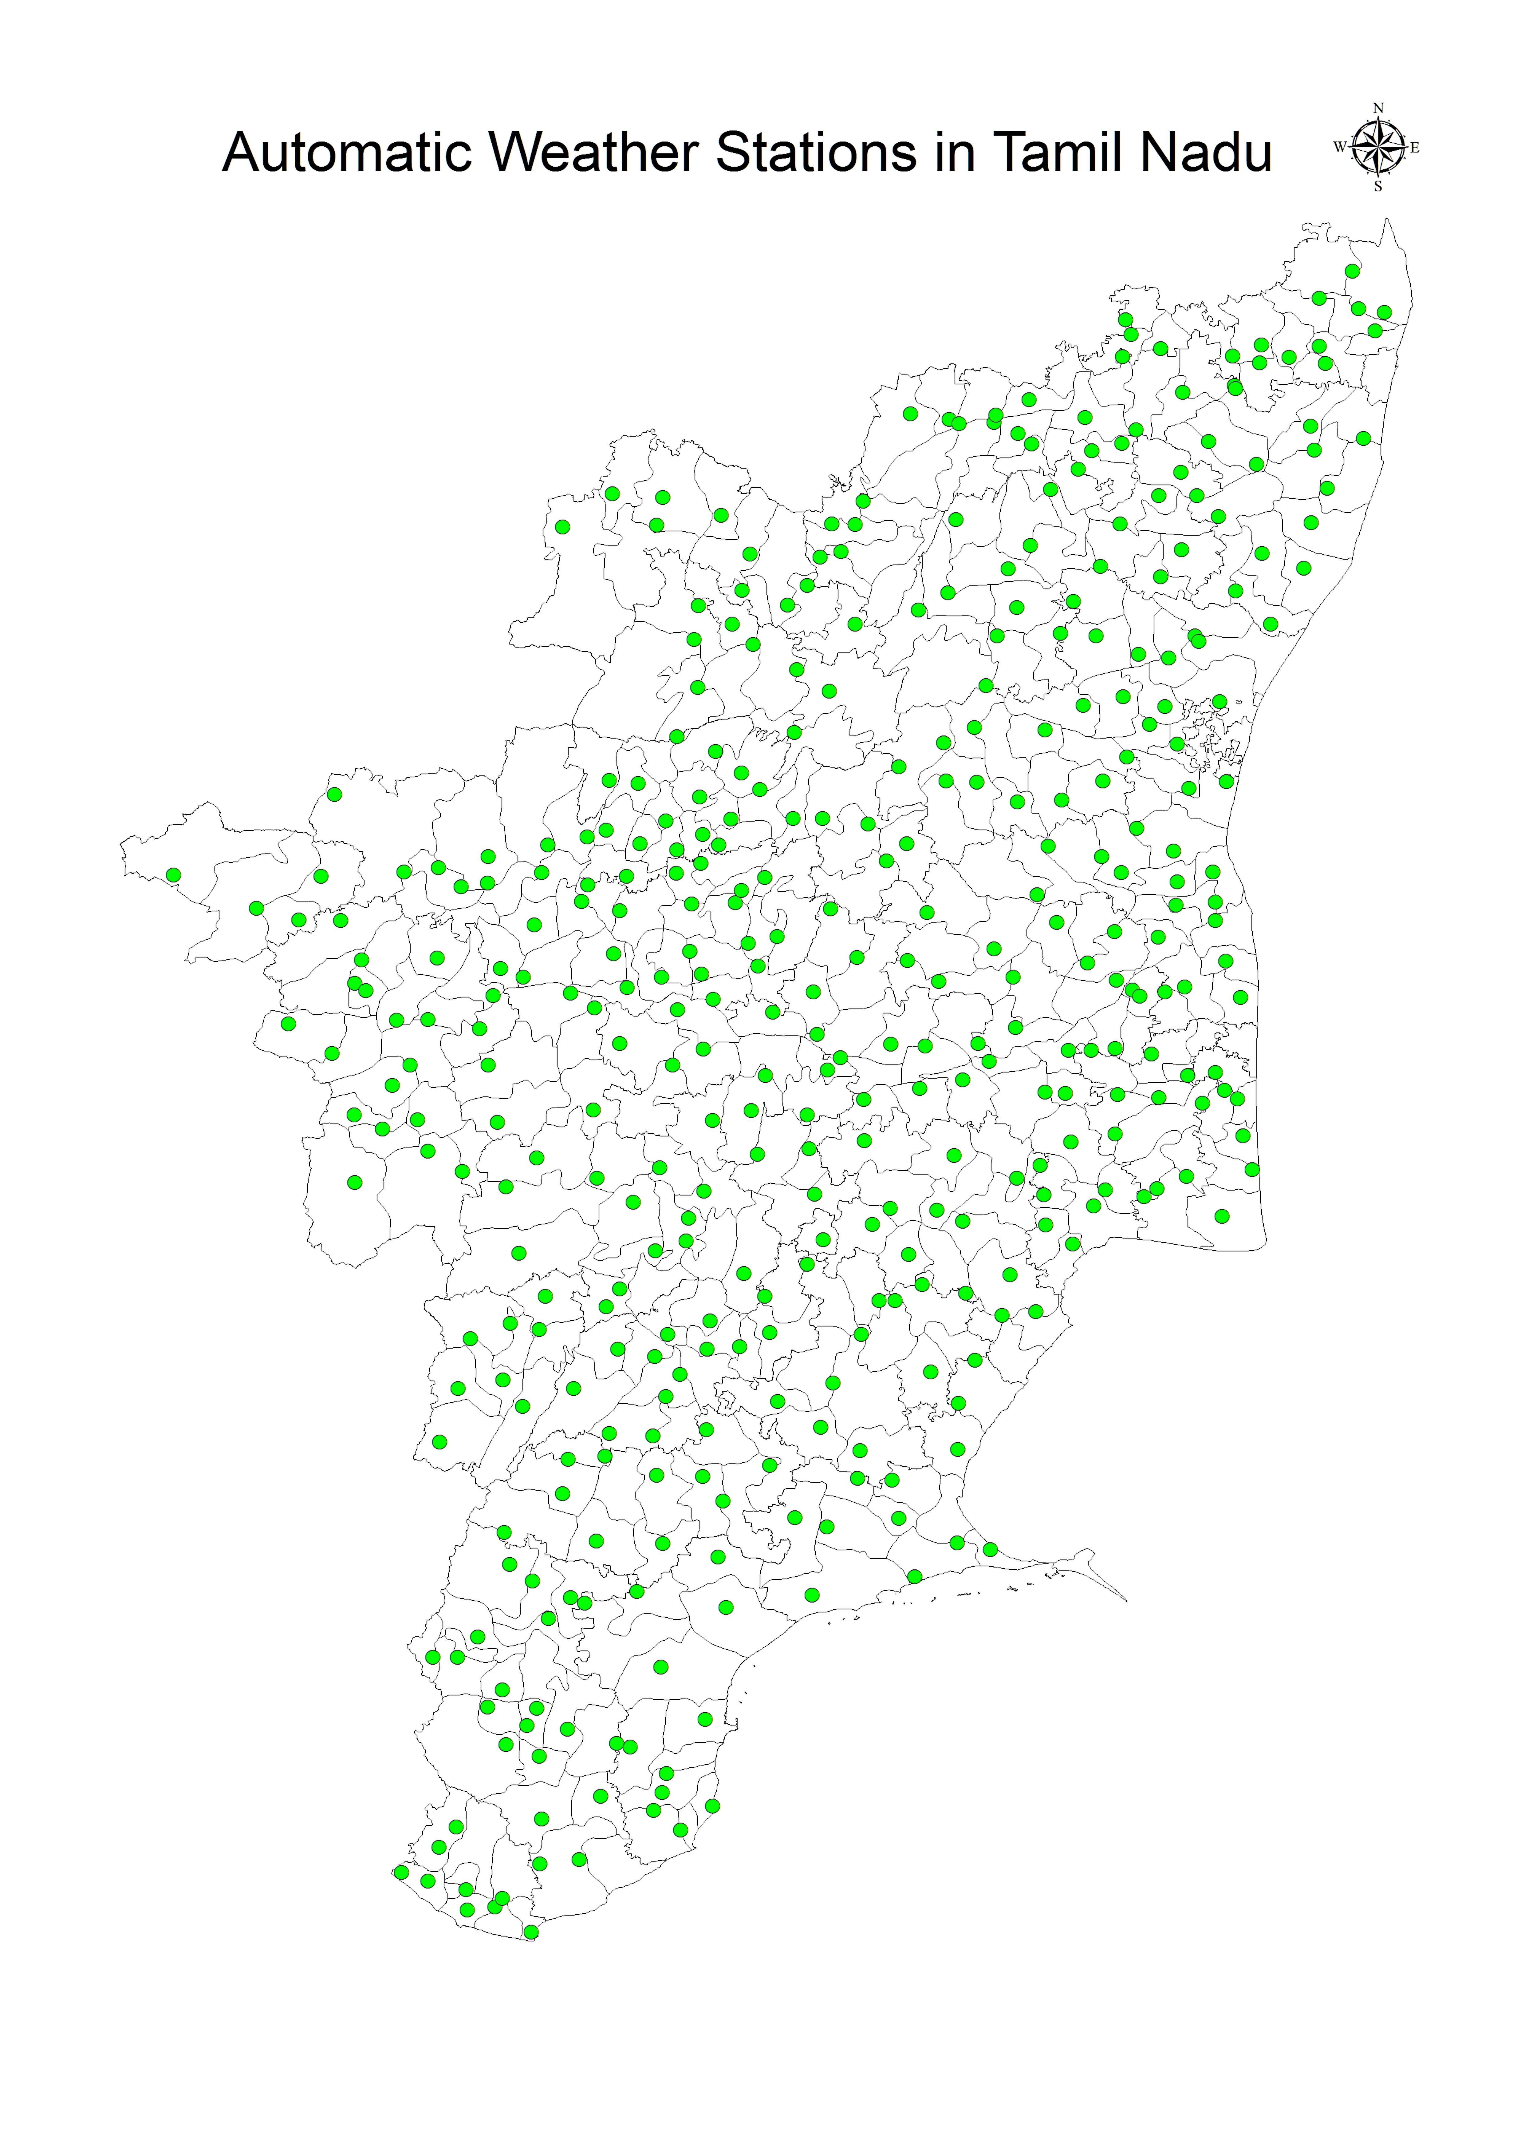
ACRC - Weather Based Response Farming Tool
Automated Agromet Advisory Service Web cum Mobile App
A pool of Good Agricultural Practices (GAP)
Climate Risk Management (CRM) Tool
Farming with Technocrats information
Directly to the farm without extension personnel
Advisories are specific to farm, weather, crop & stage
108 crops, 6 stages, 54 weather scenarios
Timely advisories in regional language
“Zero human” intervention in Tech. transfer
Both web cum Mobile App
Reduce the cost on transfer of technology
Higher success, both increased productivity and reduced loss
A
C
R
C
Tamil Nadu Agricultural University, Coimbatore 641 003

Slide 7
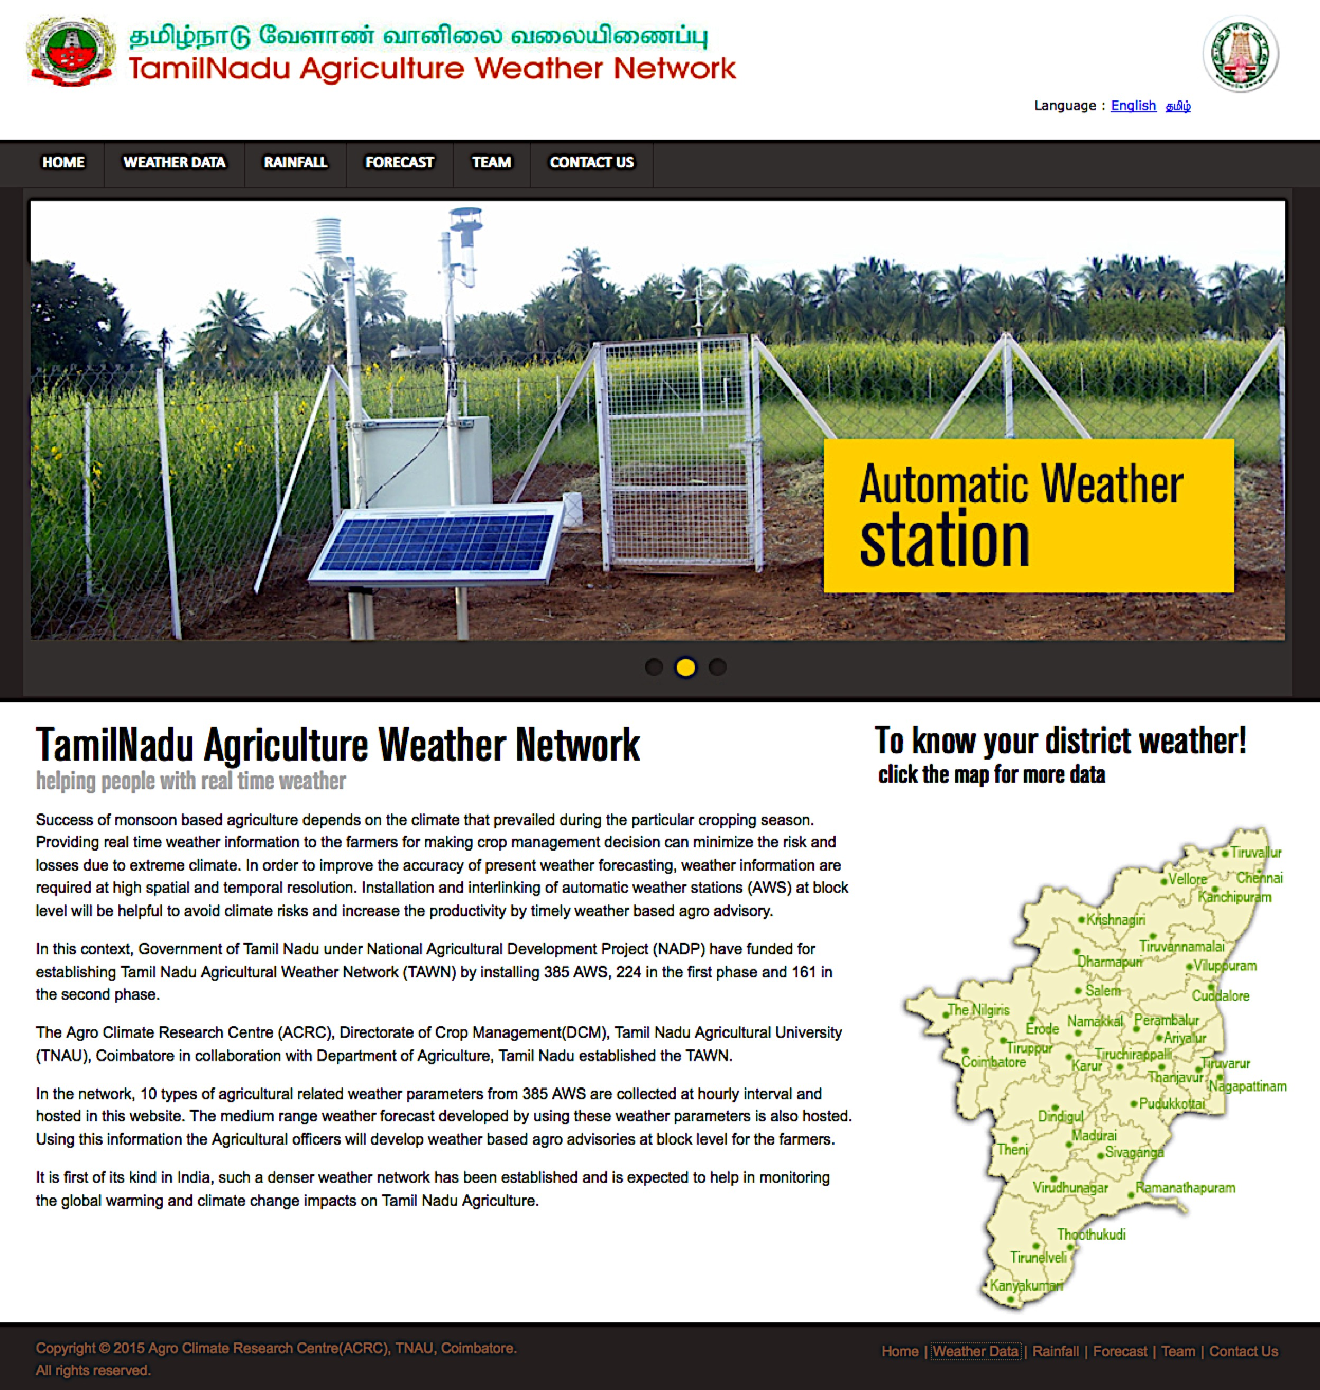
Tamil Nadu Agricultural Weather Network (TAWN)
Realtime Weather Information
By 2009, first of its kind India….
TNAU initiated closer weather network of AWS
Each one per block @ 25km interval
Especially for Agriculture with 10 parameters
Includes soil moisture & soil temperature sensors
Real time weather @ hourly interval
Also daily, weekly & monthly weather information
Public domain “http://tawn.tnau.ac.in”
Useful to farmers, administrators & civilians
Data availability : 2011- 16 & 2022 onwards
Revived 255 out of 285 AWS and working now
A
C
R
C
Tamil Nadu Agricultural University, Coimbatore 641 003

Slide 8
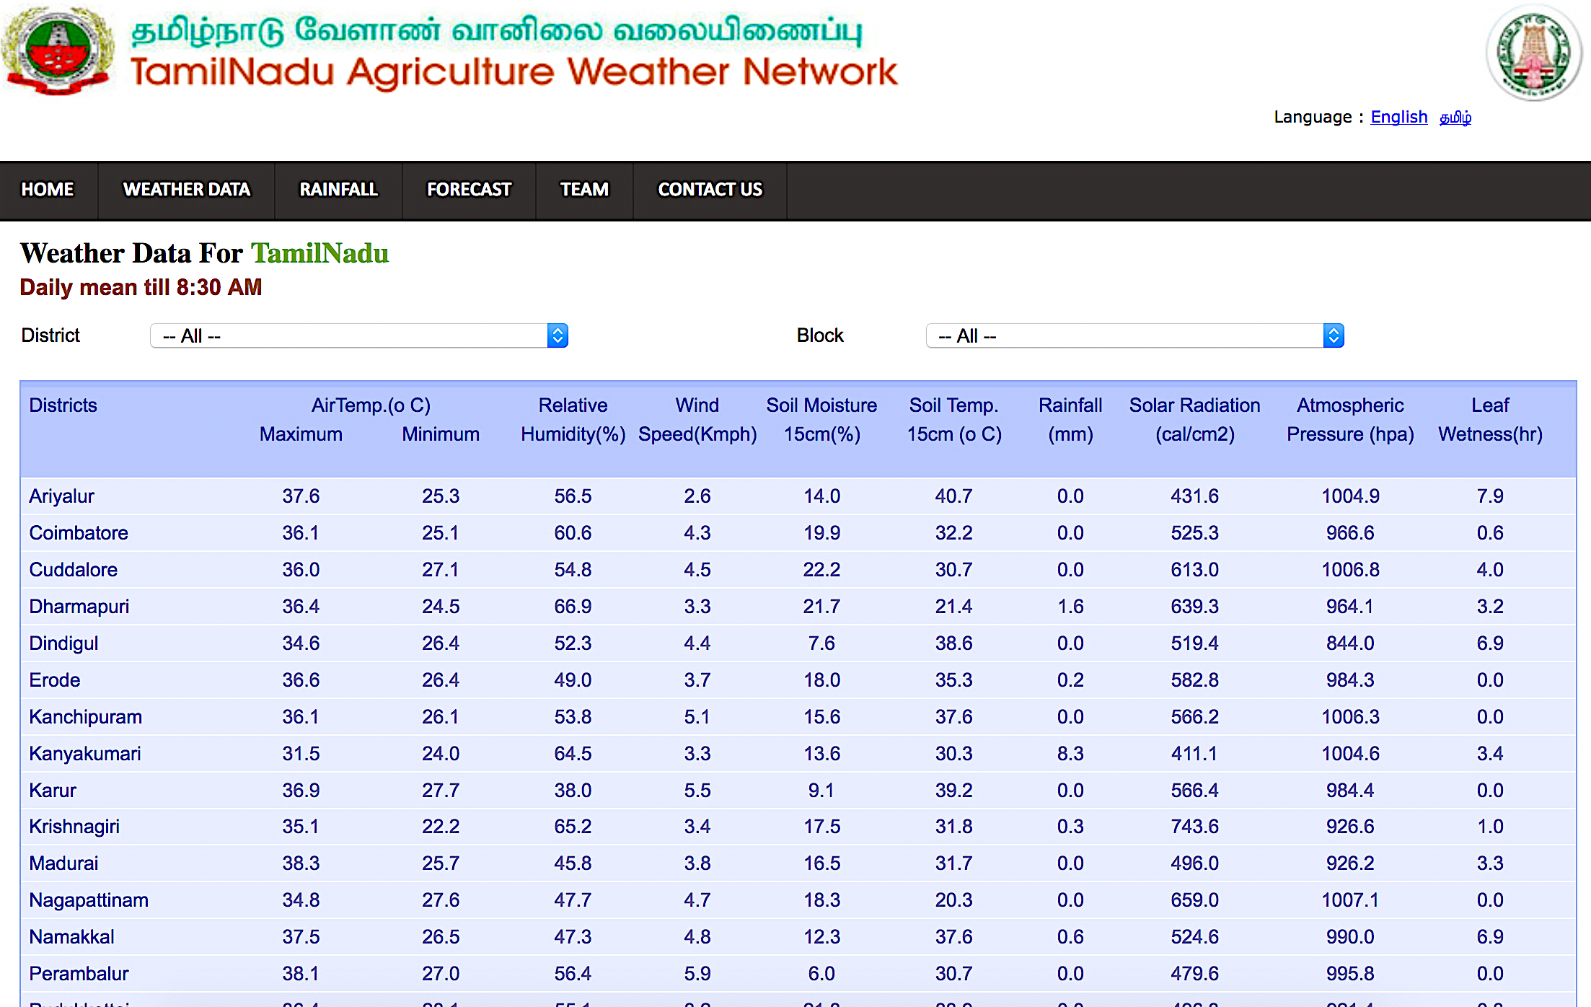
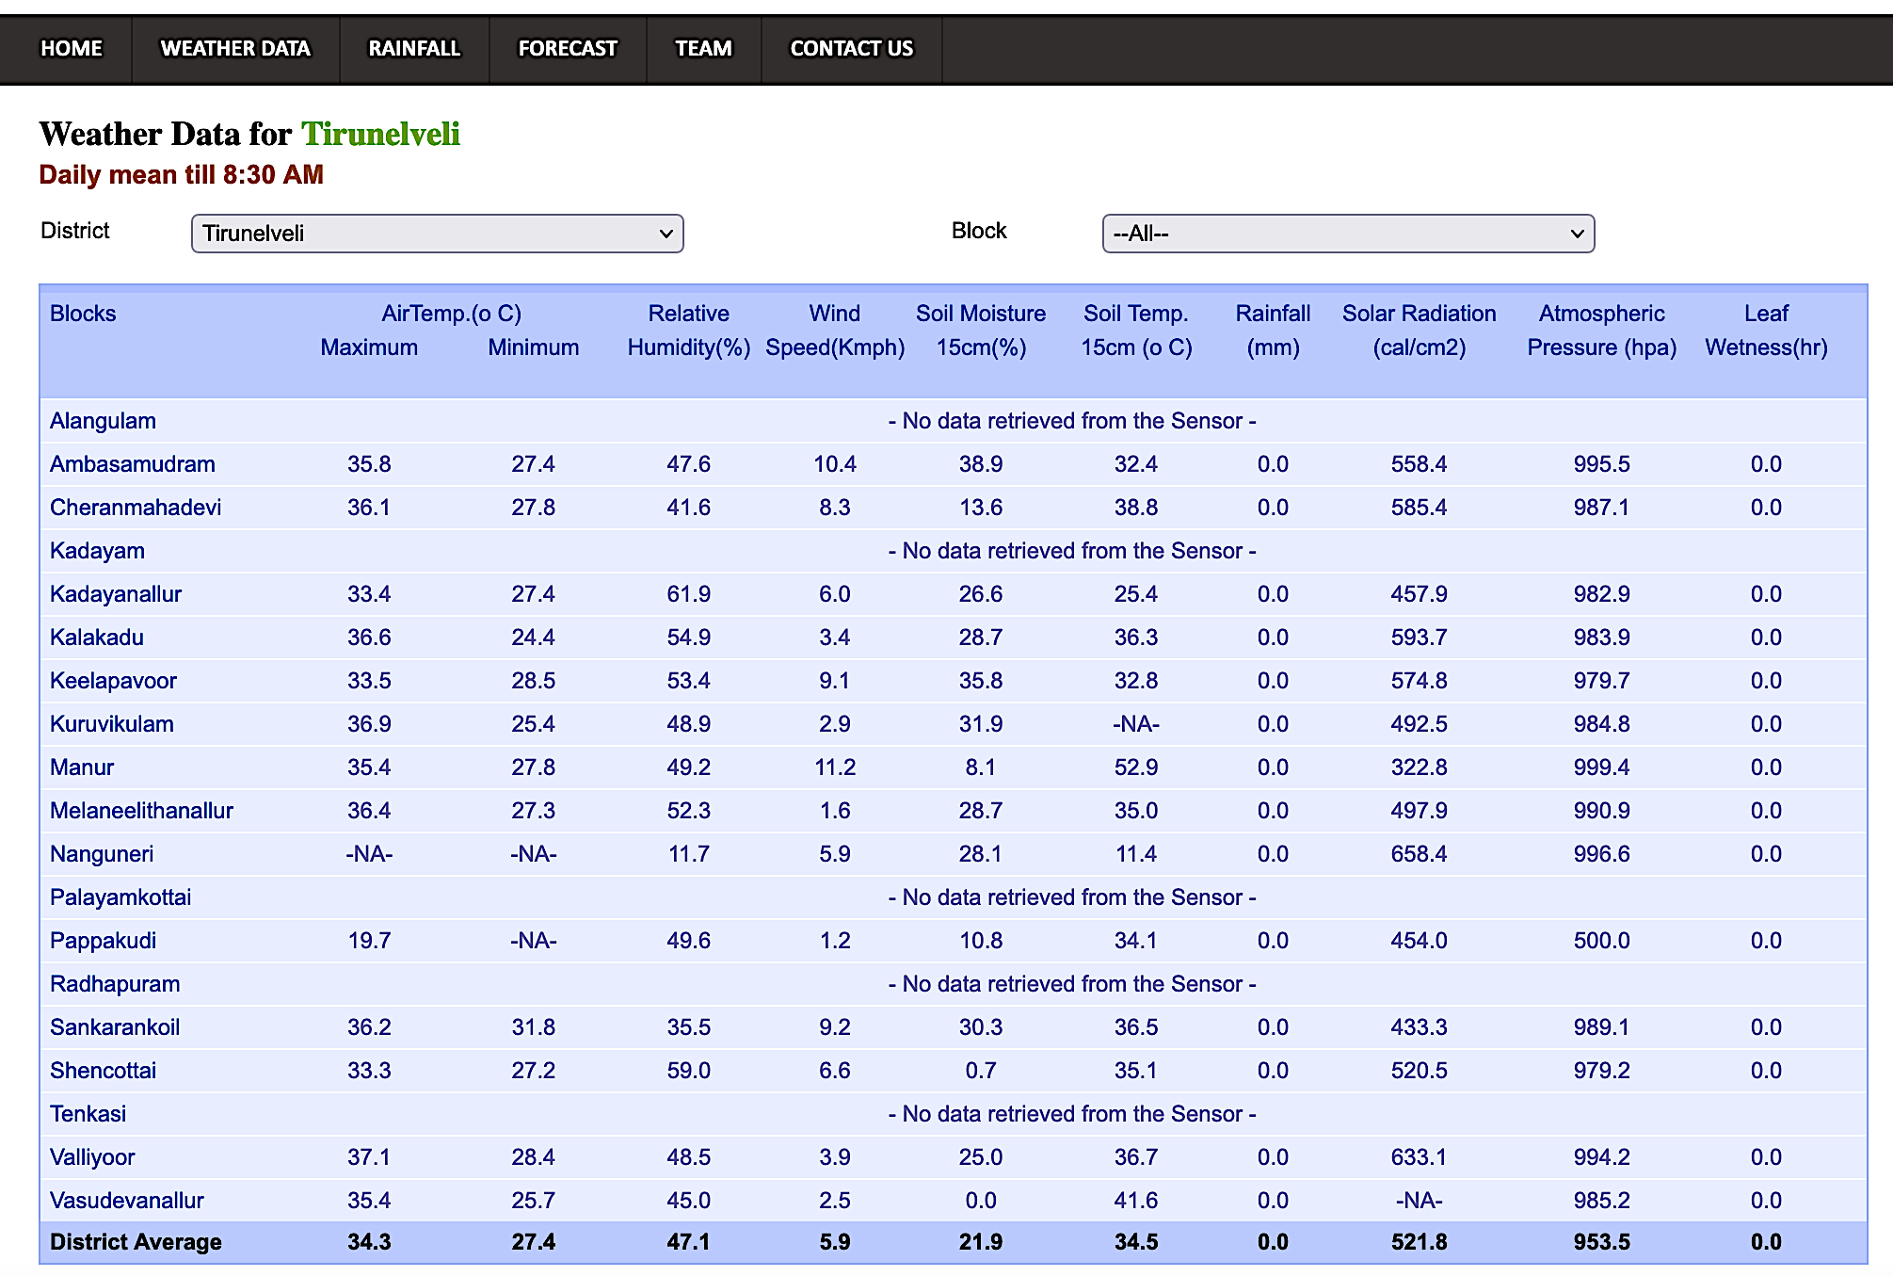
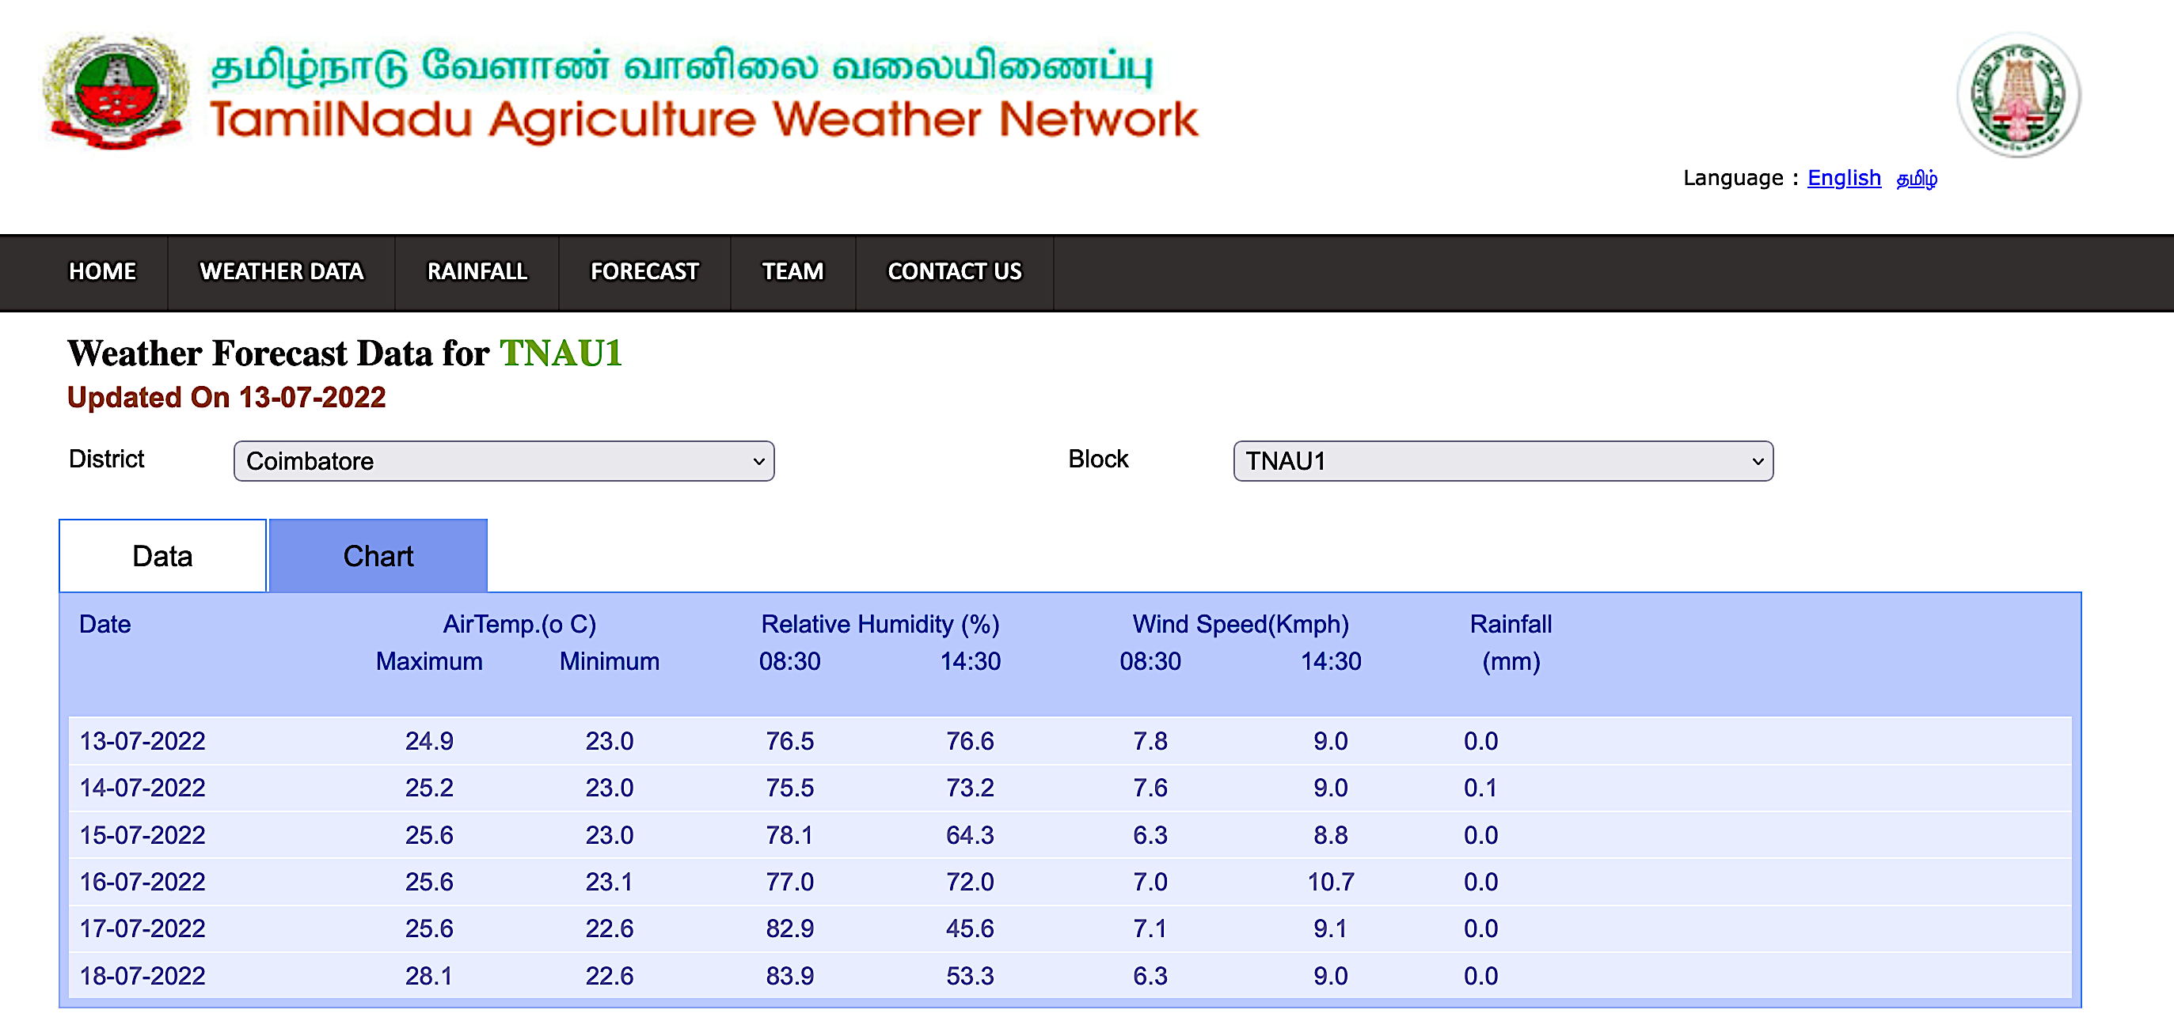
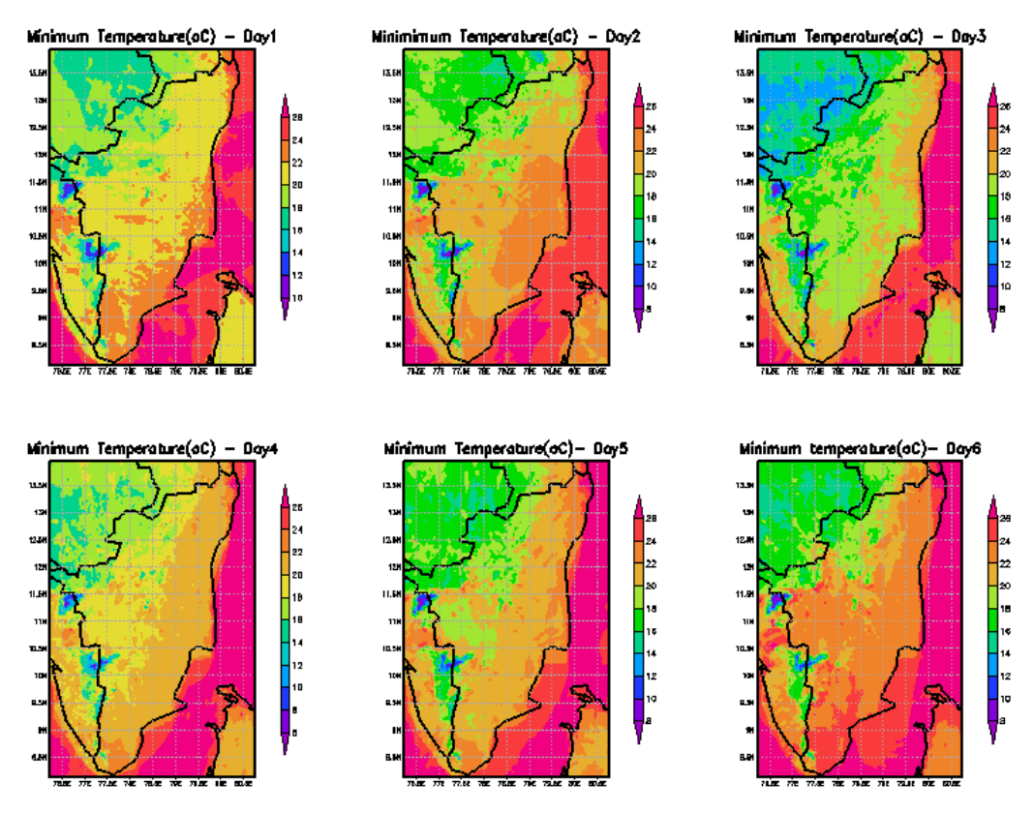
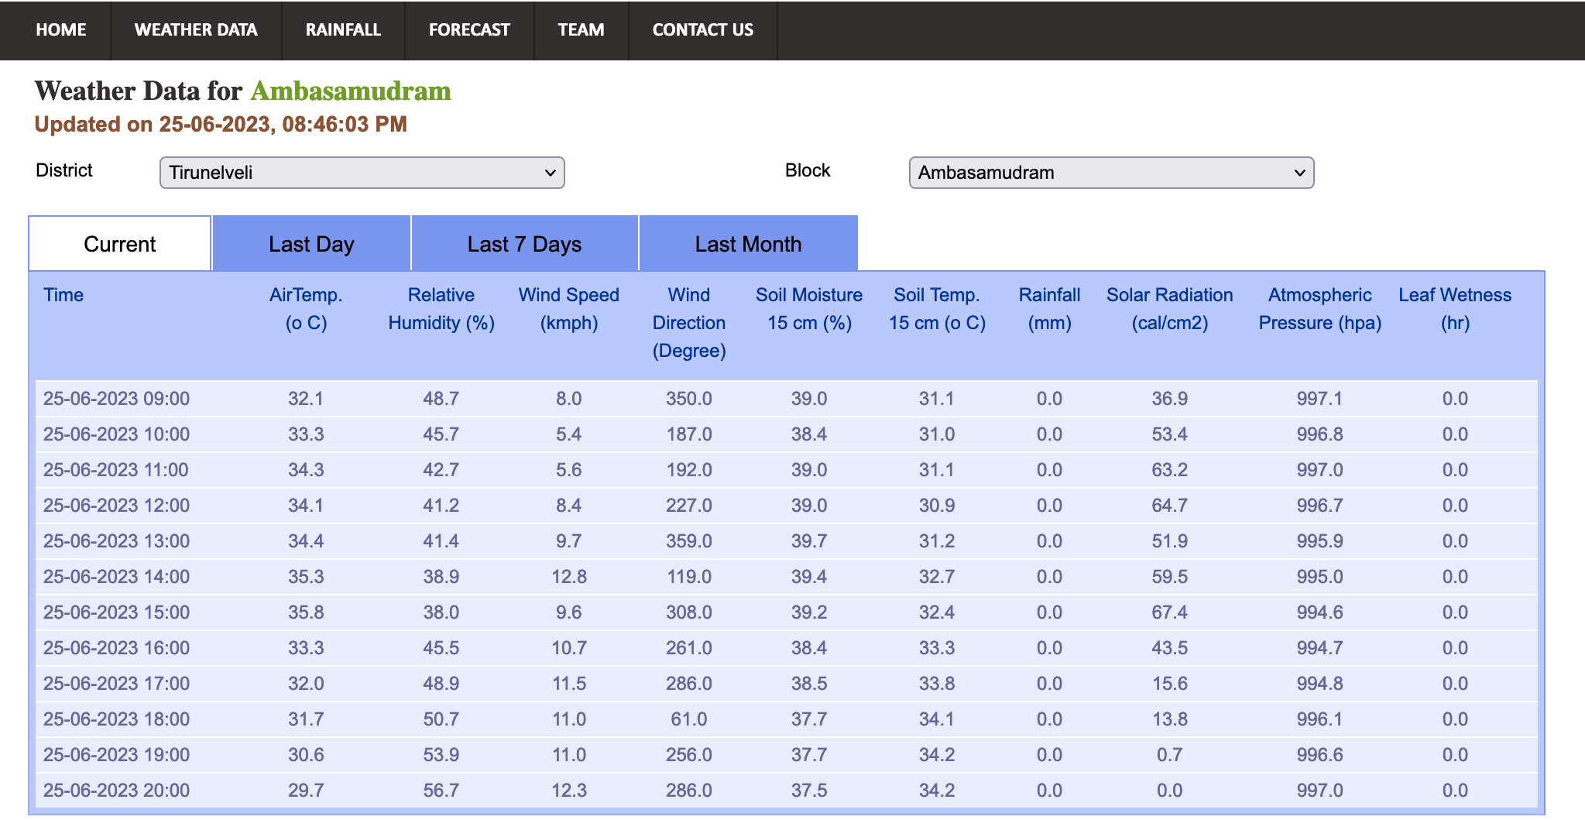
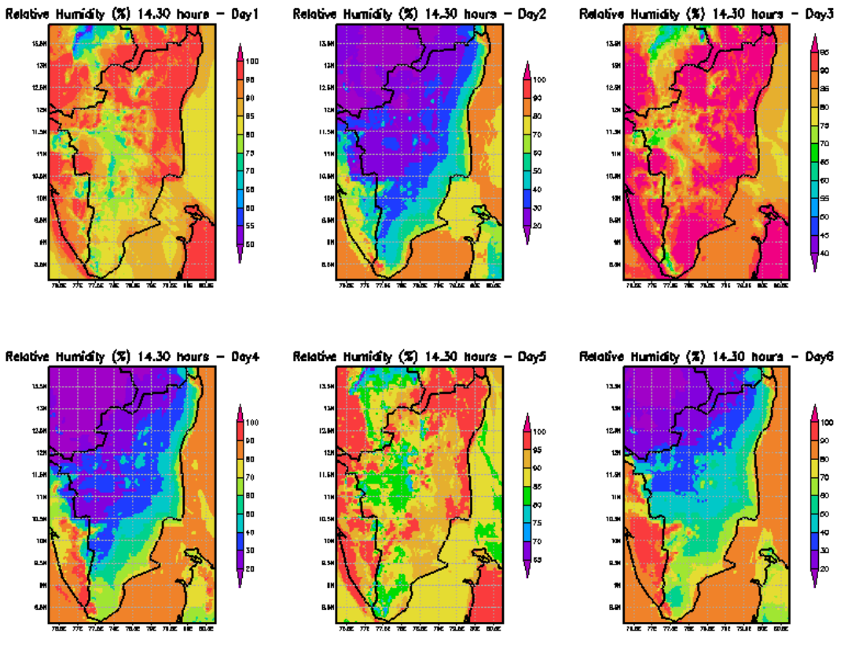
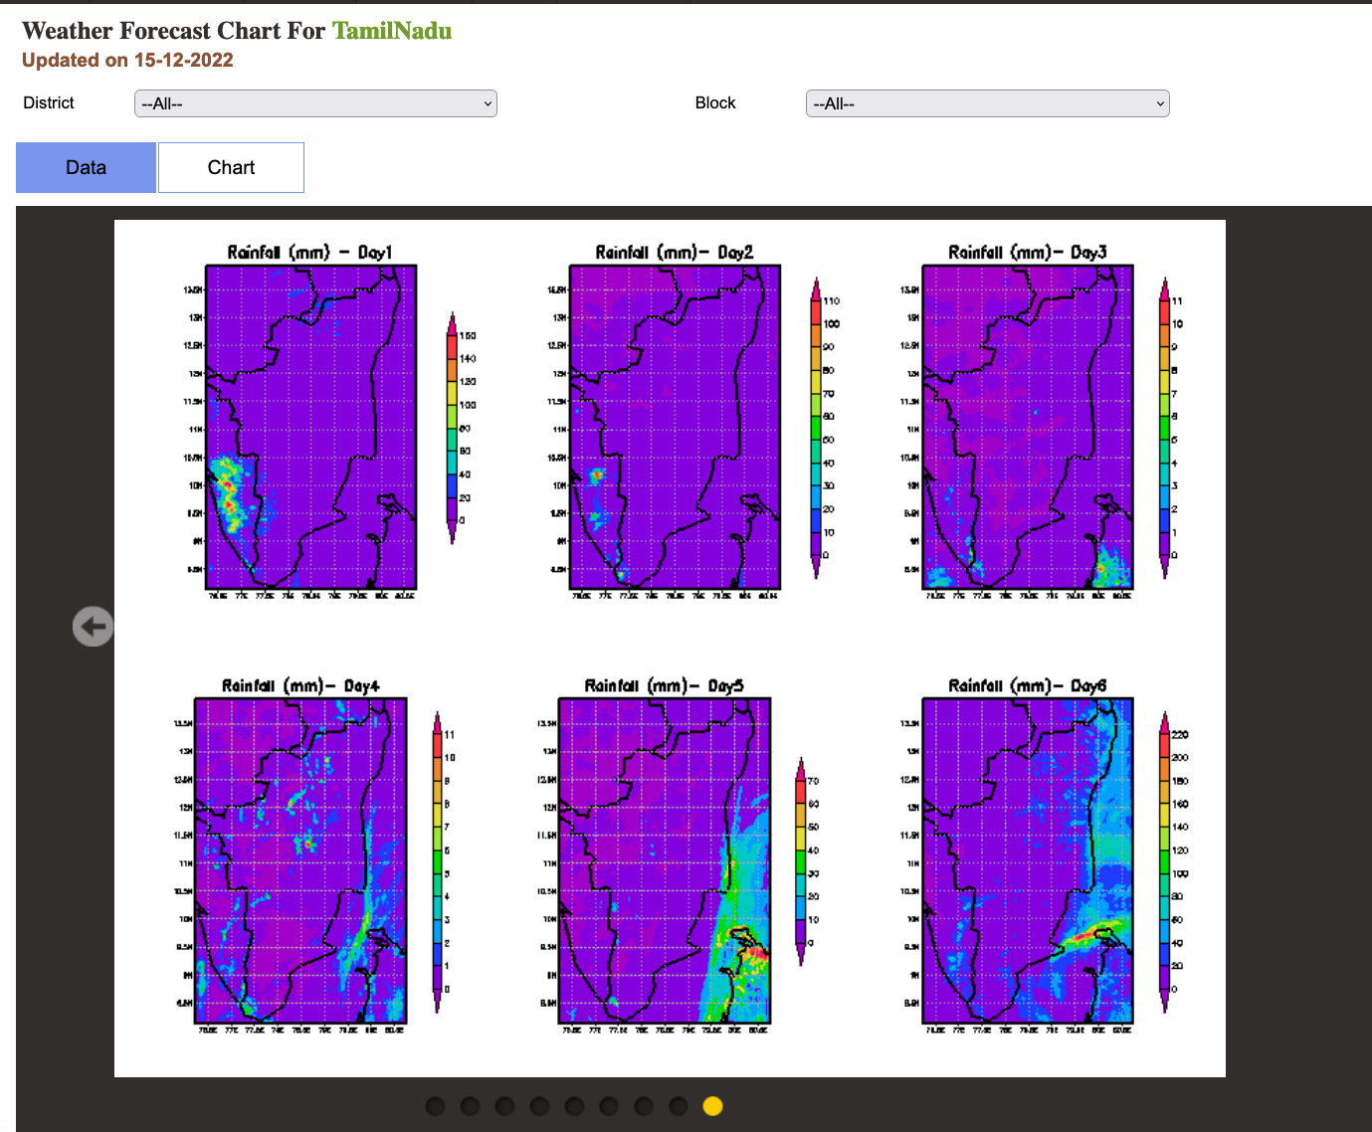
Tirunelveli District
Realtime Hourly weather
Last day, week & month

Slide 9
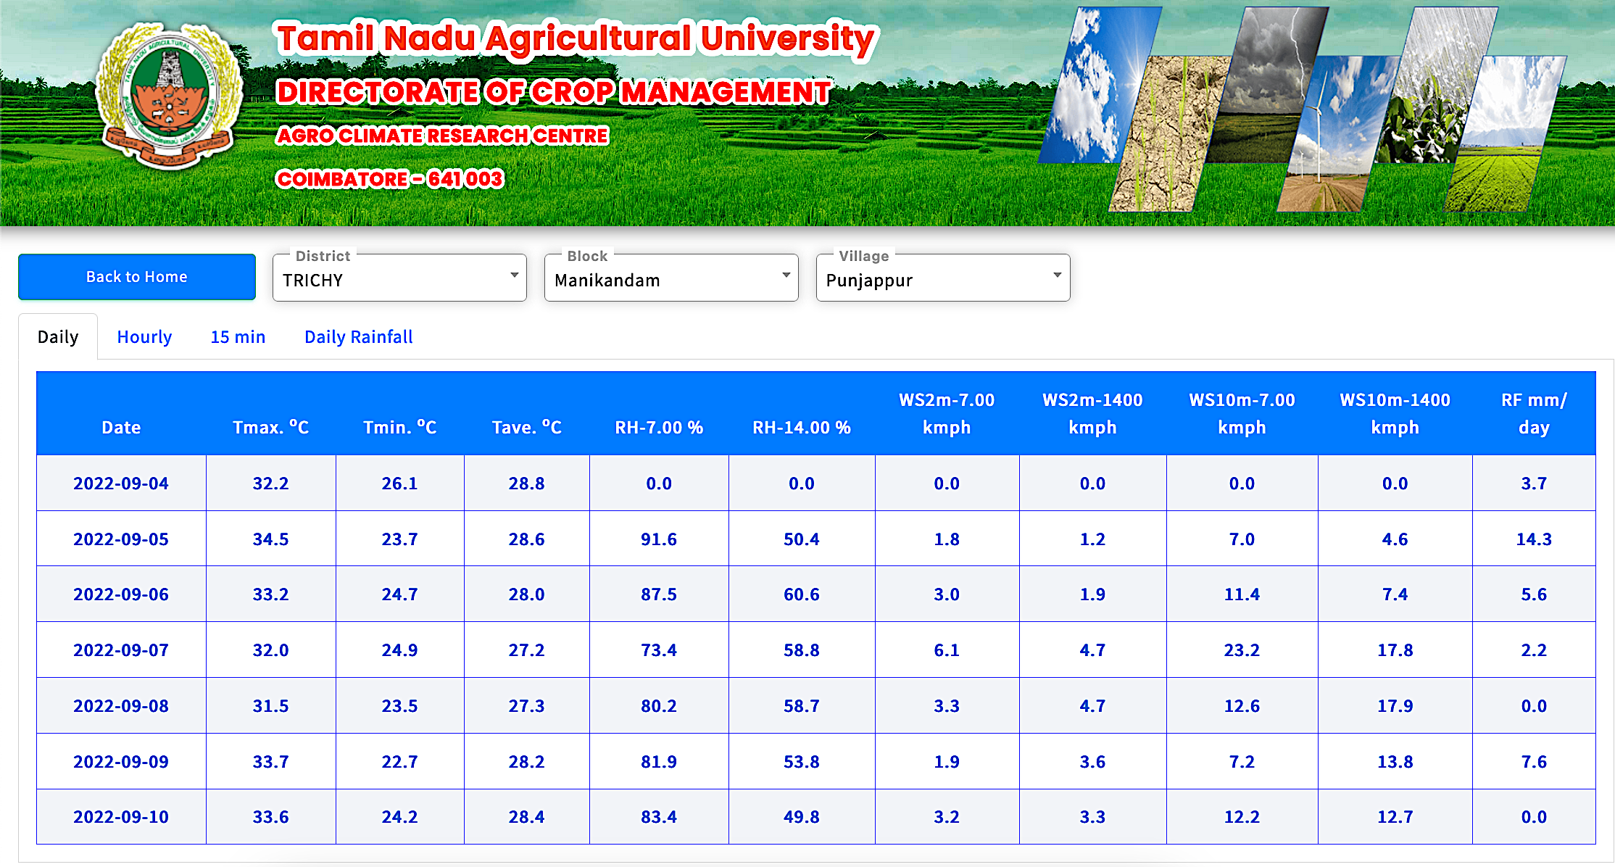
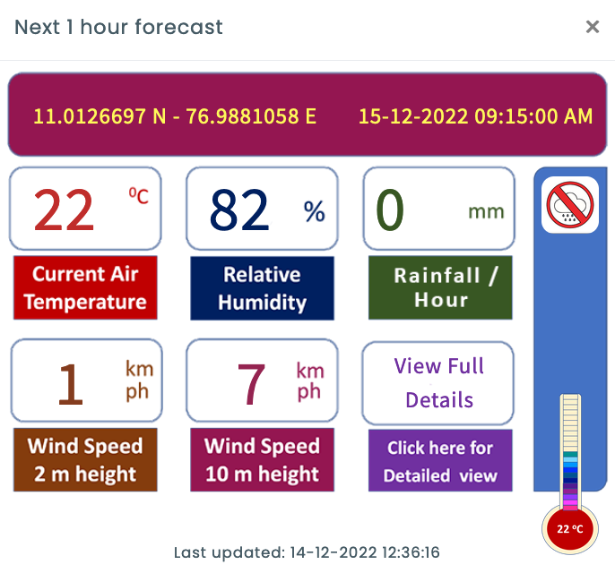
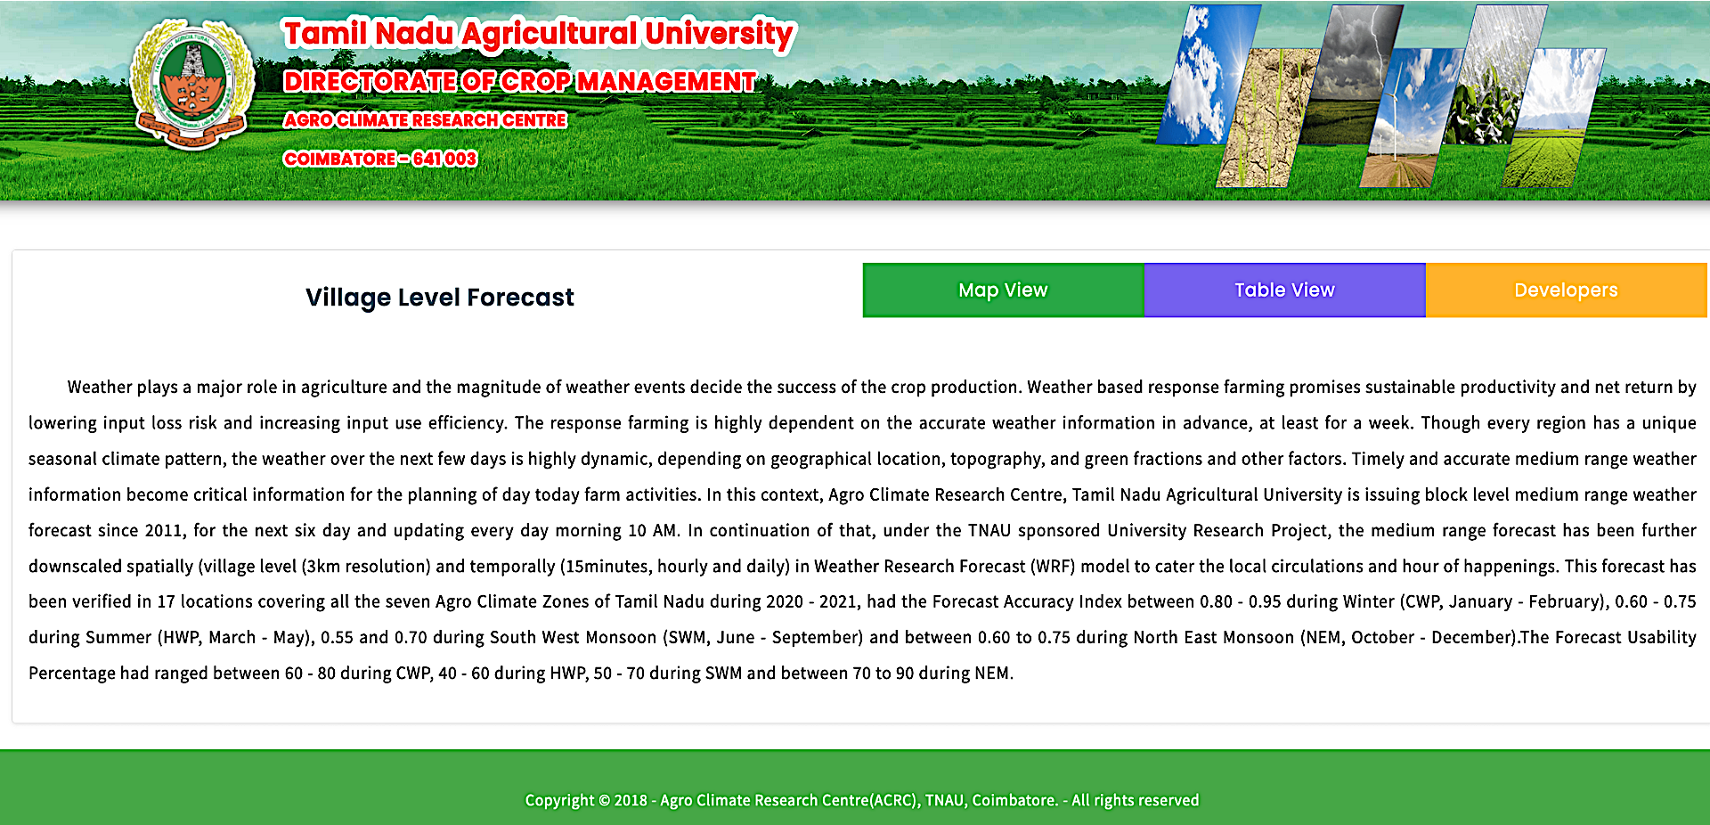
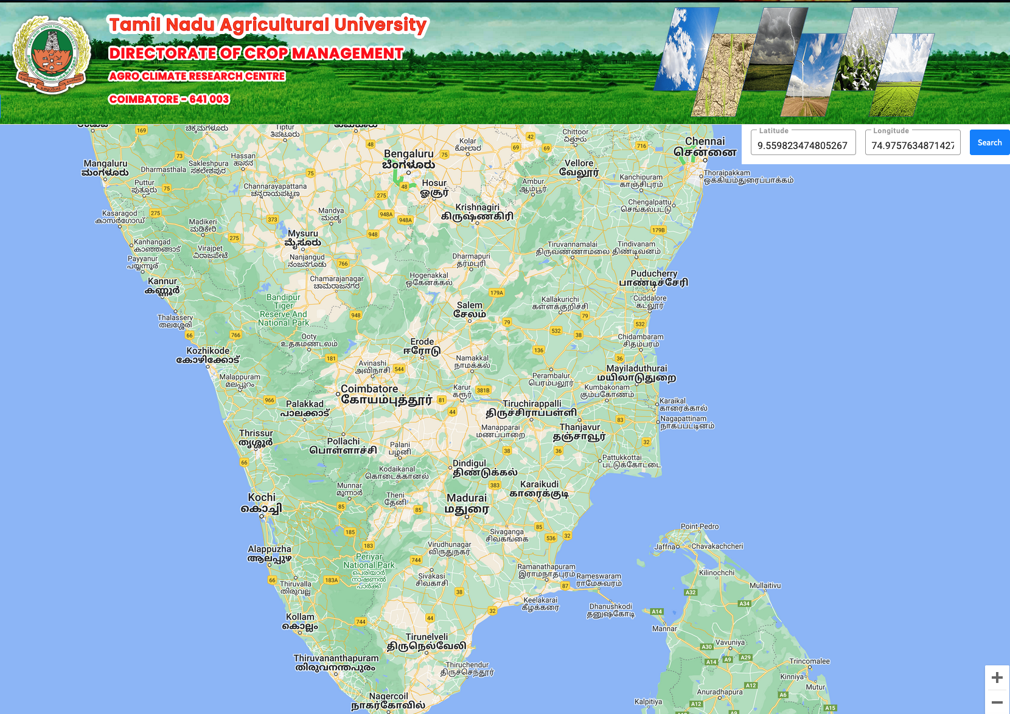
TNAU - Weather Forecasting Services
Block Level Medium Range Weather Forecast
TNAU is pioneer & only SAU providing MRWF
Since 2011, forecasting @ 9 km resolution
WRF model with GFS T12Z & Kessler
Issued to all the 385 blocks of TN
Next 6 days at Daily and Hourly interval
Both Map and Table View
Public domain, free of cost
Linked to Uzhavan App
http://tawn.tnau.ac.in/
A
C
R
C
2
Tamil Nadu Agricultural University, Coimbatore 641 003

Slide 10
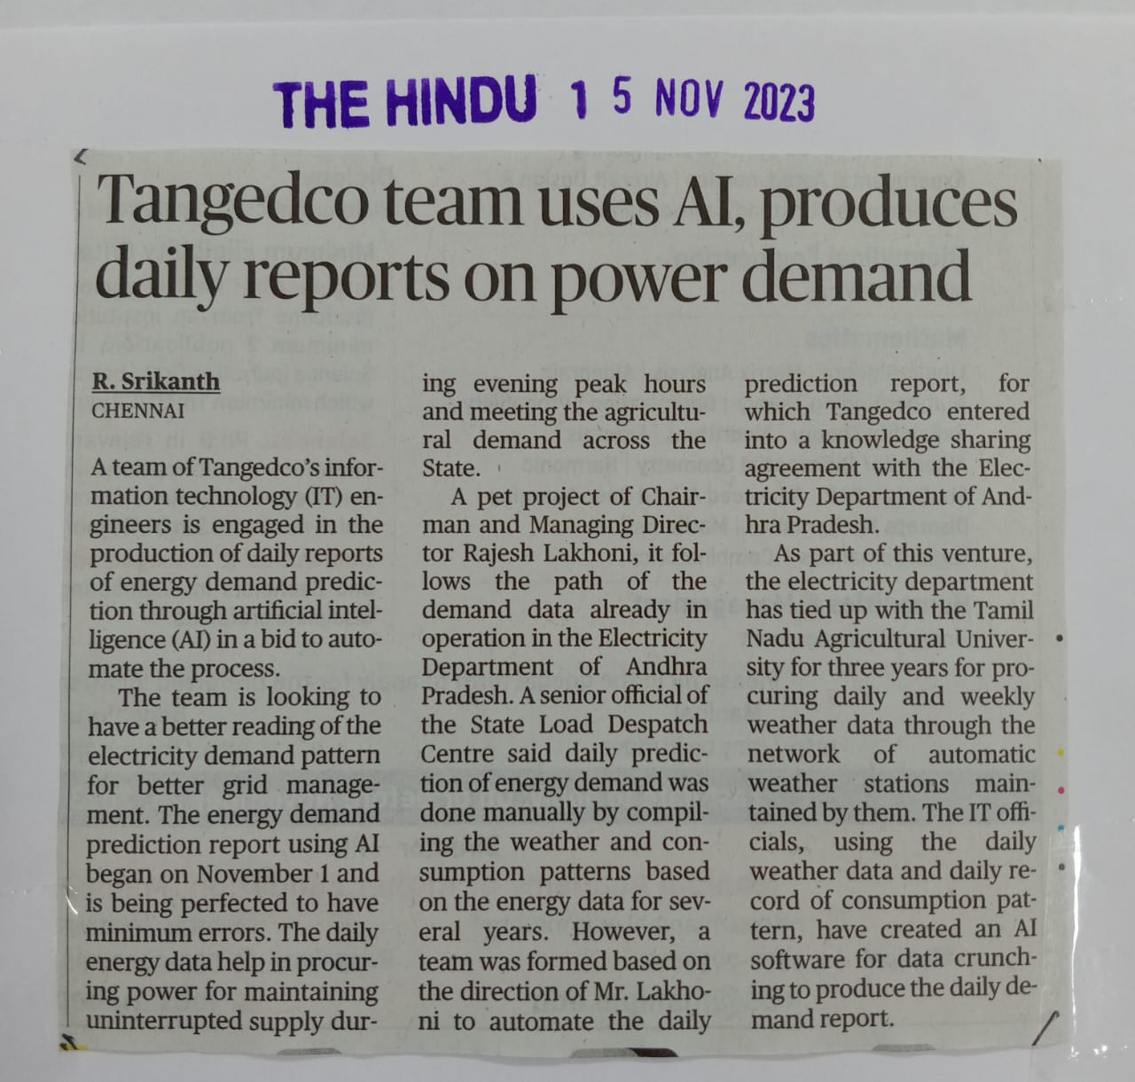
TNAU - Weather Forecasting Services
TNAU – Village Level Medium range Forecast
Now at 3 km resolution, 35640 points in TN
Next 6 days - Daily and Hourly scale
WRF model with GFS T12Z & KWSM3
Forecast in both Map & Table View
Forecast Accuracy 70 – 80%
Seven weather parameters
Rainfall & Wind Speed (2m & 10m)
RH, Max. & Min. Temperature
Forecast for all 18655 revenue villages
Public domain @ free of cost
List of rainfall expected villages
Easily locate extreme rainfall
86th S
W
C
http://aas.tnau.ac.in/vlf/
Tamil Nadu Agricultural University, Coimbatore 641 003

Slide 11
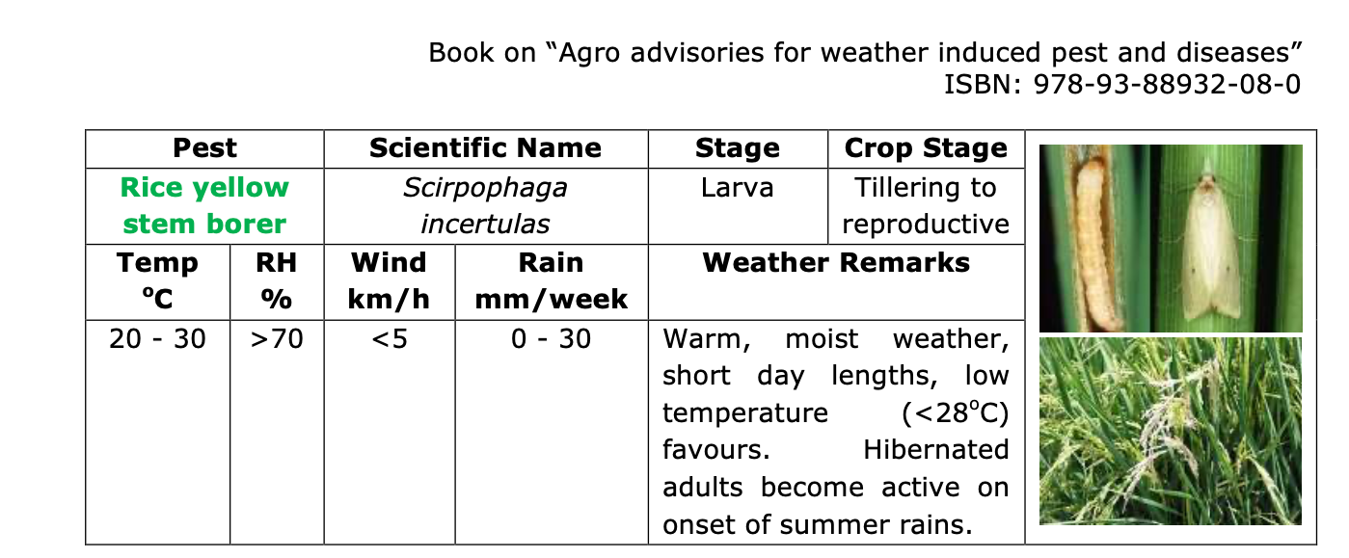
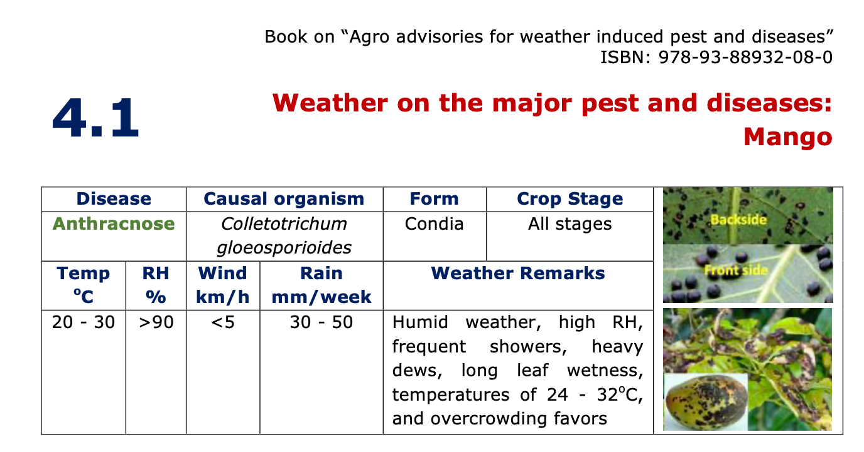
Documentation of TNAU - AAS Knowledge Bank
A
C
R
C
Tamil Nadu Agricultural University, Coimbatore 641 003

Slide 12
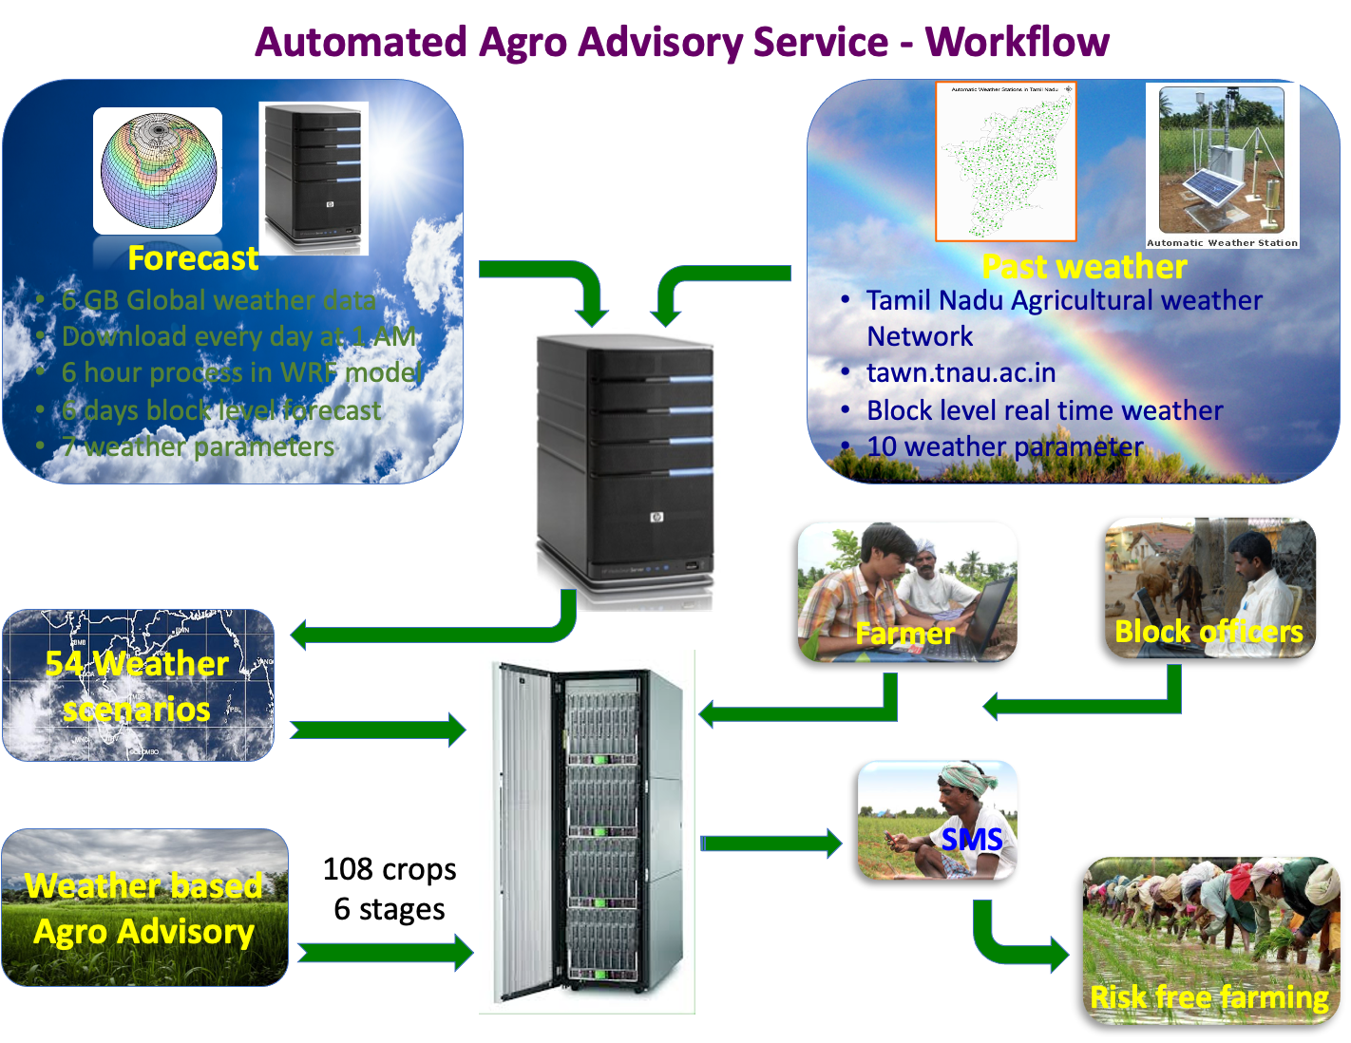
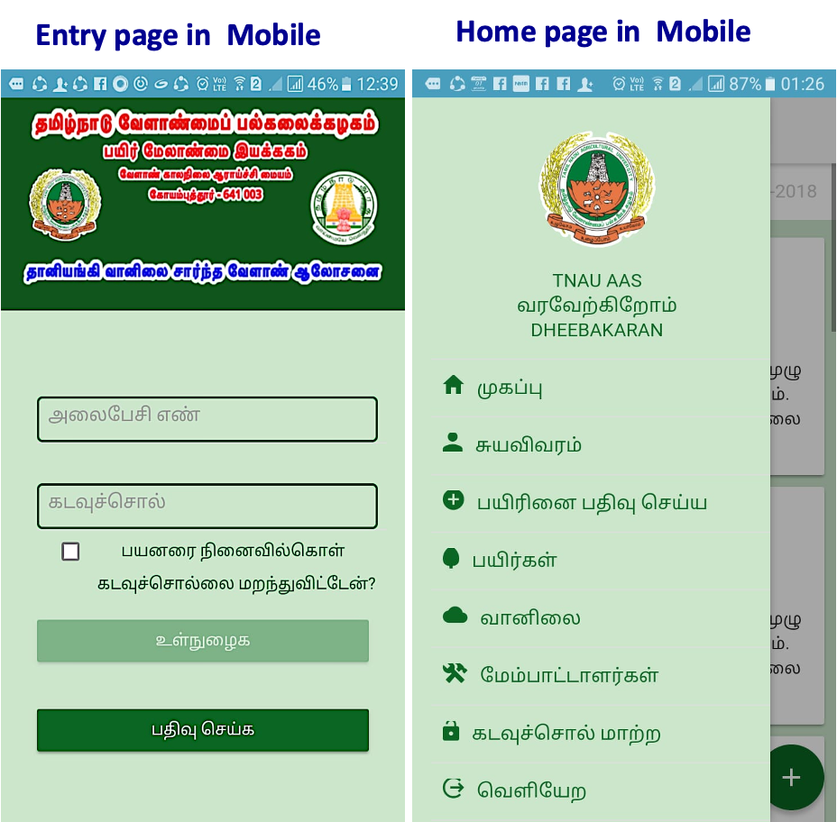


Slide 13
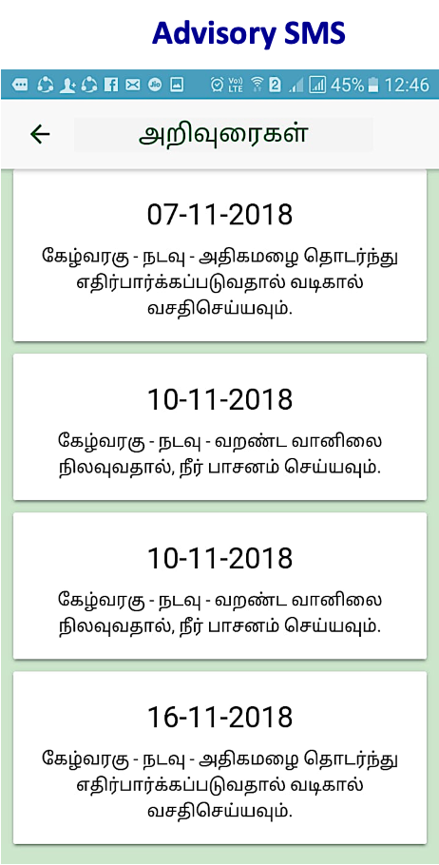
TNAU AAS Web cum Mobile App – Workflow
Android mobile App
A
C
R
C
Tamil Nadu Agricultural University, Coimbatore 641 003

Slide 14
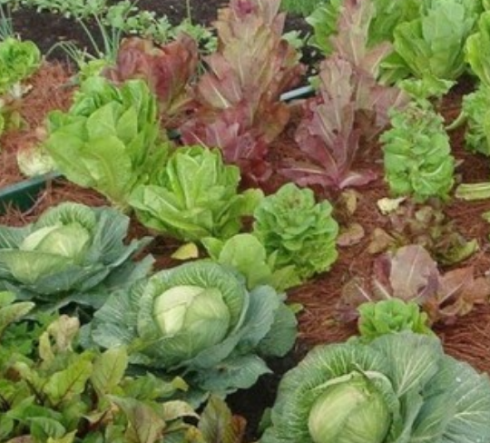
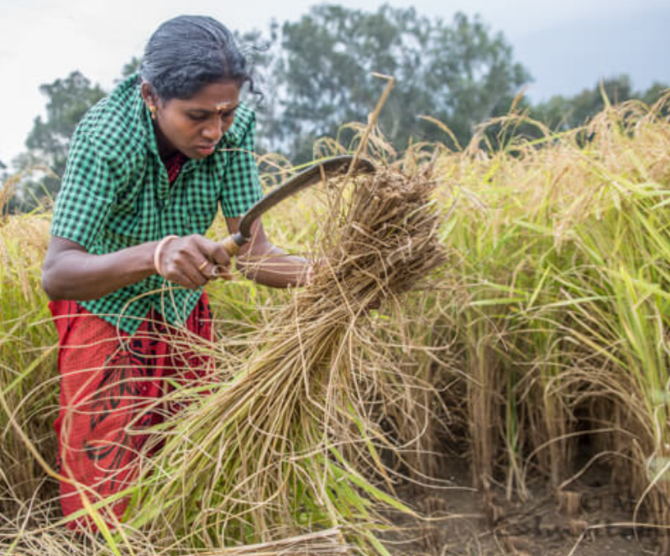
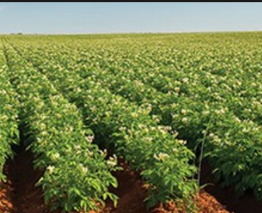
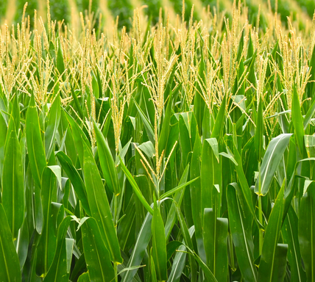
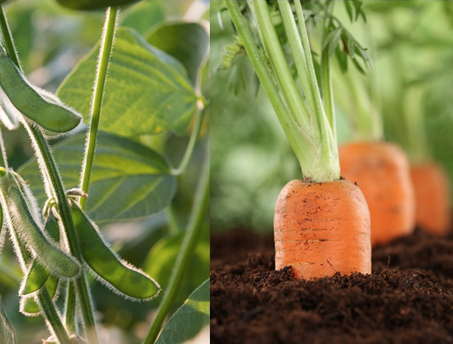
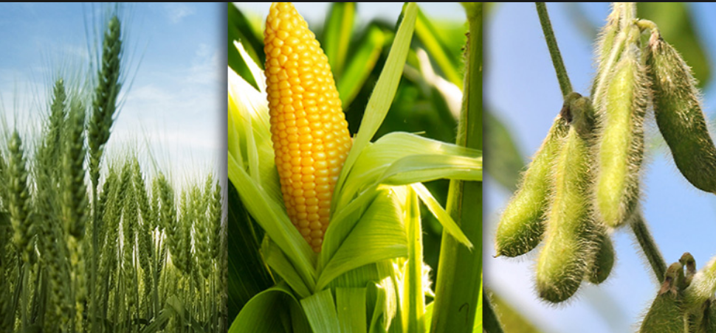
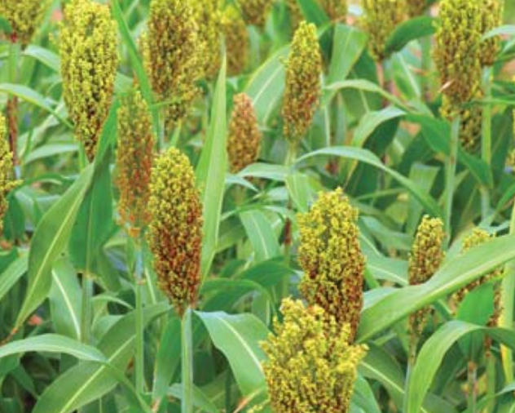
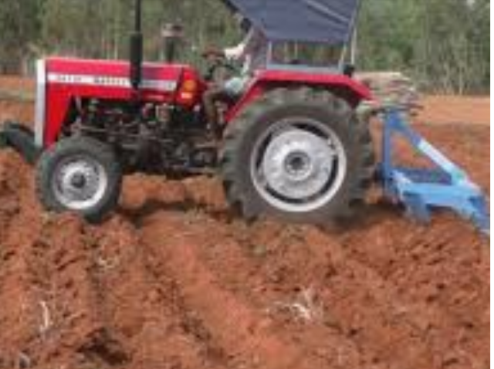

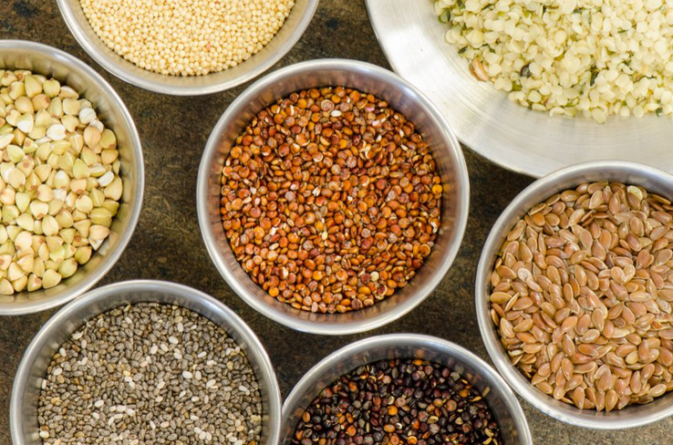
Weather scenario
(54 combinations)
Scenario | Rainfall mm | TMAX ºC | TMIN ºC | RH % | Wind km/hr
I | 0 | < 20 | < 15 | 20.1- 40 | < 5
II | 0 - 20 | 20.1 - 30 | 15.1 - 20 | 40.1 - 70 | 5.1 - 15
III | 20 - 30 | 30.1 - 35 | 20.1 - 30 | 70.1 - 90 | >15
IV | >30 | >35 | >30 | >90 | -
Sample
1 | 0 | <20 | <15 | >40 | <5
2 | 0 | 20 - 30 | <15 | >40 | <5
10 | 0.1 - 30 | <20 | <15 | >40 | <5
14 | 0.1 - 30 | 30.1 - 35 | 15.1 - 20 | >40 | <5
19 | >30 | <20 | <15 | >40 | <5
25 | >30 | 30.1 - 35 | 20.1 - 30 | >40 | <5
32 | 0 | 30.1 - 35 | 15.1 - 20 | >40 | >5
40 | 0.1 - 30 | 20 - 30 | 20.1 - 30 | >40 | >5
51 | >30 | 30.1 - 35 | 15.1 - 20 | >40 | >5
54 | >30 | >35.0 | 20.1 - 30 | >40 | >5
Block level past six days weather & next six days forecast are averaged.
Scenarios is calculated individually for both past & future weather

Slide 15
Crop stages
Crop groups
Agriculture
Cereals
Millets
Pulses
Oilseeds
Fibre crops
Sugar and Starch Crops
Green manures
Horticulture
Vegetables
Cole Vegetable
Root and Tuber vegetables
Bulb vegetables
Leafy vegetables
Spices and Condiments
Medicinal Plants
Flowering Plants
Fruits (Perennial)
1. Land preparation
2. Seedling
3. Vegetative
4. Reproductive
5. Grain development
6. Harvest

Slide 16
Cereals
Rice - SD
Rice - MD
Rice - LD
Wheat
Millets
Maize
Sorghum
Cumbu
Ragi
Kuthiraivali
Samai
Varagu
Oilseeds
Groundnut
Sesame
Castor
Safflower
Sunflower
Niger
Pulses
Redgram
Blackgram
Blackgram_Rice_fallow
Greengram
Cowpea
Horsegram
Bengalgram
Garden Lab lab (Avarai)
Soya bean
Sword bean
Fibre crops
Cotton
Jute
Sugar and Starch Crops
Sugarcane
Sugar beet
Tapioca
Vegetables
Tomato
Brinjal
Bhendi
Chillies
Pumpkin
Snake gourd
Ribbed gourd
Bottle gourd
Bitter gourd
Ash gourd
Cucumber
Gherkin
Watermelon
Muskmelon
Tinda
Chow chow
Cluster beans
Vegetable Cowpea
Lab lab
French bean
Broad beans
Peas
Annual moringa
Cole Vegetable
Cabbage
Cauliflower
Root and Tuber vegetables
Carrot
Radish
Beet root
Potato
Sweet potato
Tapioca
Elephant foot yam
Colocasia
Dioscorea
Chinese potato
Bulb vegetables
Onion (big)
Onion (small)
Leafy vegetables
Amaranthus
Spices and Condiments
Turmeric
Ginger
Coriander
Fenugreek
Fennel
Medicinal Plants
Gloriosa superba
Coleus forskohlii
Senna
Periwinkle
Medicinal solanum
Flowering Plants
Chrysanthemum
Marigold (African)
Tuberose
Cut Chrysanthemum
& many more…

Slide 17
Crop stage database (sample)
Stage durations are kept multiples of seven for easy calculations
Land preparation and post harvest are one week before sowing and after harvest
Group | Crop | Seedling | Vegetative | Reproductive | Grain devpt. | Harvest
Cereals | Rice - SD | 21 | 42 | 63 | 105 | 119
 | Rice - MD | 28 | 56 | 84 | 133 | 147
 | Rice - LD | 35 | 70 | 105 | 154 | 168
Millets | Maize | 14 | 42 | 63 | 105 | 119
 | Sorghum | 14 | 35 | 63 | 105 | 119
Pulses | Redgram | 14 | 35 | 63 | 119 | 133
 | Blackgram | 14 | 35 | 56 | 70 | 84
Oilseeds | Groundnut | 14 | 35 | 49 | 98 | 112
 | Sesame | 14 | 42 | 63 | 84 | 98
Vegetables | Tomato | 14 | 42 | 140 | 182 | 196
 | Bhendi | 14 | 28 | 84 | 105 | 119
 | Chillies | 14 | 35 | 154 | 182 | 196

Slide 18
Weather based agro advisory
Every crop, every stages are given with separate ID
Weather based agro advisories are stored in data base
Based on the weather scenario, suitable advisory for the chosen crop and its stage is sent to farmers App
Farmers may get approx. one or two advisories in a week, if the condition meets.
Crop | Stage | Past weather scenario | Forecast Scenario | Advisory
Paddy | Land preparation | 10/ 11/ 12/13/ 14/ 15/ 16/ 17/ 18/ 19/ 20/ 21/ 22/ 23/ 24/ 25/ 26/ 27/ 37/ 38/ 39/40/ 41/ 42/ 43/ 44/ 45/ 46/ 47/ 48/ 49/ 50/ 51/ 52/ 53/ 54 |  | By using last week rainfall, prepare nursery for rice.
Paddy | Seedling | 19/ 20/ 21/ 22/ 23/ 24/ 25/ 26/ 27/ 46/ 47/ 48/ 49/ 50/ 51/ 52/ 53/ 54 | 19/ 20/ 21/ 22/ 23/ 24/ 25/ 26/ 27/ 46/ 47/ 48/ 49/ 50/ 51/ 52/ 53/ 54 | Continuous rain is expected. Provide adequate drainage
Paddy | Flowering |  | 19/ 20/ 21/ 22/ 23/ 24/ 25/26/ 27/ 46/ 47/ 48/ 49/ 50/ 51/ 52/ 53/ 54 | Rainfall anticipated. Postpone the irrigation and fertilizer application
Maize | Vegetative | 1/ 2/ 20/ 28/ 29/ 37/ 38/ 46/ 47 | - | Due to low temp. & high RH, Downey mildew may appear. Spray Mancozeb @ 2g/lit of water
Black gram | Grain development | 6/ 8/ 9/ 33/ 35/ 36 | 6/ 8/ 9/ 33/ 35/ 36 | Due to dry weather, pod borer may appear. Spray NPV 3 x10¹² POB/ha in 0.1% teepol
Chillies | Vegetative | 17/ 18/ 26/ 27/ 44/ 45/ 53/ 54 | 17/ 18/ 26/ 27/ 44/ 45/ 53/ 54 | Due to dry weather, Thrips may appear. Spray Imidacloprid 17.8 % SL @ 3.0 ml/10 lit.

Slide 19
Registration in AAS – Farmer and technical officer
Need active mobile number
Registration form – Name, Father name, District, block, mobile number,
Any number of crops per mobile number
He can generate his password on his own
Approved by admin / technical officer of his block
Can edit his details later except his mobile number
After approval only he can register for crop and stage
Can register crop up to one month before sowing and any time in middle after sowing
He can change crop either crop is harvested or after two months.
SMS is limited to total duration/7 (if 105 days = 15 Nos.)
Reminder for registration of new crop at the end of previous crop.
Same method for technical officer’s registration
A
C
R
C
Tamil Nadu Agricultural University, Coimbatore 641 003

Slide 20
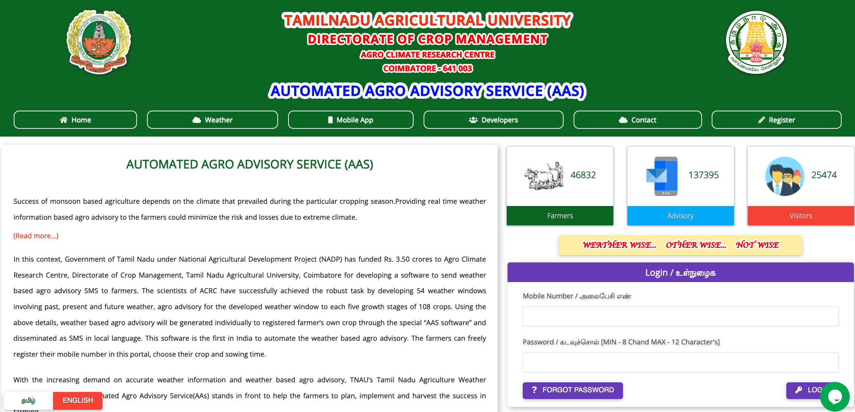
AAS Reports
SMS sent – Abstract: Single or multiple block for a specific period
District | Block | Total Farmer | Total No. of SMS Sent
Coimbatore | Thondamuthur | 564 | 4658
SMS sent - Detailed:(Single or multiple block) for a specific period
District | Block | Farmer | Crop | No. of SMS Sent
Coimbatore | Thondamuthur | P.Murugan | Turmeric | 7
Detailed Day wise SMS sent: Single or multiple block for a specific period
District | Block | Farmer | Crop | Stage | Date | Advisory
Coimbatore | Thondamuthur | P.Murugan | Turmeric | Vegetative | 18.7.18 | Continuous rainfall. Provide drainage
 |  |  |  | Vegetative | 23.7.18 | Considering the high soil moisture, drench root with bavistin @1g/1lit water to arrest rhizome rot.
A
C
R
C
Tamil Nadu Agricultural University, Coimbatore 641 003

Slide 21
A
C
R
C
Tamil Nadu Agricultural University, Coimbatore 641 003

Slide 22
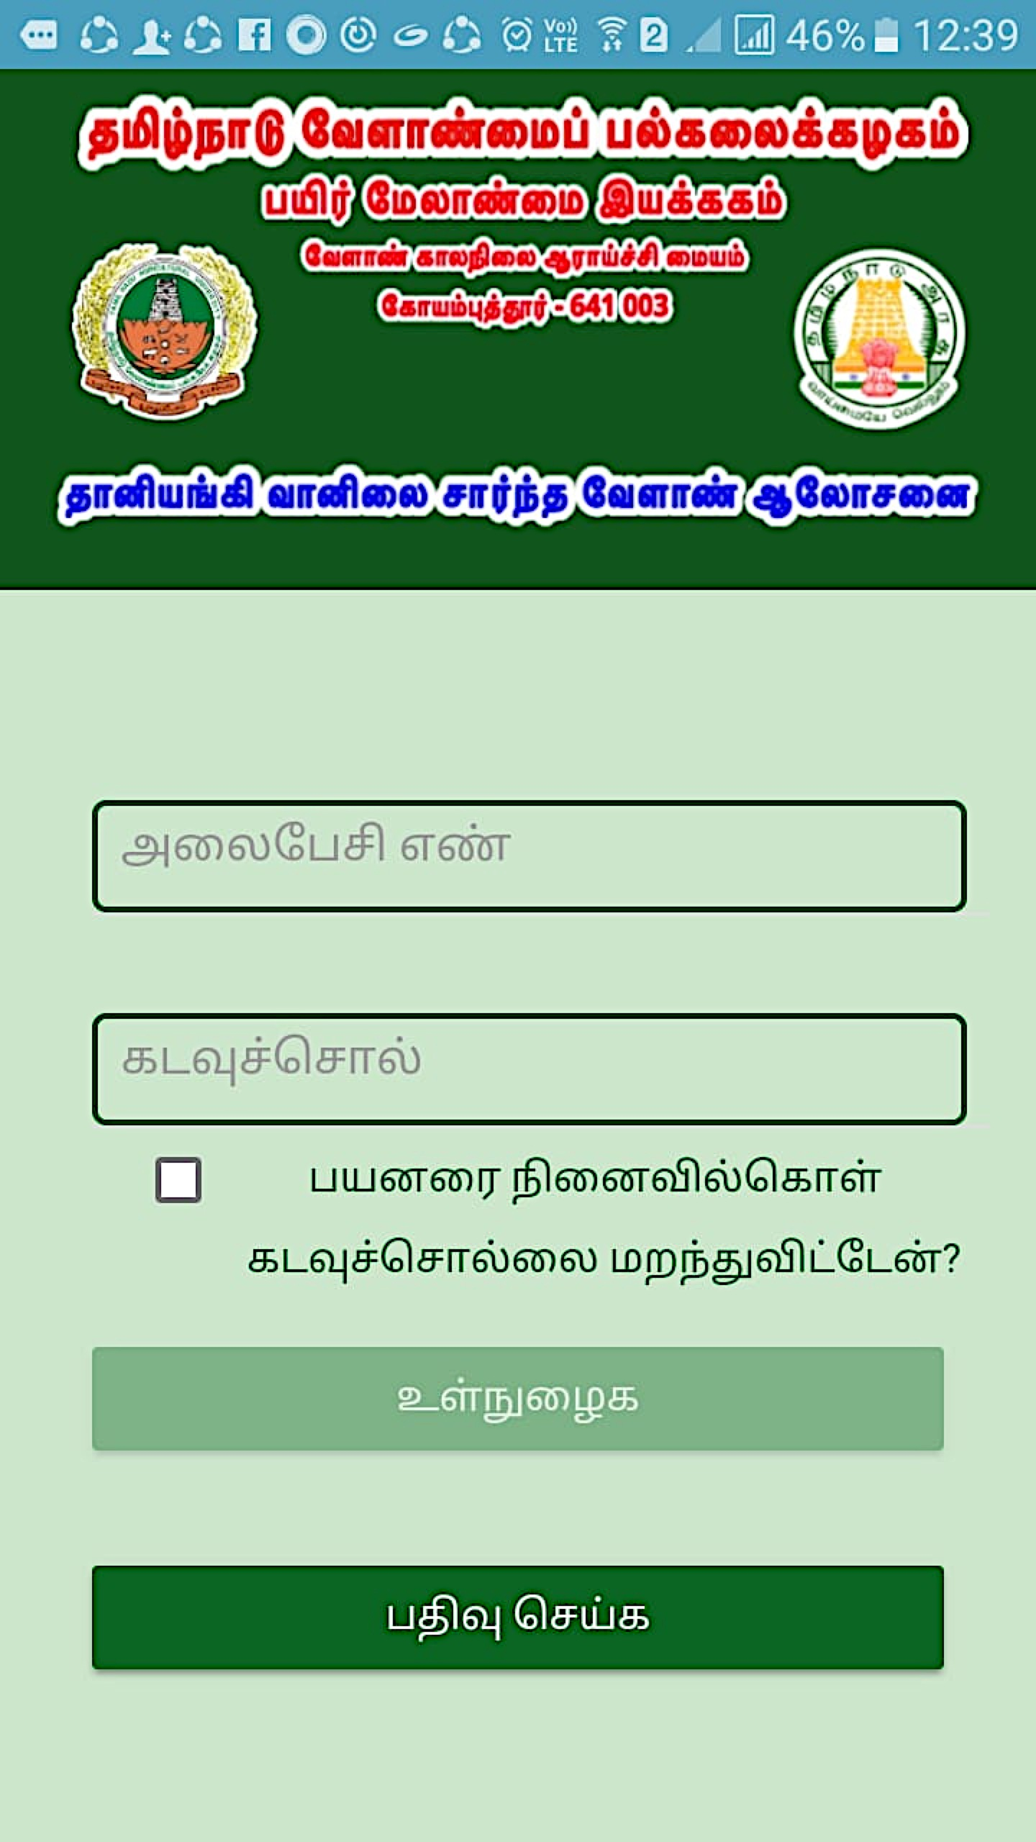
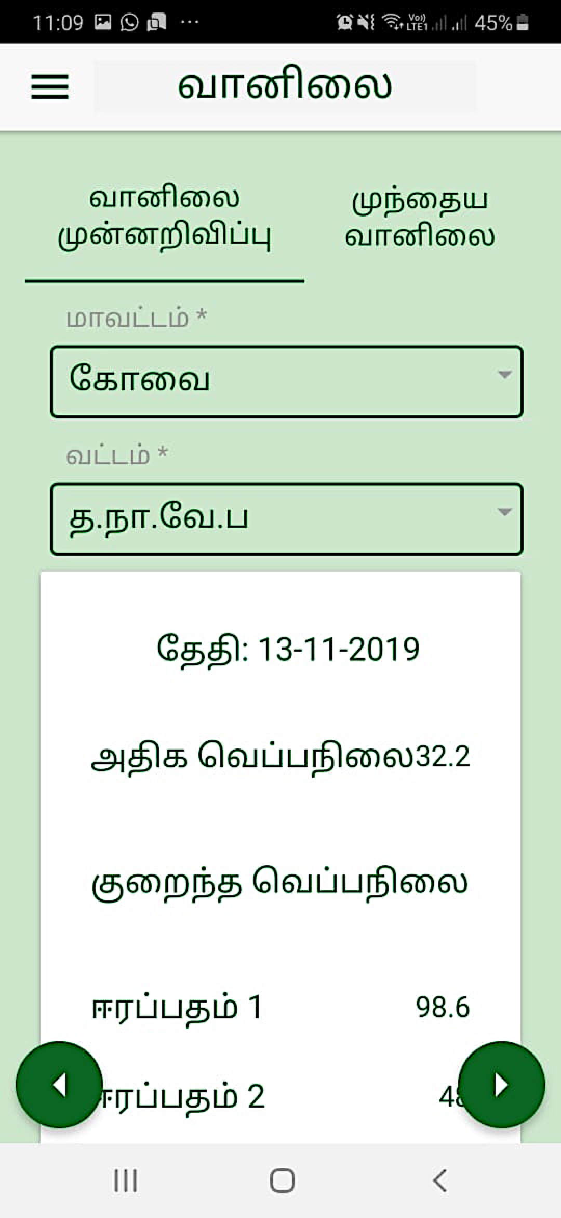
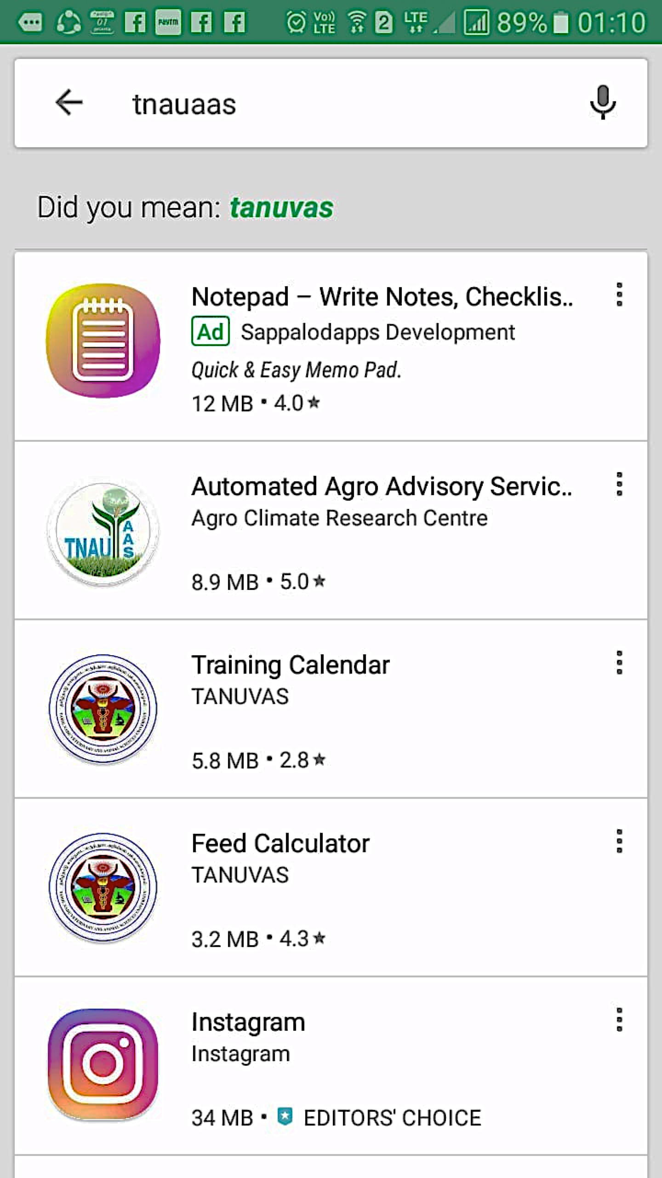
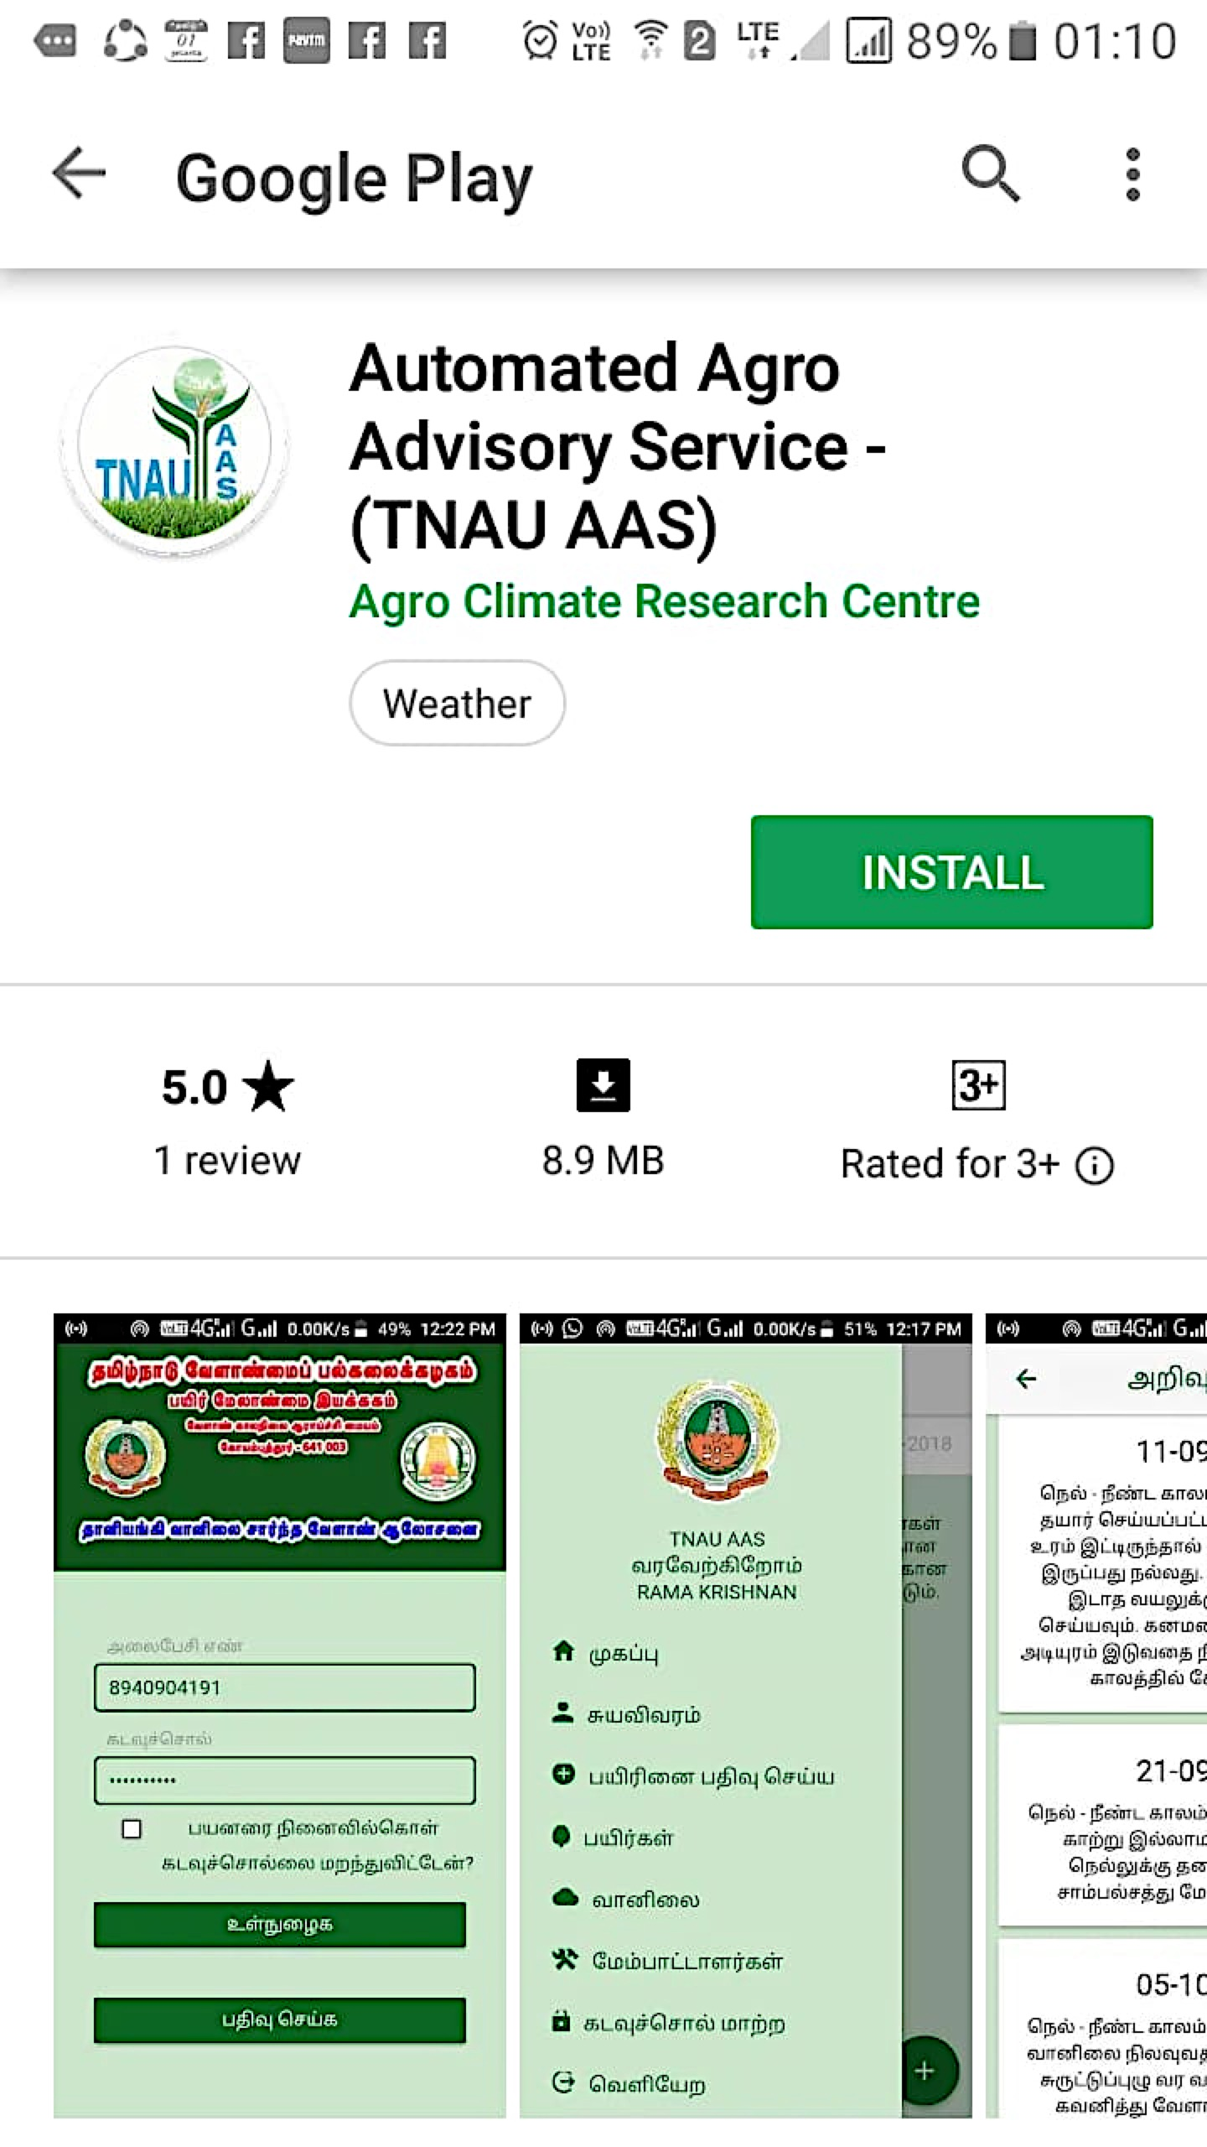
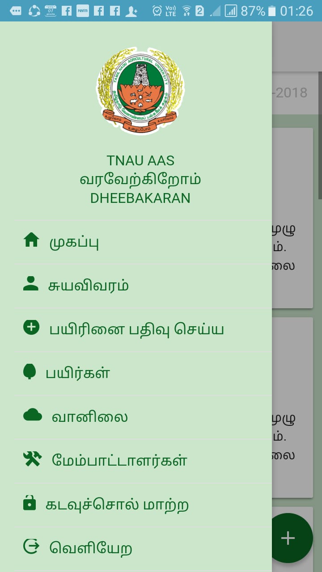
Android mobile App
Google Play store
Search TNAUAAS
Select Automated Agro advisory service
Install
Link available in website
http://aas.tnau.ac.in
Register with mobile number
A
C
R
C
Tamil Nadu Agricultural University, Coimbatore 641 003

Slide 23
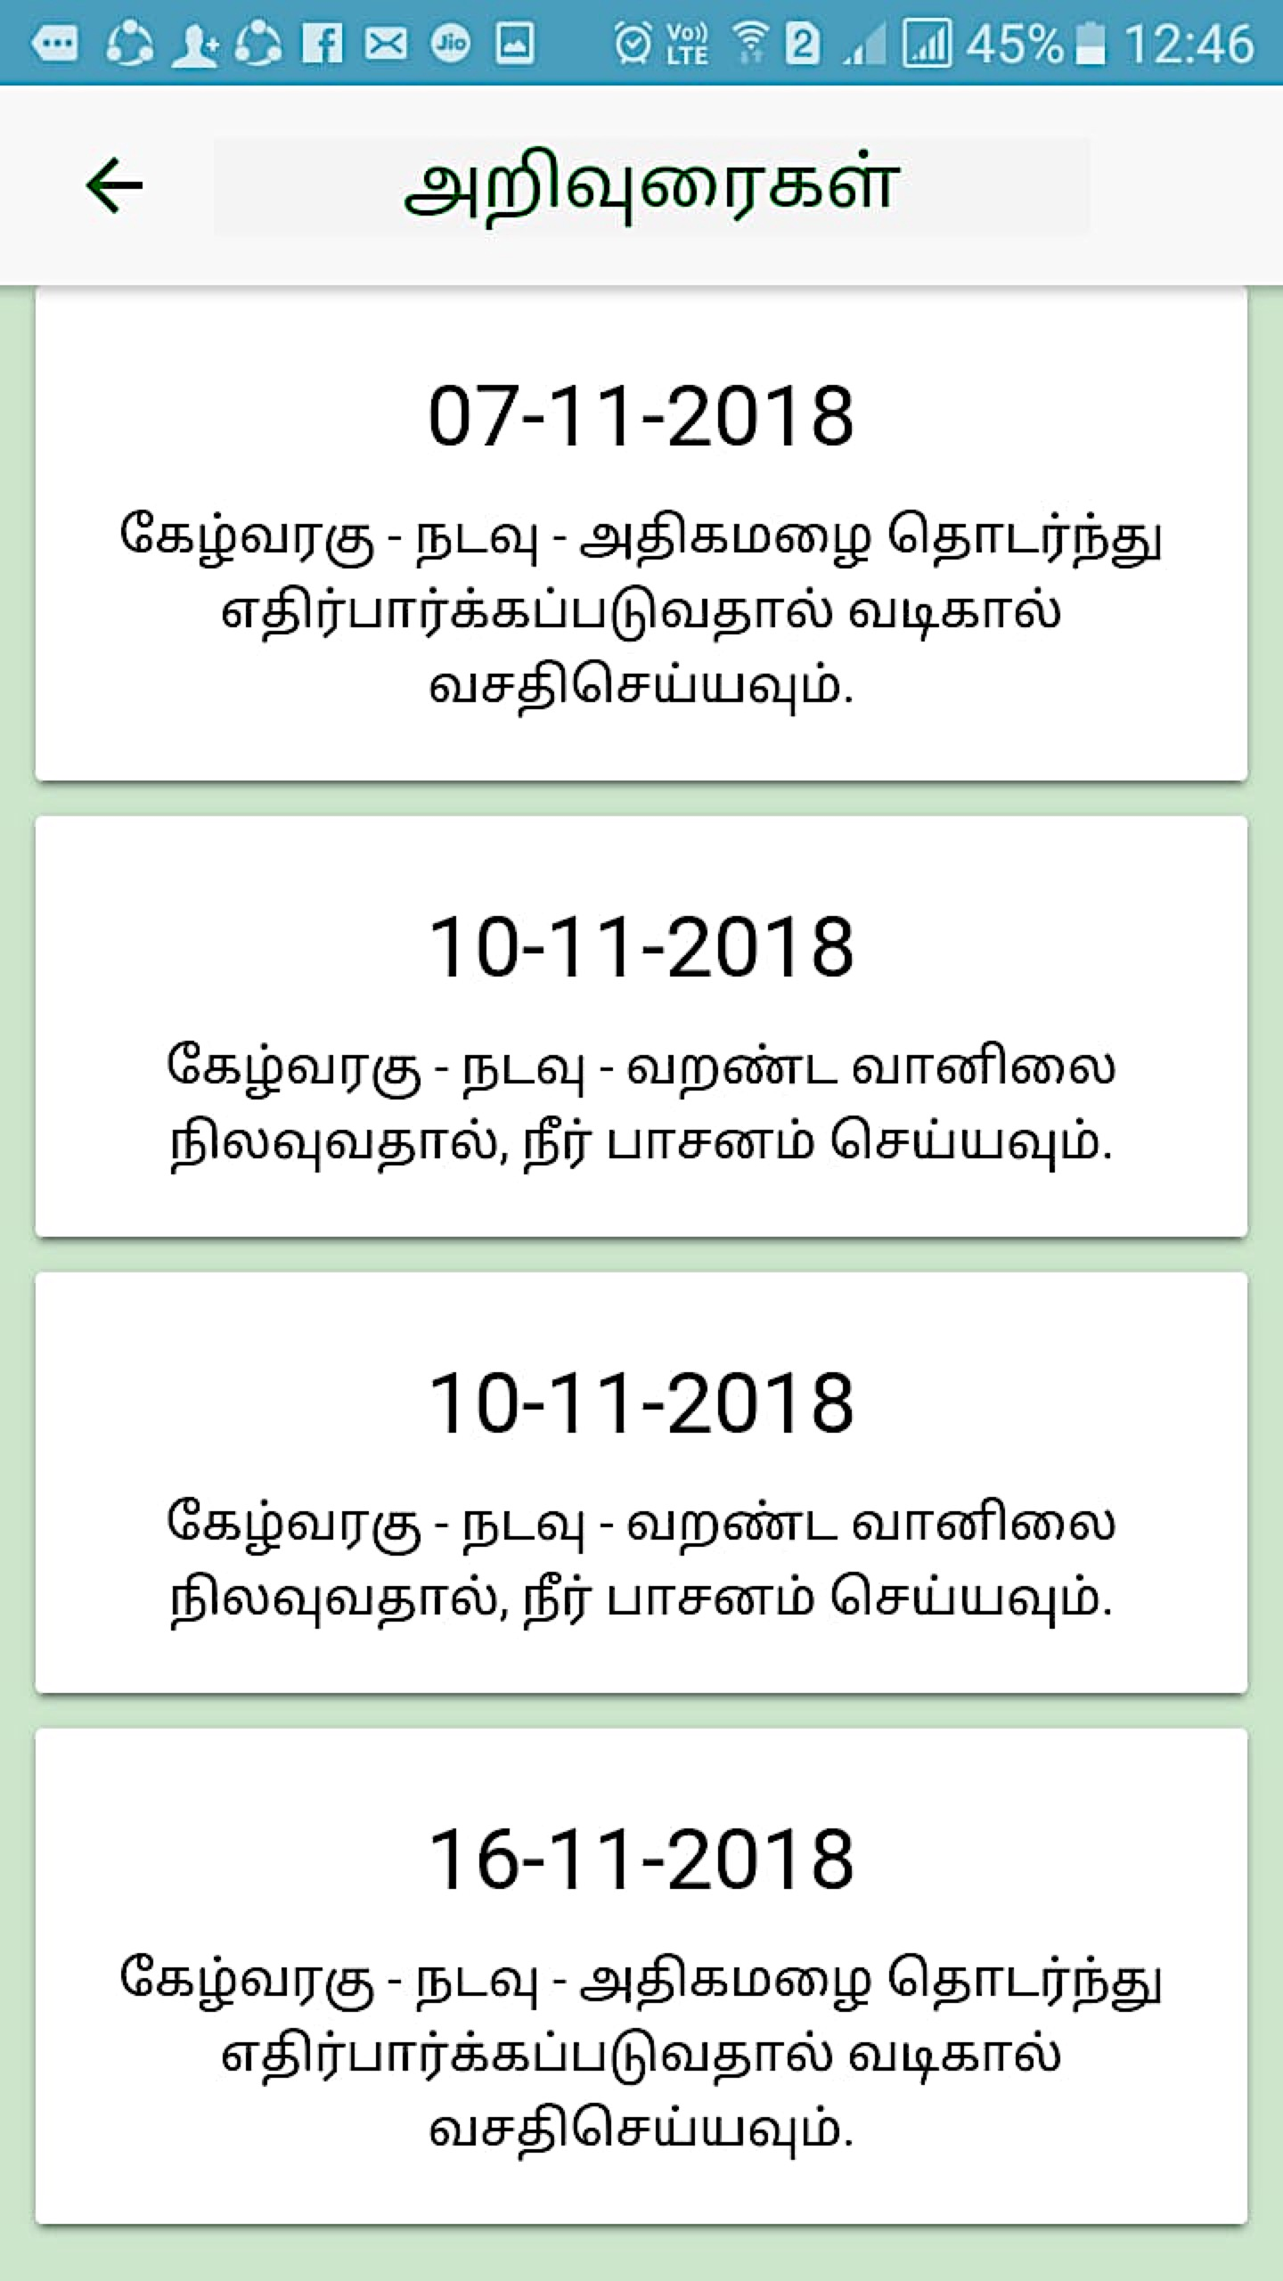


Android mobile App
Entry page in Mobile
Home page in Mobile
Weather Forecast
Mobile number
Home
Personal
Password
Crop Registration
Registered crop
Login
Weather
A
C
R
C
Developers
Register new
Change password
Logout
Tamil Nadu Agricultural University, Coimbatore 641 003

Slide 24


Android mobile App - Advisories
A
C
R
C
Tamil Nadu Agricultural University, Coimbatore 641 003

Slide 25

Android mobile App - Advisories
A
C
R
C
Tamil Nadu Agricultural University, Coimbatore 641 003

Slide 26

Android mobile App - Advisories
A
C
R
C
Tamil Nadu Agricultural University, Coimbatore 641 003

Slide 27

Android mobile App - Advisories
A
C
R
C
Tamil Nadu Agricultural University, Coimbatore 641 003

Slide 28

Android mobile App - Advisories
A
C
R
C
Tamil Nadu Agricultural University, Coimbatore 641 003

Slide 29


A
C
R
C
Tamil Nadu Agricultural University, Coimbatore 641 003

Slide 30


Action Plan 1: Piloting pulse producer support system through ICT enabled services
URP: DCM/CBE/AMT/PUL/2019/001
Obj: To study the response farming in pulses thro’ TNAU–AAS Mobile App
Centre | Eco system | Farmers (AAS + Non AAS) | Gain (Rs.) per ha
Coimbatore | Irrigated | 26 + 5 | Rs. 2800/-
Aduthurai | Rice fallow | 15 + 2 | Rs. 2300/-
Kovilpatti | Rainfed | 13 + 2 | Rs. 1900/-
  Reason for gain
  Maintained population with gap filling advisory .
  AAS farmers managed the whitefly & powdery mildew with advisory 2 -3 days in advance
  Non AAS farmers reacted after incidence.
  AAS farmers: 40 – 45 pods/plant
  Non AAS farmer: 36 – 38 pods/plant.
Pest & disease incidences have well matched (68 - 83%).
AAS provided 10 - 12 advisories, specific to pulses & stage
GKMS SMS issued only one advisory for the entire crop.
60 % of the registered farmers effectively utilize advisories.

Slide 31




Feedback on TNAU Weather Services
A
C
R
C
Tamil Nadu Agricultural University, Coimbatore 641 003

Slide 32





06.02.2024 Time of India
TNAU has upgraded the earlier version with AI function in selection of advisories based on farmers feedback and the upgraded version will be released in a month.

Slide 33


Weather wise…
Other wise…
Not wise…
A
C
R
C
Tamil Nadu Agricultural University, Coimbatore 641 003

