Slide 1
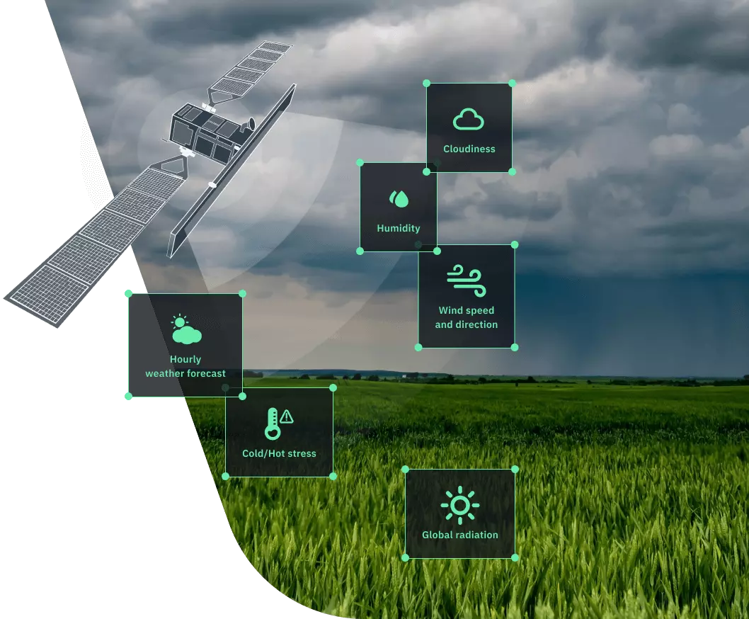

Village Level
Weather forecast:
Scope, Method and Tools
Dr. Ga. Dheebakaran, Ph.D.,
Associate Professor (Agronomy)
Agro Climate Research Centre
TNAU, Coimbatore – 641 003
gadheebakaran@tnau.ac.in
9443935107

Slide 2
Weather forecast
Application of science and technology to predict the state of the atmosphere for a future time and a given location.
Weather prediction starts informally for millennia, and formally since 19th century.
Weather forecasting involves .
Collection of quantitative data about the current state
Scientific understanding of atmospheric processes
Project how the atmosphere will evolve.

Slide 3

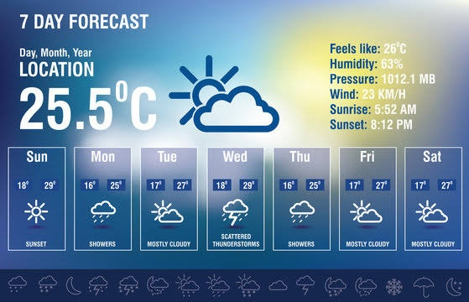
Types of weather forecast
Now Casting - 0 to 2 hours (2hrs)
Very Short Range Forecast (3-12hrs)
Short Range - 12 hrs to 3 days (72 hrs)
Medium Range - 3 days to 10 days
  Extended range Forecast (30 days) - present
Long Range - beyond 10 days up to month or season
  Seasonal climate Forecasting

Slide 4
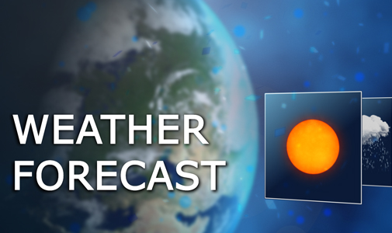

Agencies involved in weather forecast
India Meteorological Department (IMD) – Official forecaster of India
National Centre for Medium Range Weather Forecast (NCMRWF)
  Medium, Long range and Seasonal
Regional Meteorological Centre (RMC)
  Medium range – District level (Tuesday and Friday)
State Agricultural Universities (SAU)
  TNAU – Medium range - Block level (Daily updated)
Commercial & private groups – Skymet, Accuweather
  Location specific – Short range and now casting

Slide 5

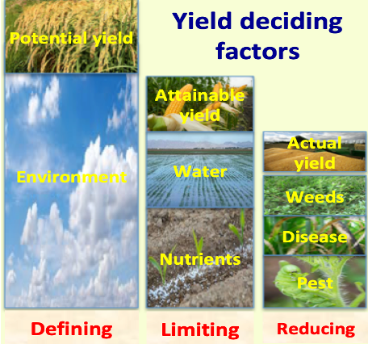
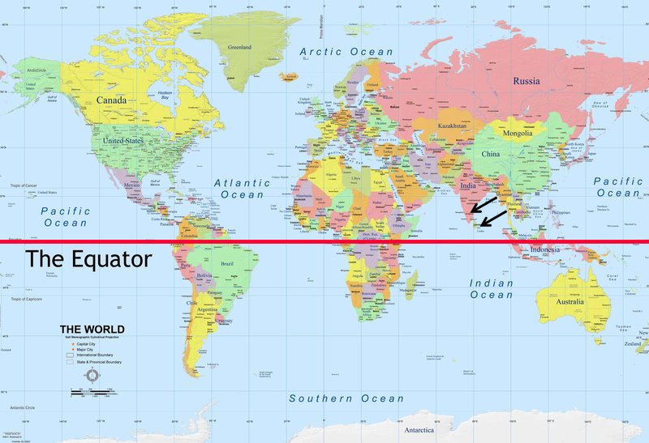
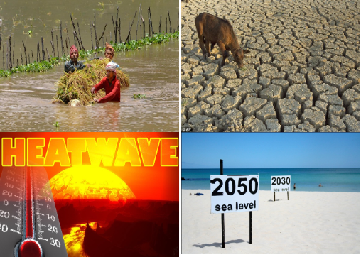


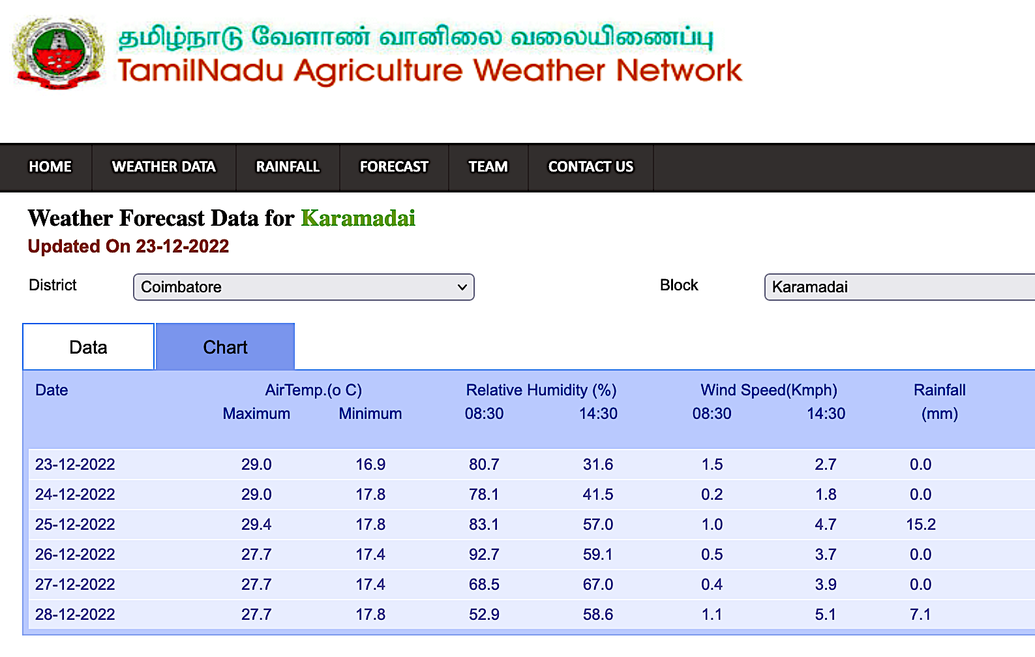
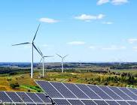
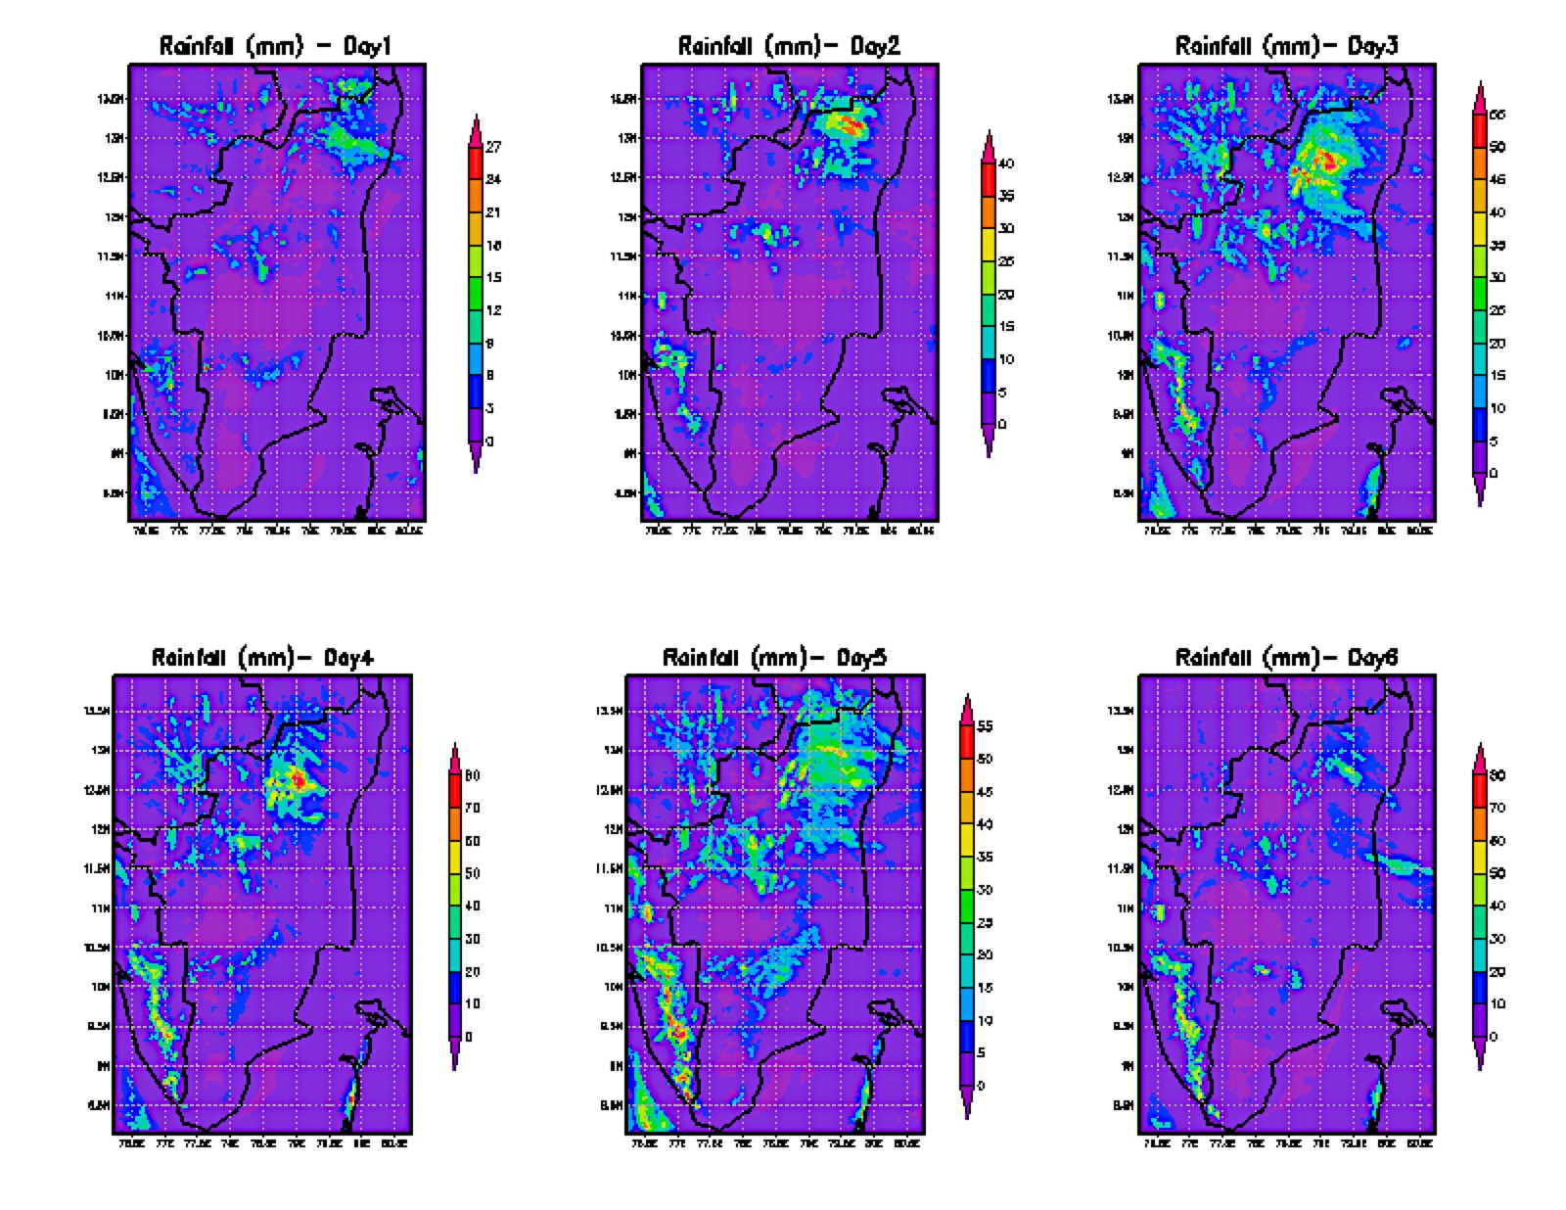

Problems to be addressed by Medium Range Weather Forecast
Weather decides success of crop production
Equatorial nearness brings high climate variability
Climate change worsen farming by increasing extreme events’
MRWF is highly useful for day to day farm decision
TNAU is issuing the block level MRWF (6 days), since 2011
Disaster Management & Energy sectors need accurate forecast
Agro Climate Research Centre, Directorate of Crop Management, Tamil Nadu Agricultural University, Coimbatore 641 003

Slide 6
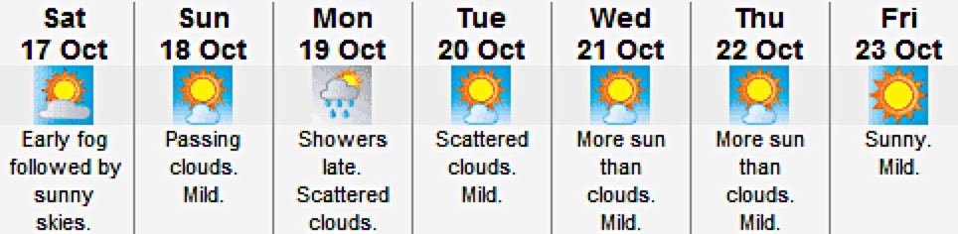
Medium range forecasting – 4 – 10 days

Slide 7
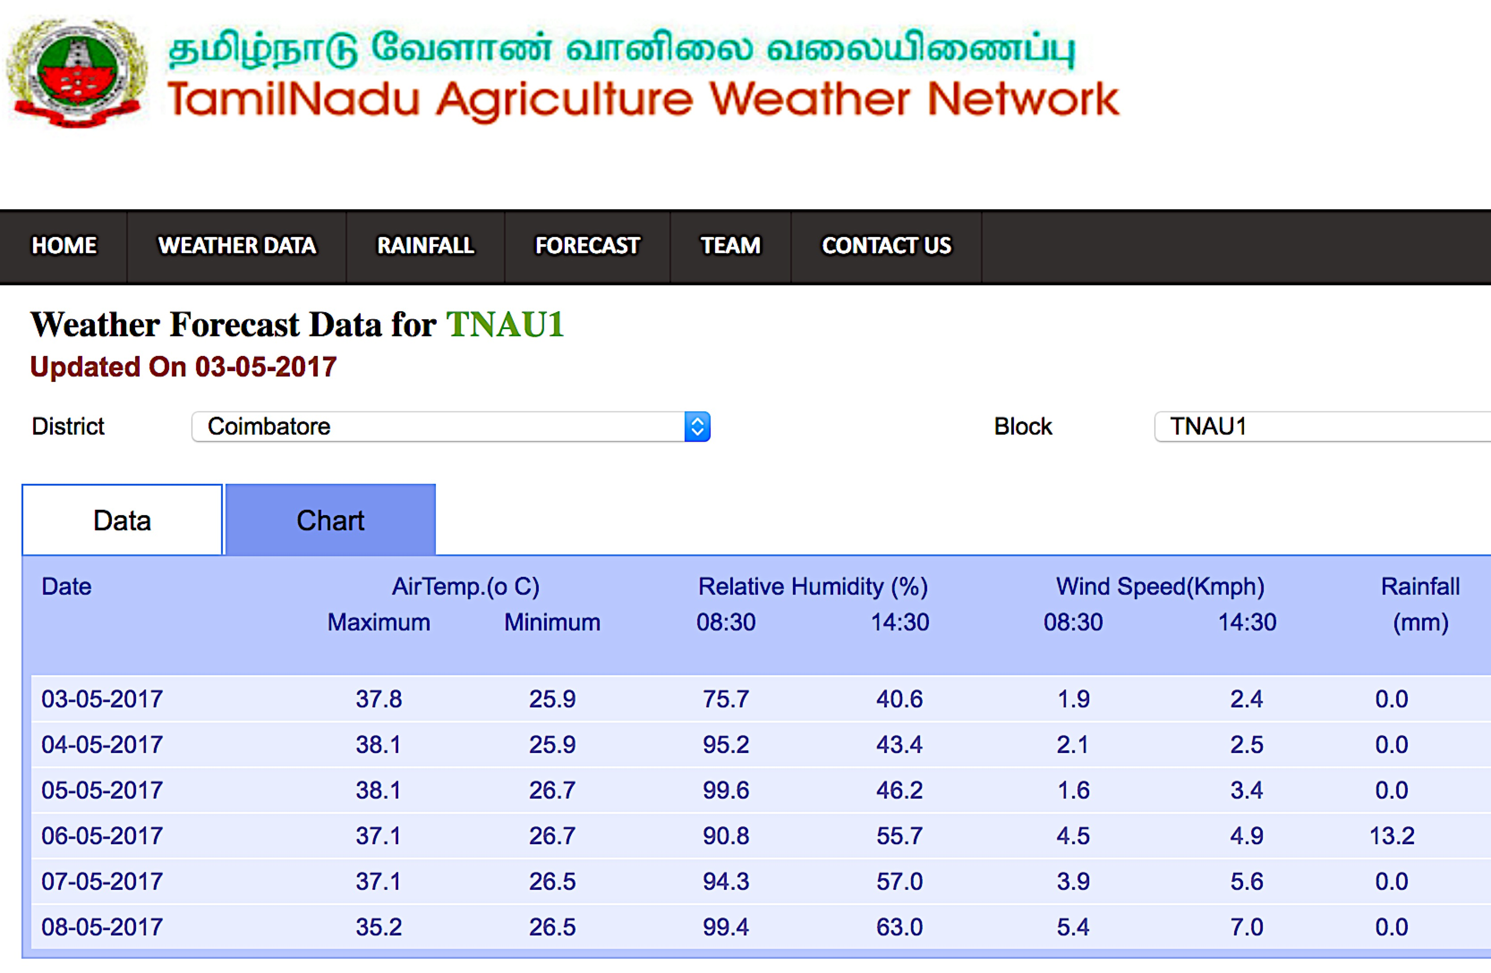
Medium Range Weather Forecasting at TNAU
Website: tawn.tnau.ac.in

Slide 8
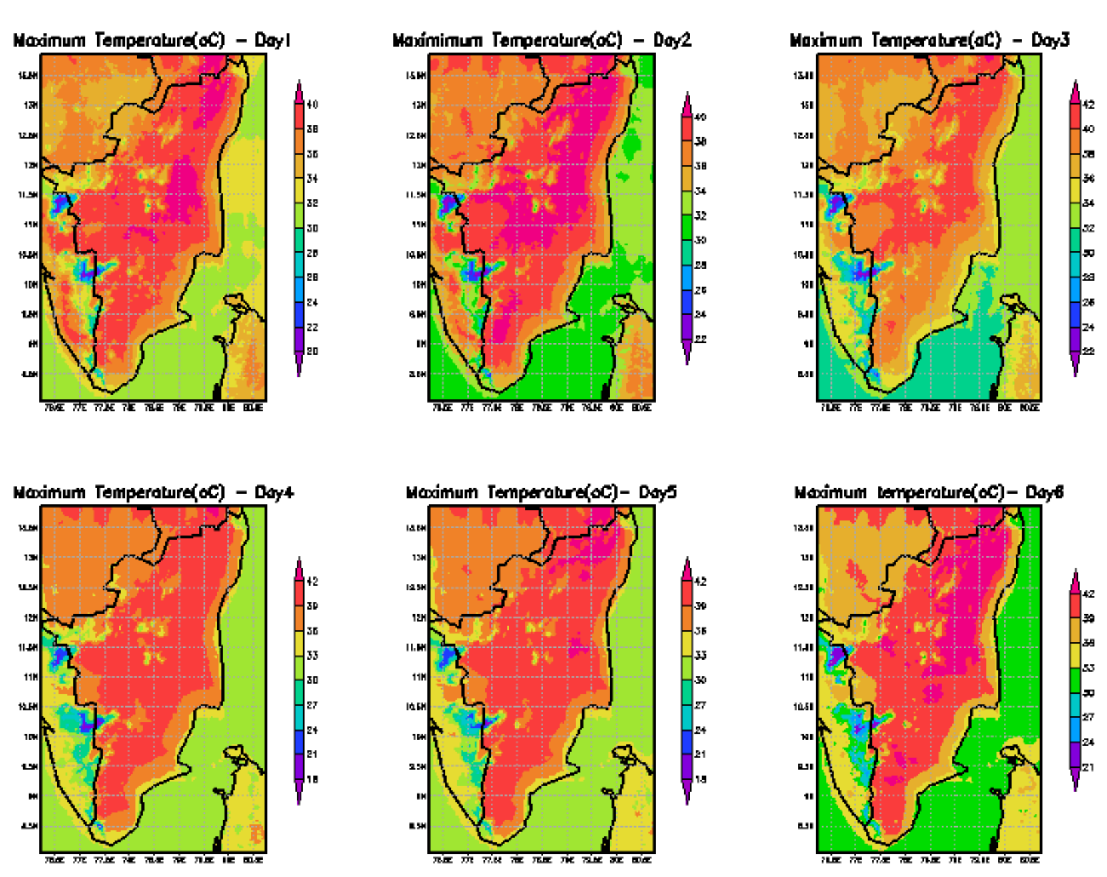
Temperature chart

Slide 9
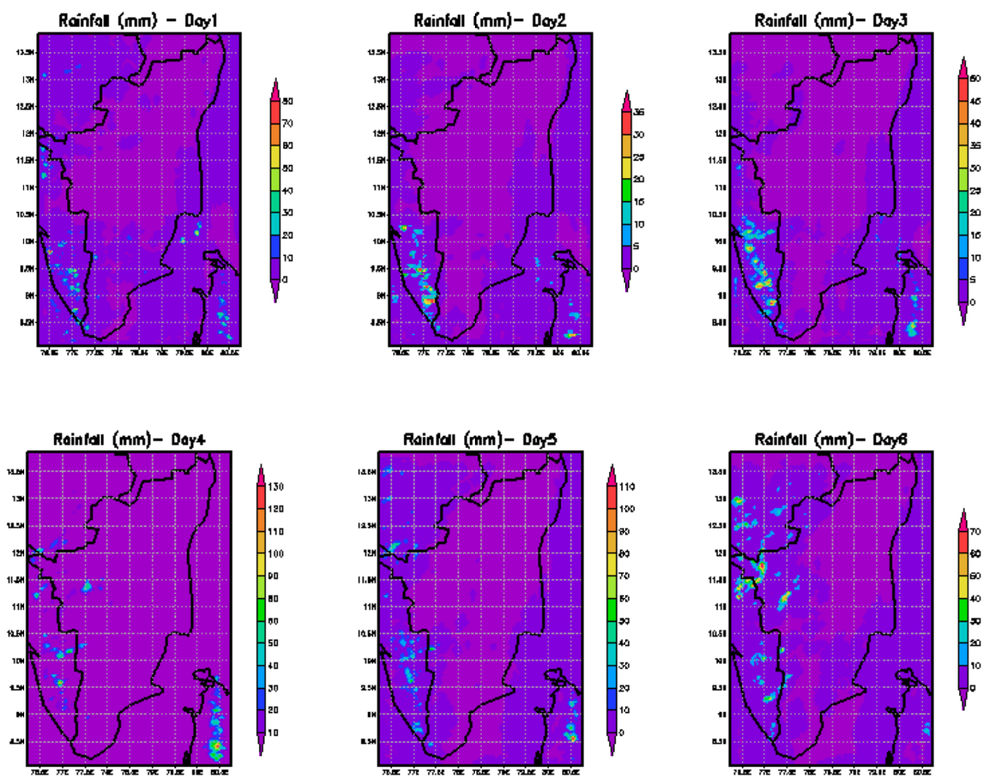
Rainfall chart

Slide 10
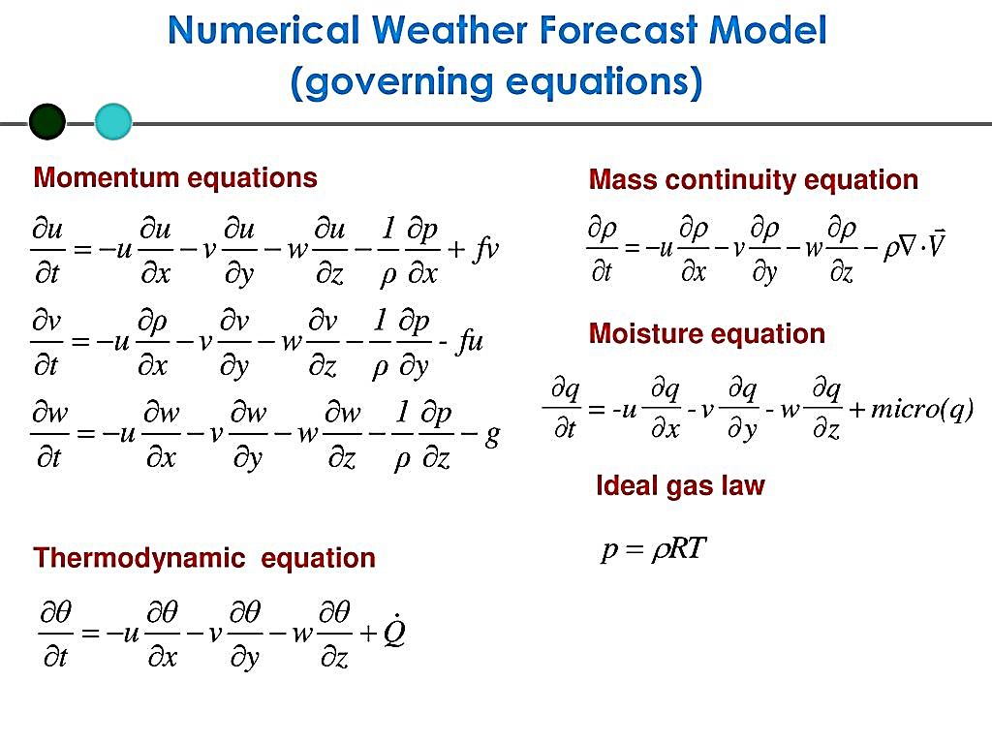
Numerical weather prediction (NWP)
Numerical Weather Prediction – A Real-Life Application at the Intersection of Mathematics
No one suggested, erratic weather could be predicted mathematically until 1901
Cleveland Abbe wrote down the seven equations that govern the atmosphere and insisted that there must be some way to solve them,
1-3. Newton’s 2nd law of motion in three directions.
4. Conservation of energy (First Law).
5. The ideal gas equation.
6. Conservation of mass of dry air.
7. Conservation of mass of water.
Vilhelm Bjerknes had the same vision in 1903, but saw no way to solve the equations

Slide 11
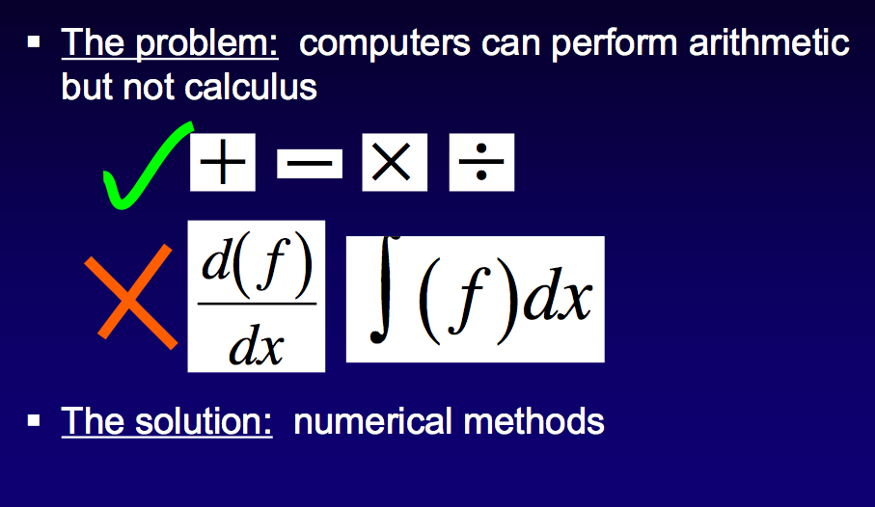
The Problem: Could not solve the calculus

Slide 12
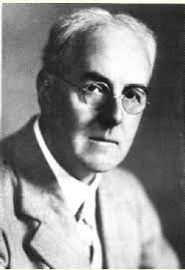
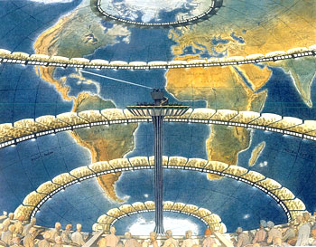
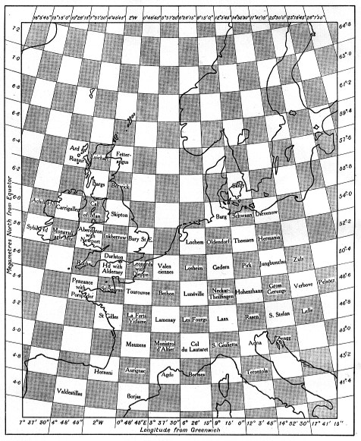
Lewis Fry Richardson did see a way. - A psychologist & a physicist,
Established the mathematical basis for computerized weather forecasts during World War I, long before the computer invention.
Equations are too difficult to solve using calculus, Richardson transformed them to simple arithmetic equations.
But every simplification has its price. To predict 24 hours in advance, each of the 7 equations was solved 100 times at 1000 of points.
Richardson envisioned a peaceful army of 64,000 human computers to "race the weather" mathematically and produce forecasts.
He then formed his own one-man army and spent six weeks making all the computations to forecast the weather for a single point, one time step (six hours) ahead.

Slide 13
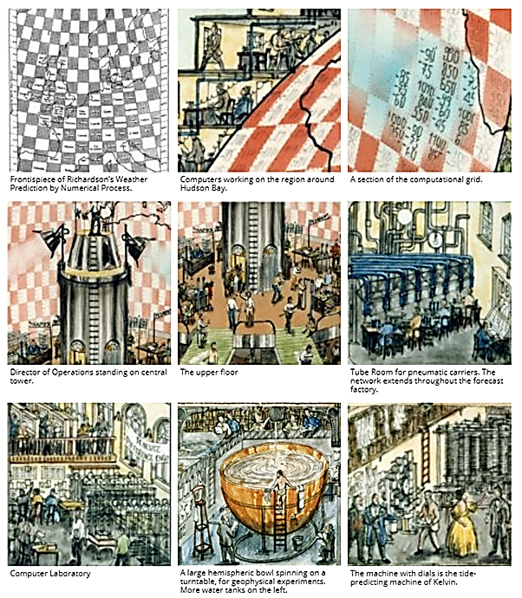
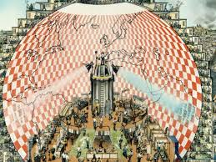
Richardson’s
"race the weather“
Army of 64,000 human computers

Slide 14
Atmospheric models
Used for predicting the final state of weather through purely mathematical process
It accounts the current state of weather in a number of synoptic stations of a given region.
The NWP technique is used in medium range weather forecasting.
Main inputs - surface observations from manual / automated weather stations at ground level over land and from buoys at sea.
WMO standardized the instrumentation, practices and timing of observations worldwide.
Stations either report hourly in METAR reports, or every six hours in SYNOP reports.
Weather satellites & Doppler radars data are used, if traditional data sources are not available.

Slide 15
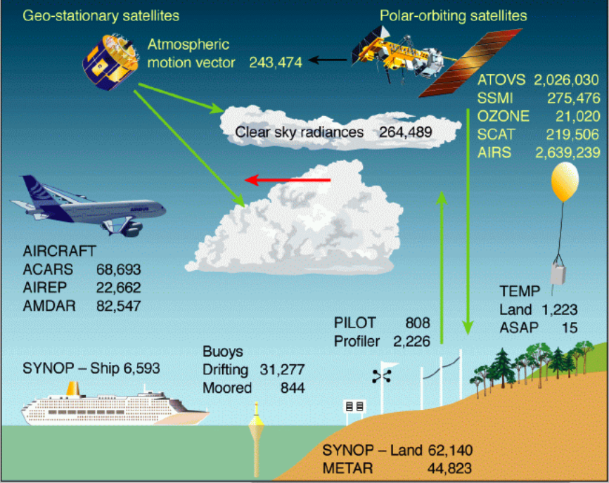
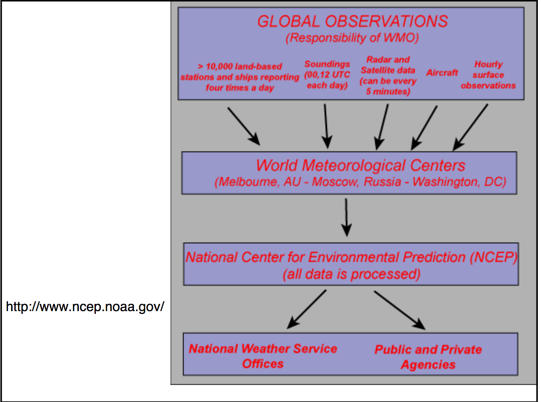

Gathering observation

Slide 16
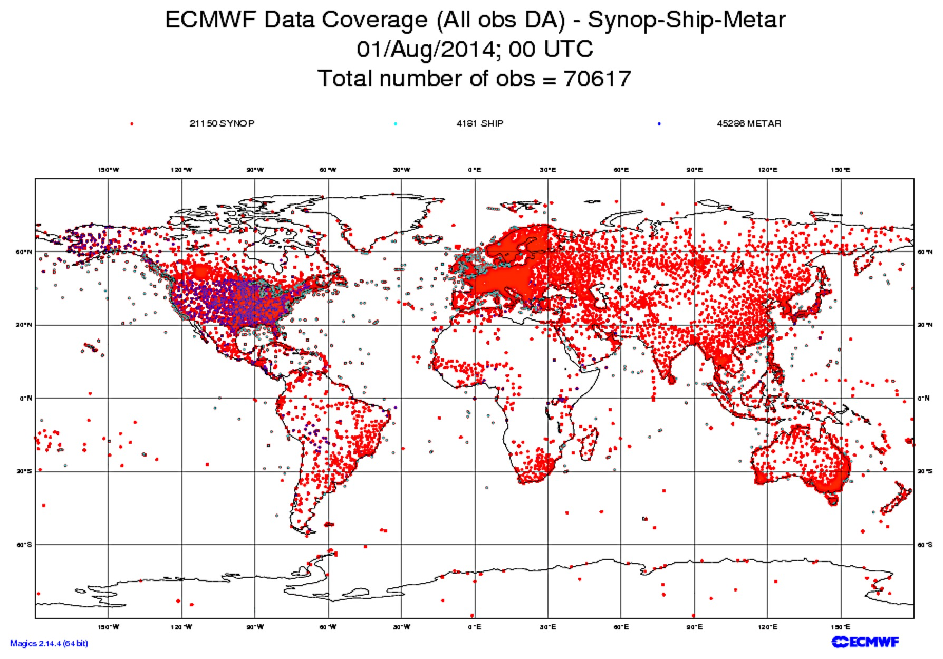
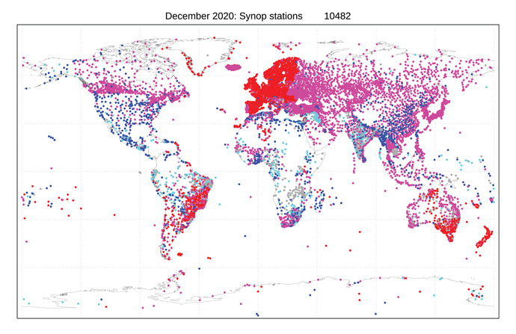
Global Observatories

Slide 17
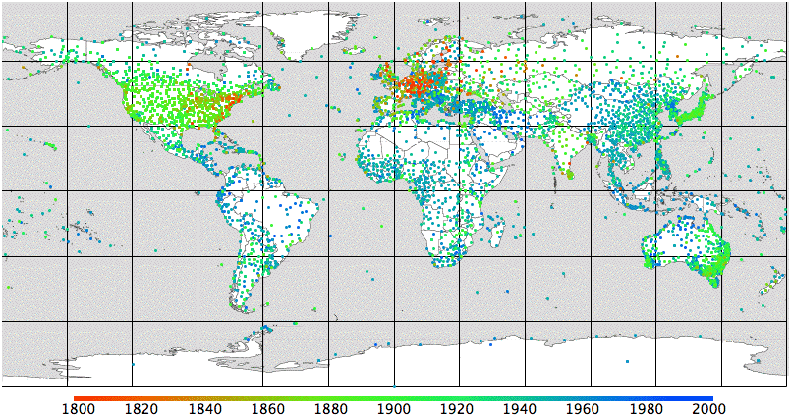
Station Distribution
The oldest stations are red and the newest are blue.

Slide 18
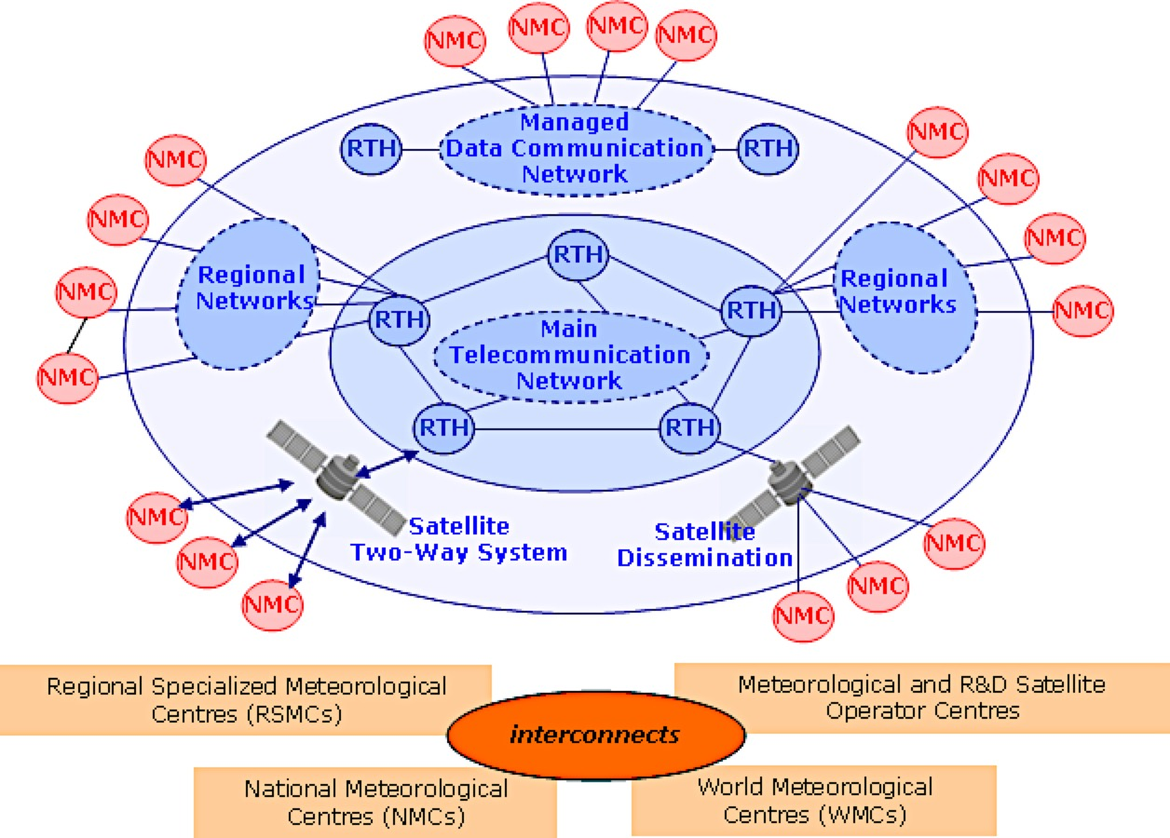
Global Telecommunication System - WMO

Slide 19
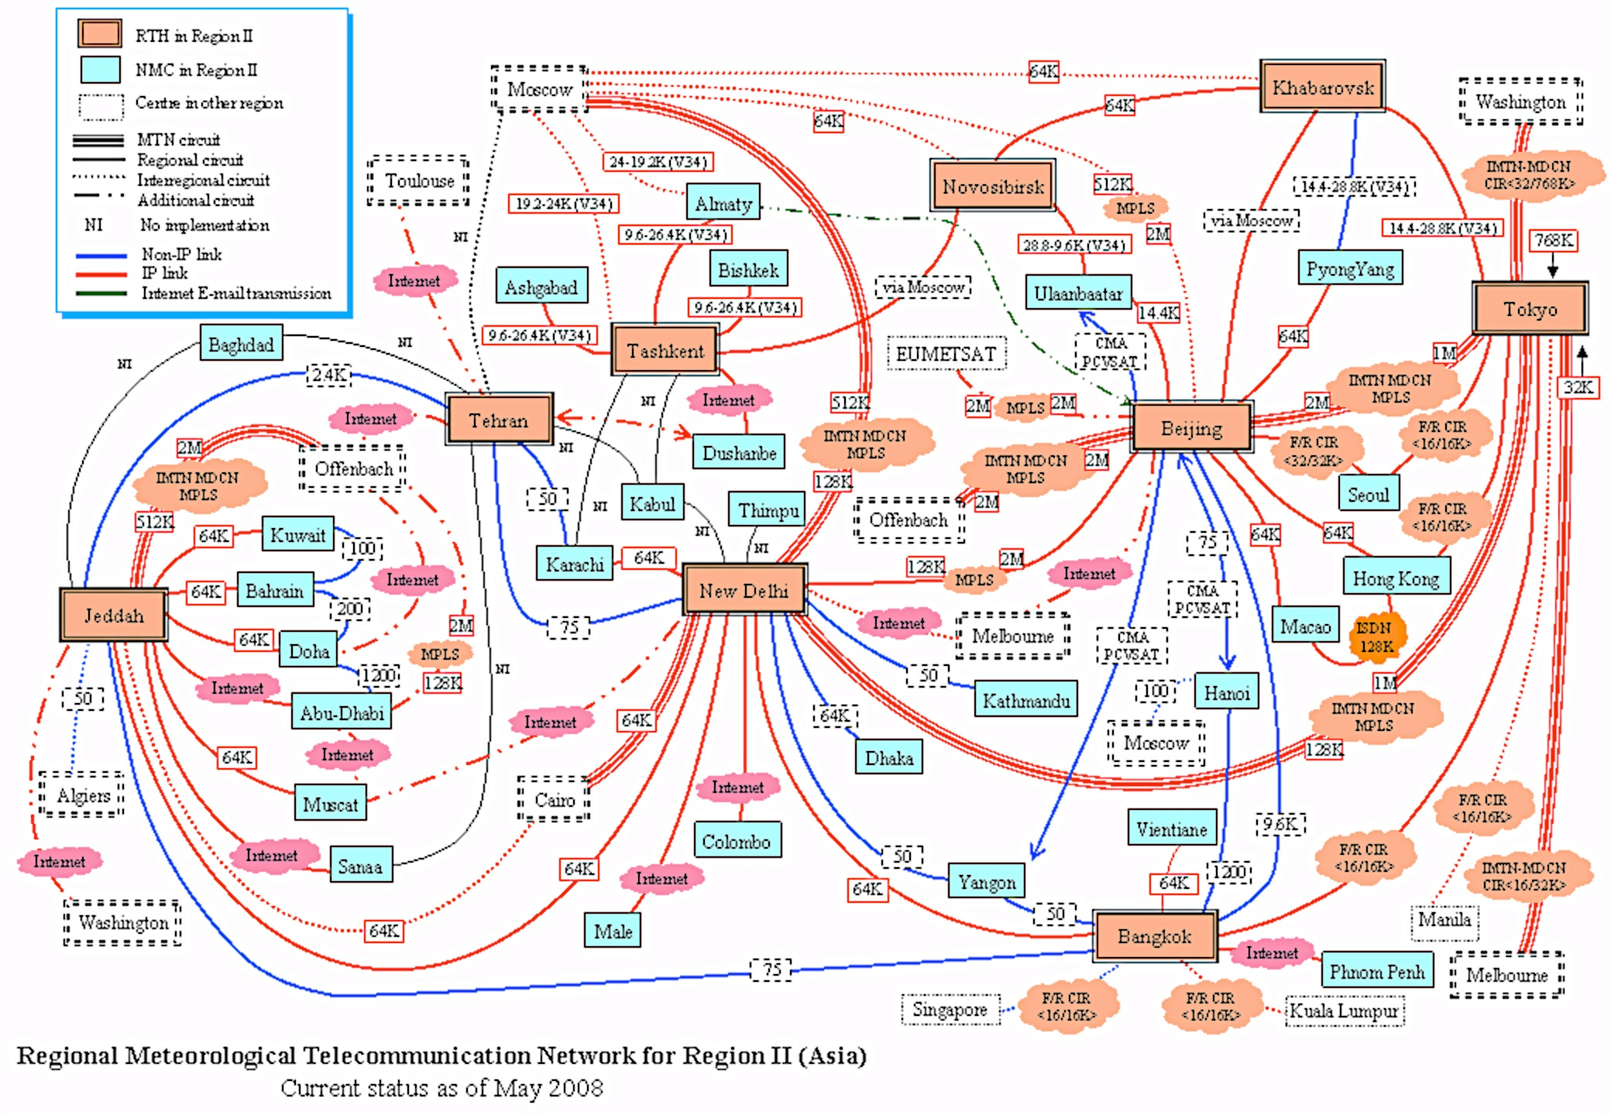
Regional Meteorological Telecommunication Network - Asia

Slide 20
Global Weather data agencies
United Kingdom - Climatic Research Unit, University of East Anglia
United States - NOAA National Oceanic & Atmospheric Administration http://www.noaa.gov/
Canada - Environment Canada http://www.weatheroffice.gc.ca
Europe - European Centre for Medium-Range Weather Forecasts (ECMWF) http://www.ecmwf.int/
Japan - Japan Meteorological Agency http://www.jma.go.jp
International - METAR data from airports http://en.wikipedia.org/wiki/METAR
APRS network http://www.aprs-is.net/
  APHRODITE: Asian Precipitation - Highly-Resolved Observational Data Integration Towards Evaluation of Water Resources
  NCAR – UCAR – Climate Data Guide
    https://climatedataguide.ucar.edu/climate-data

Slide 21
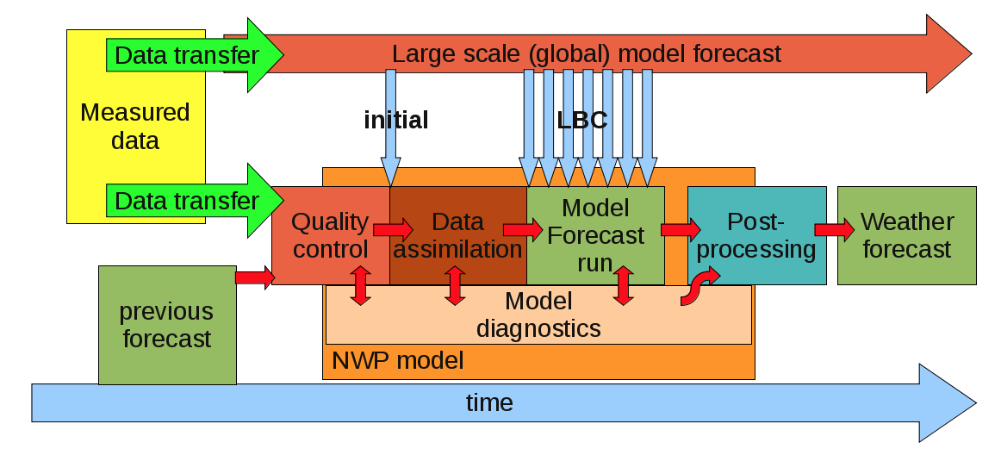
Scheme of the steps taken when making the weather forecast

Slide 22
Types of forecast models
Global Circulation Model (GCM)
Regional Circulation Model (RCM)
General (Global) Circulation Model (GCM)
General Circulation Models (GCMs) are a class of computer-driven models for weather forecasting, understanding climate and projecting climate change,
Commonly called Global Climate Models
A global climate model or general circulation model aims to describe climate behavior by integrating a variety of fluid-dynamical, chemical, or even biological equations that are either derived directly from physical laws (e.g. Newton's law) or constructed by more empirical means.

Slide 23
Regional Circulation Model (RCM)
A high resolution climate model that covers a limited area of the globe (5,000 x 5,000 km) with horizontal resolution of < 50 km
Based on physical laws represented by mathematical equations that are solved using a three-dimensional grid
Includes atmosphere and land surface components of climate system, containing representations of the important processes within climate system (e.g., cloud, radiation, rainfall).
Many of these physical processes take place on much smaller spatial scales than model grid and cannot be modeled and resolved explicitly

Slide 24
General Circulation Models (GCMs)
HadGEM3: Developed by the UK Met Office, it is used for climate prediction and research.
GFDL CM4: Developed by the Geophysical Fluid Dynamics Laboratory, it focuses on simulating the Earth’s climate system.
MPI-ESM: Developed by the Max Planck Institute for Meteorology, it is used for studying climate dynamics and variability.
CESM: The Community Earth System Model, developed by the National Center for Atmospheric Research (NCAR), is used for simulating the Earth’s climate system.
CNRM-CM: Developed by Météo-France, it is used for climate research and prediction.
Regional Climate Models (RCMs)
WRF (Weather Research and Forecasting Model): Used for both weather forecasting and climate research.
RegCM: The Regional Climate Model, developed by the International Centre for Theoretical Physics (ICTP), is used for regional climate studies.
COSMO-CLM: Developed by the CLM-Community, it is used for regional climate simulations in Europe.
PRECIS: Developed by the UK Met Office, it is used for generating high-resolution climate change scenarios.
HIRHAM: Developed by the Danish Meteorological Institute, it is used for regional climate modeling in Europe.

Slide 25
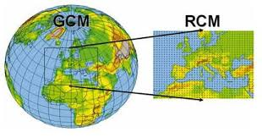

Slide 26
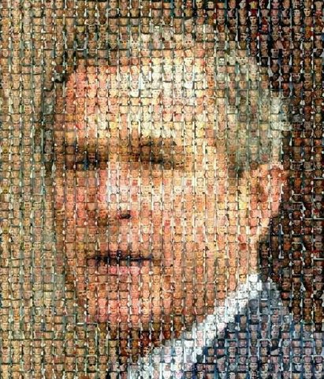

Slide 27
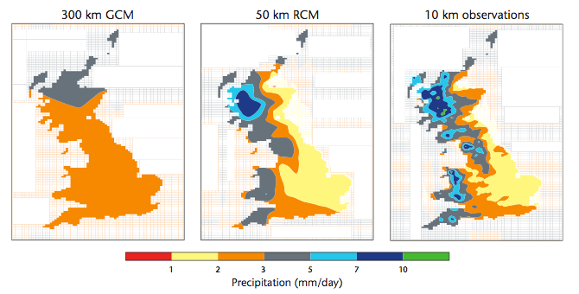
Advantages of RCM
RCMs simulate current climate more realistically
RCM includes ocean, land, mountain, water bodies, small islands etc.,
RCMs simulates better changes in extremes

Slide 28
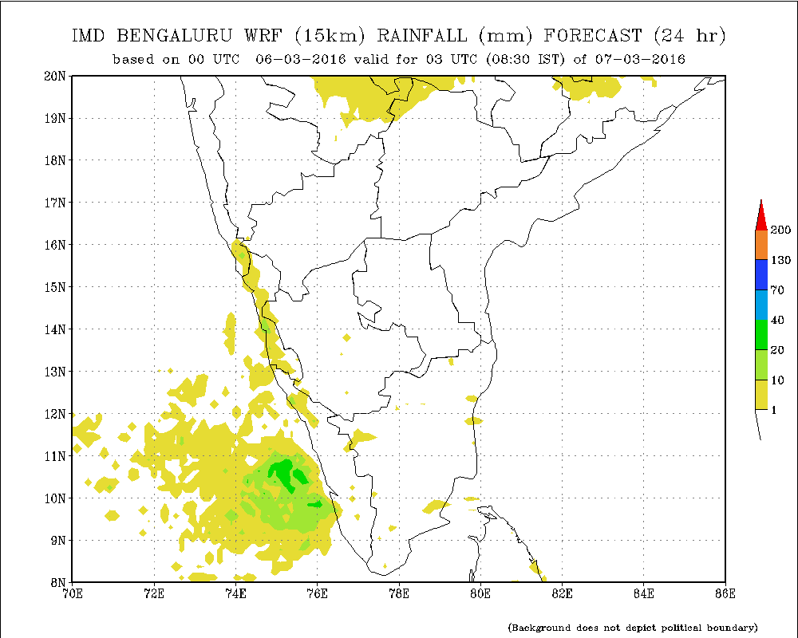
Weather Research Forecast (WRF) Model

Slide 29
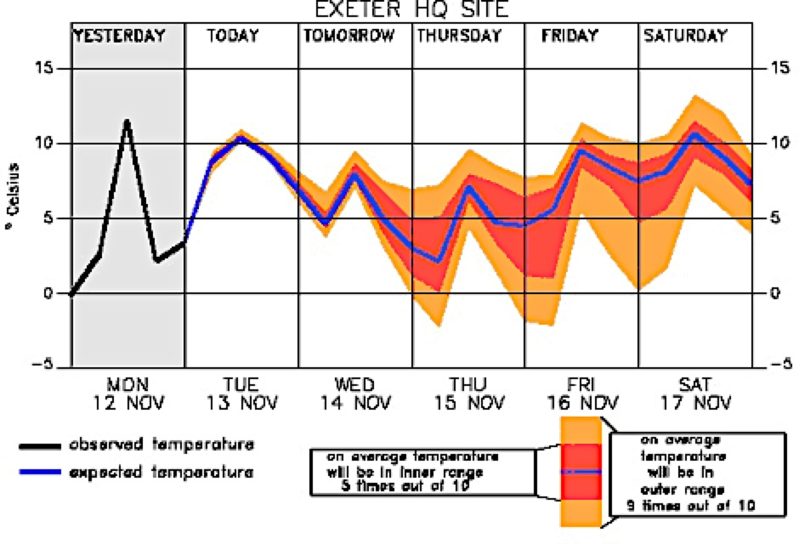
Ensemble forecast
Do a set of calculation with a model using slightly different initial conditions
Use several different models using the same initial conditions
average the model results

Slide 30
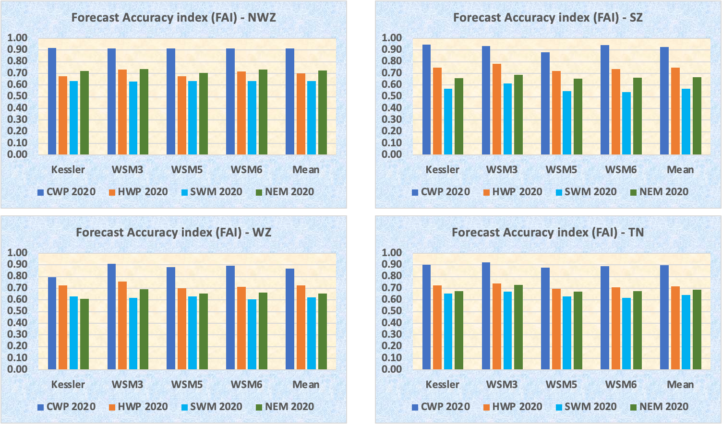
Description of the Technology – TNAU VLF
TNAU – VLF
Verification
Medium Range Weather forecast
Next 6 days - Daily and Hourly scale
RF, Temp, RH, WS2 & WS10
Public domain http://aas.tnau.ac.in/vlf/
17 Locations
Advantages
WRF v 4.4 with WSM 3 microphysics
Resolution – 3km, 35640 points of TN
All 18555 revenue villages
Forecast Accuracy 70 – 80%
Date wise abstract of rainfall expected locations
Rainfall intensity info from hourly rainfall
Verified for Temporal & spatial – 4 season, 7 ACZ & 6 lead days
Agro Climate Research Centre, Directorate of Crop Management, Tamil Nadu Agricultural University, Coimbatore 641 003

Slide 31
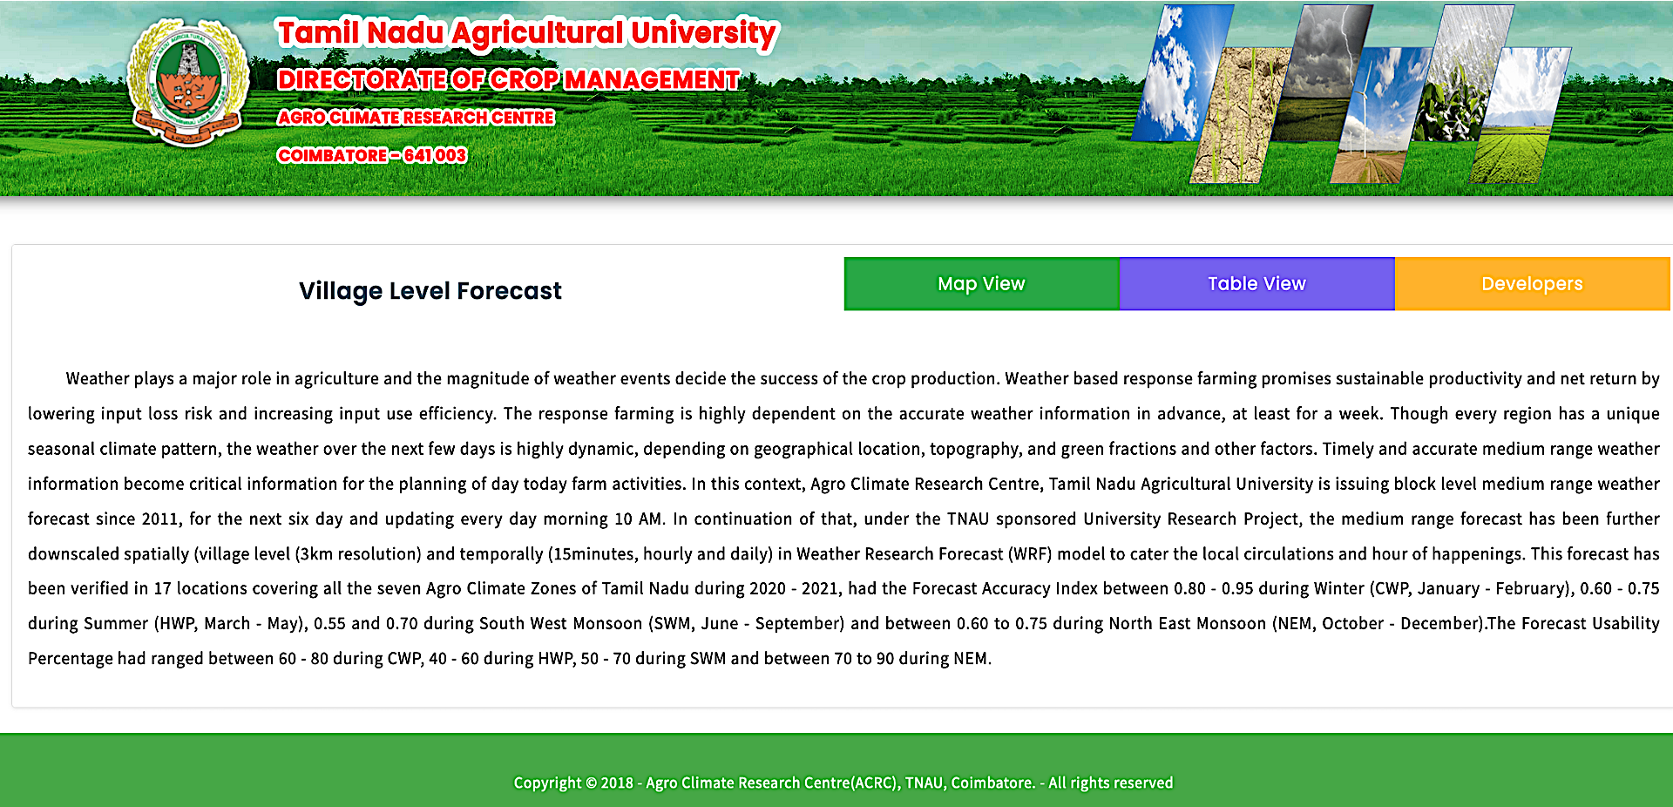
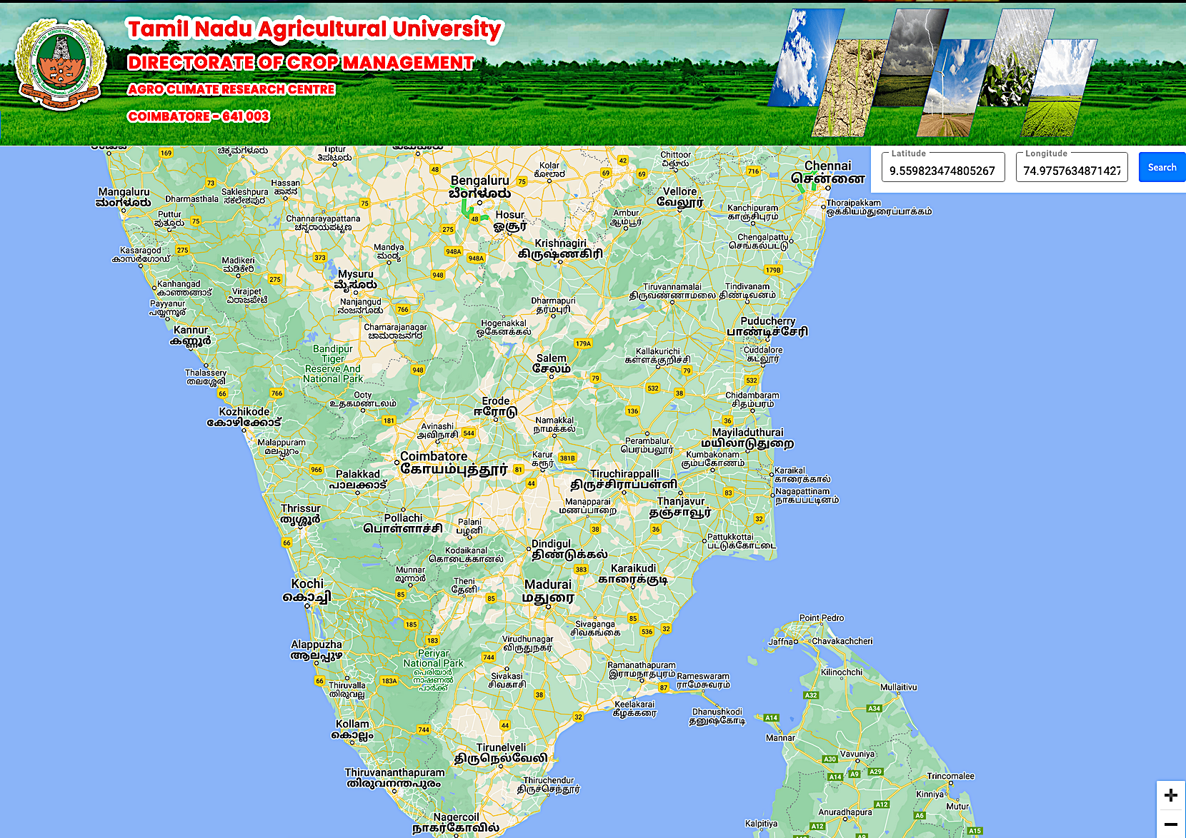
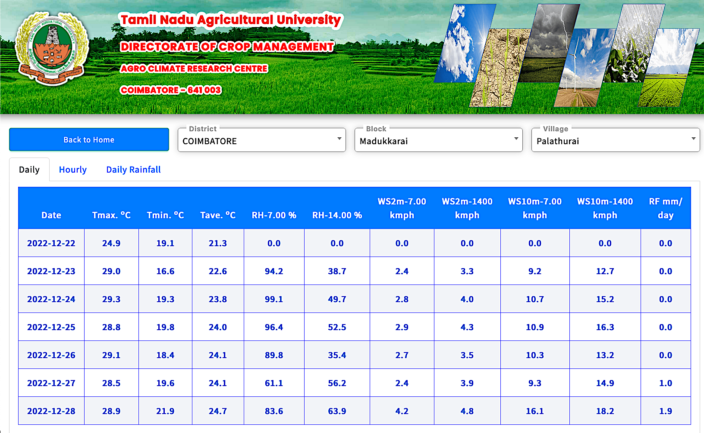
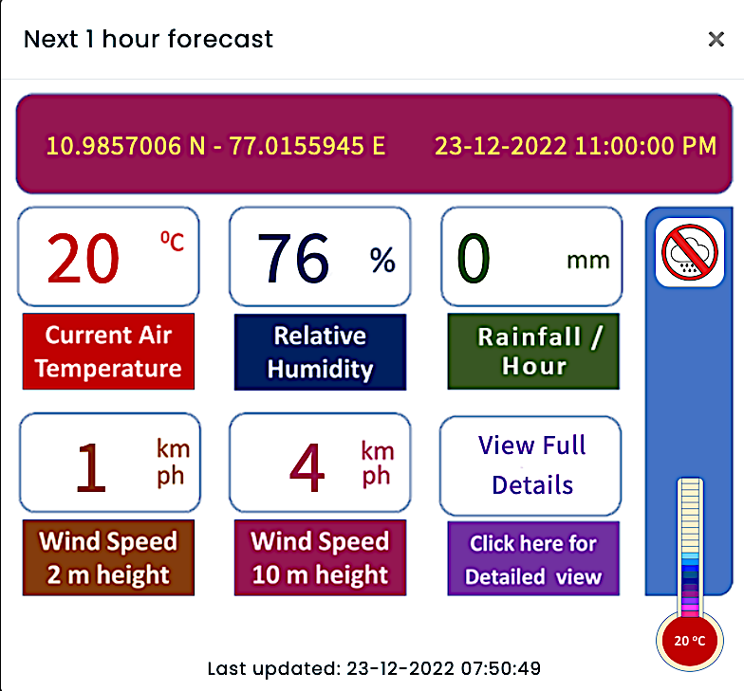
Cost and Ease of Application
Requirement & Cost
10 MBPS ILL & Cloud space
Rs. 2.5 lakh/year
Ease of Application
Simple and user friendly website
Forecast available in both Map & Table view
Google map to select location
Click on map provides next hour forecast.
Table provides daily and hourly forecast.
Lat/long or District/block/village selection.
Easily locate extreme rainfall events
Helps to identify extreme rainfall & intensity
Can be linked with Uzhavan App as of TAWN
UVTRSC 2022
Agro Climate Research Centre, Directorate of Crop Management, Tamil Nadu Agricultural University, Coimbatore 641 003

Slide 32
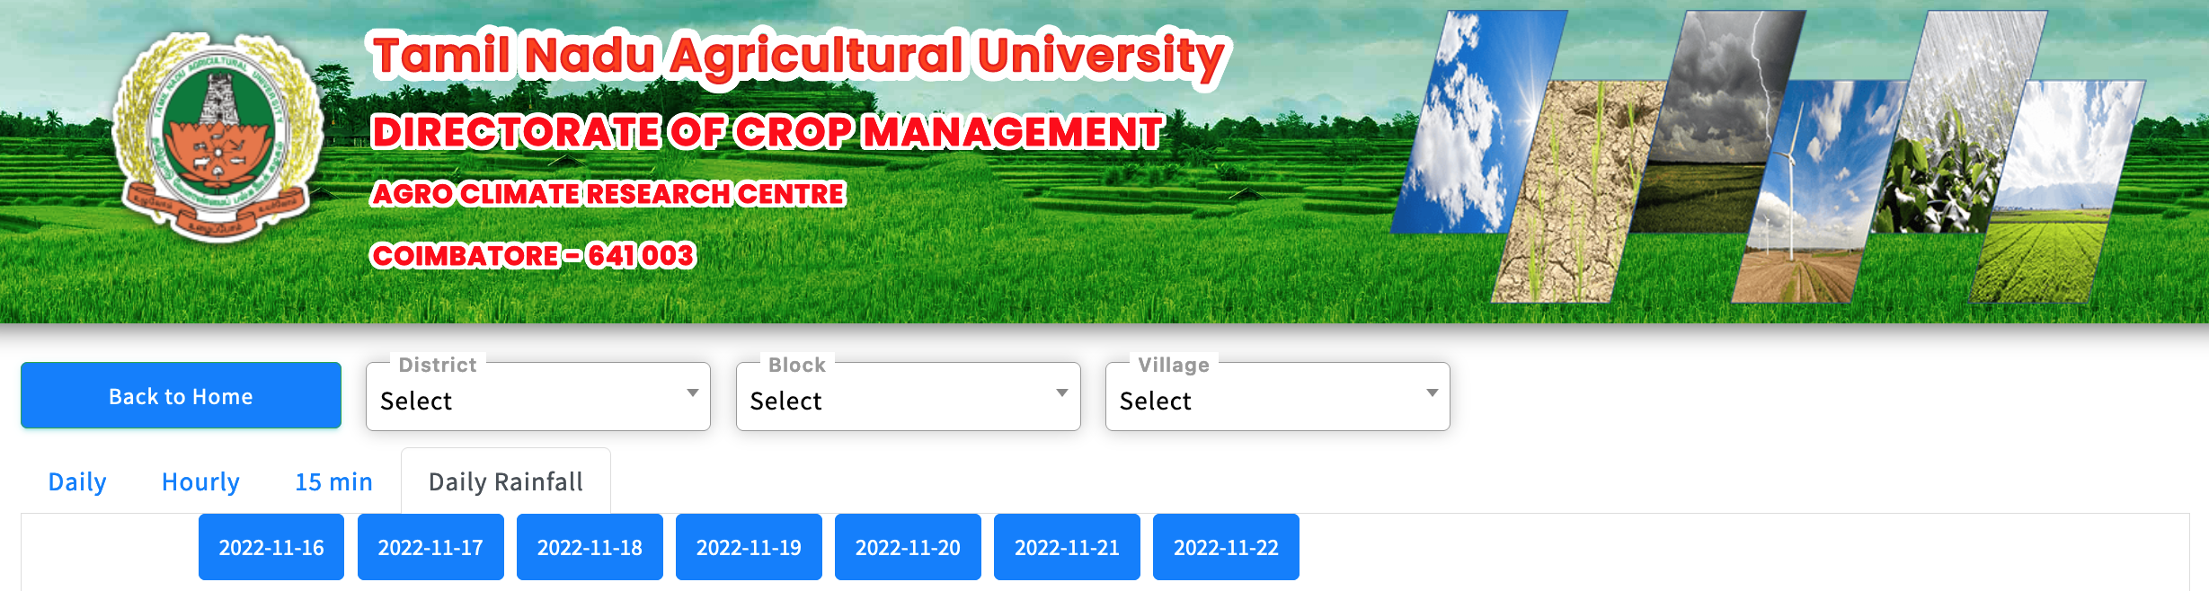
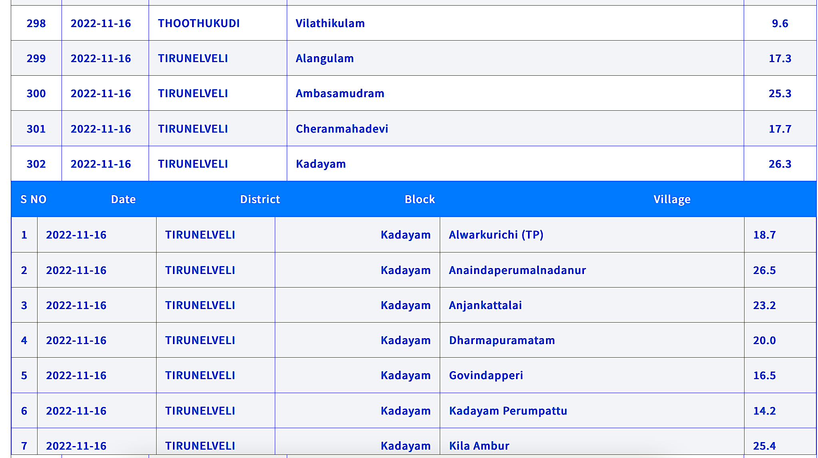
Date wise abstract of rainfall occurring blocks / villages for identifying extreme events
Rainfall occurring places in Tamil Nadu alone abstracted and displayed
Block wise & village wise
Block wise
Village wise

Slide 33
Daily forecast for next six days
Block wise & village wise
10 weather parameters

Slide 34
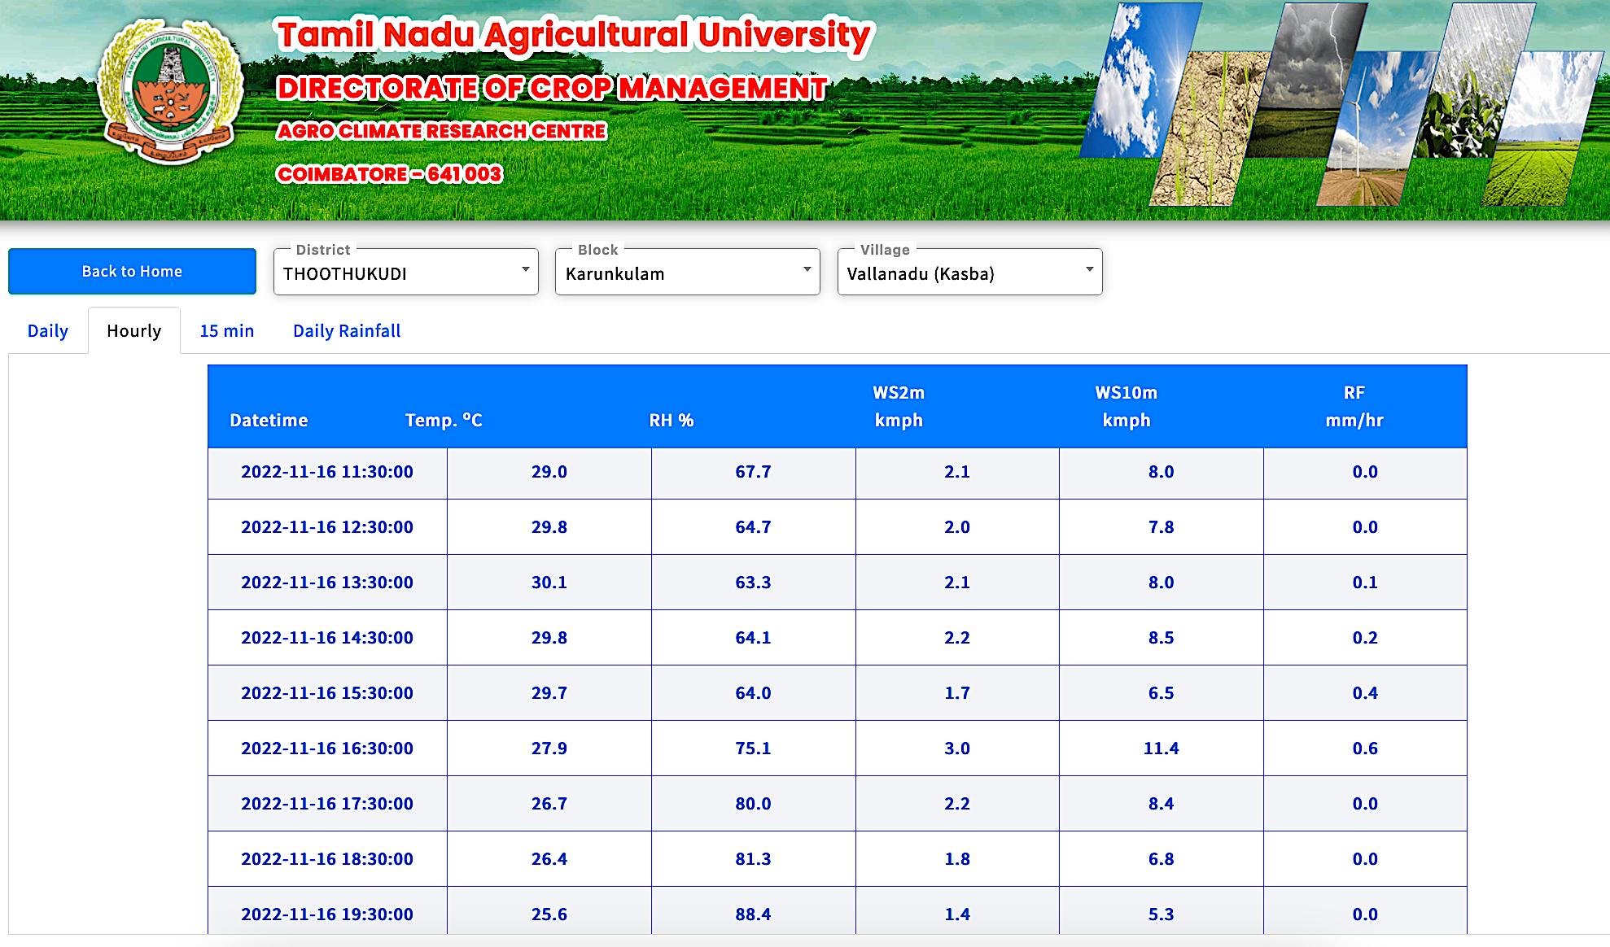
Table view is displaying hourly forecast for next six days
Hourly Forecast for temp.(ºC), RH (%), WS (kmph) Rainfall (mm/day)

Slide 35
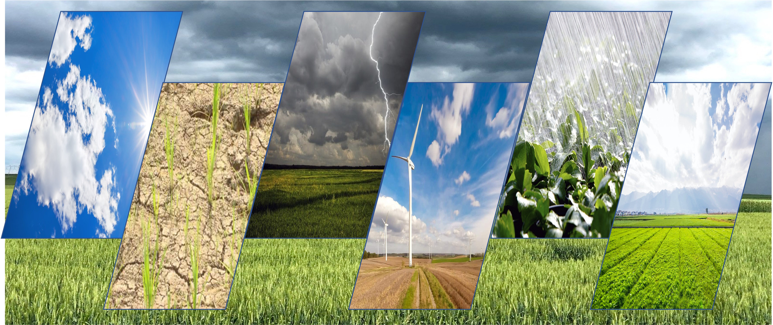

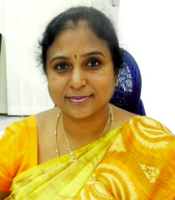
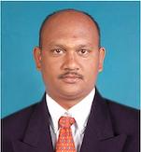
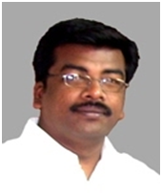
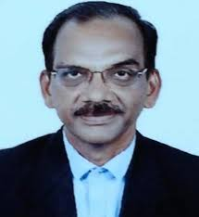
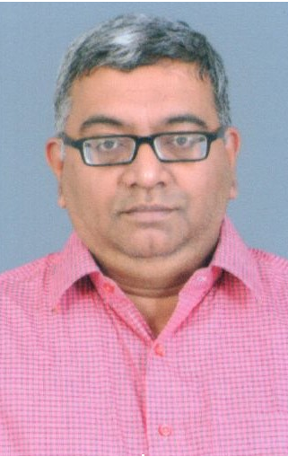
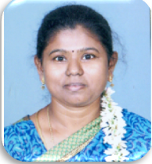
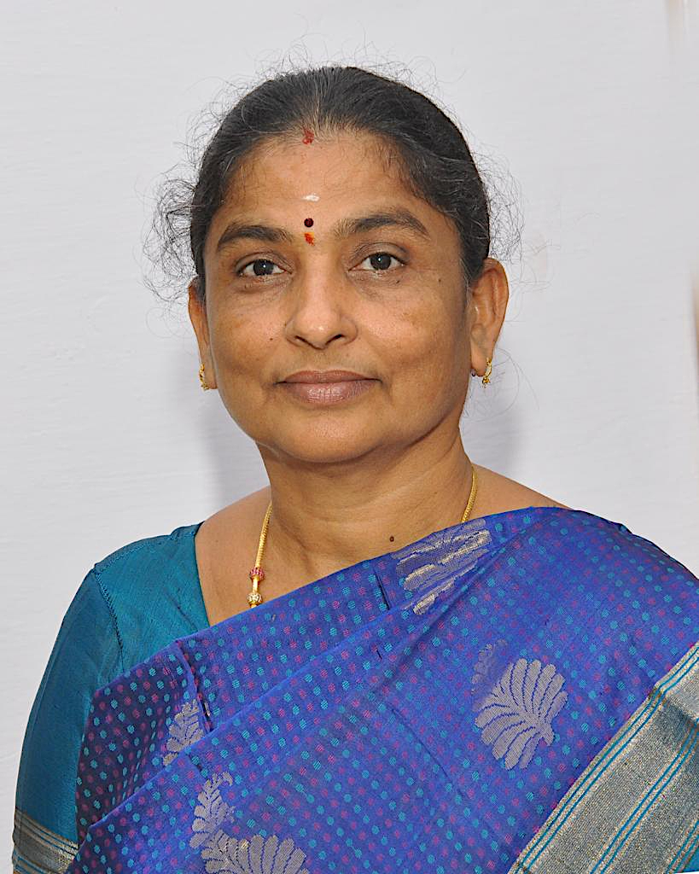

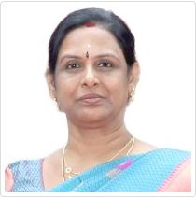



TNAU’s Village Level Medium Range Forecast
Sponsoring Centre & contributors
Agro Climate Research Centre
Directorate of Crop Management
TNAU, Coimbatore – 641 003
TNAU - VLF
Dr. V. Geethalakshmi
Vice Chancellor
Dr. Ga. Dheebakaran
Assoc. Prof. (Agronomy)
Dr. KP. Ragunath
Assoc. Prof. (SS&AC)
Dr. SP. Ramanathan
Professor and Head
Dr. Balaji Kannan
Professor & Head (PS&IT)
Dr. S. Kokilavani
Asst. Prof. (Agrl. Met.)
UVTRSC 2022
Dr. M.K. Kalarani
Director, Crop Management
Dr. N.K. Sathyamoorthy
Professor (Agronomy)
Dr. N. Maragatham
Dean, CSW
Dr. R. Jagannathan
Prof. (Agronomy) Retd
Dr. R. Gowtham
Res. Assoc. (Agrl. Met.)
Dr. R. Karthikeyan
Assoc. Prof. (Agronomy)

Slide 36

TNAU’s VLF is used by Tamil Nadu Electricity Board for power demand computation
86th S
W
C
Tamil Nadu Agricultural University, Coimbatore 641 003

Slide 37









Decadal Transition of Indian Agriculture
1967 – 78 GRI
2021 - 30
Artificial Intelligence with ICT, IoT & RSGIS
1971 - 80 HYV
1981-90 Fertilizer
1990 – 95 FMP
1996-2k Irrigation
2001-10 New Agrl. Chem.
2011-20 Climate change

Slide 38

We Just need a smile from the farmer… Nothing Else…
Thank you

