Slide 1
The Science of Weather Forecast: Scope, Types and Methods
Dr. S. Kokilavani, Ph.D.,
Assistant Professor (Agrl. Meteorology),
Agro Climate Research Centre,
TNAU, Coimbatore

Slide 2
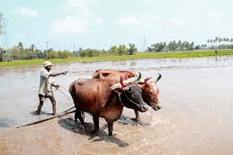
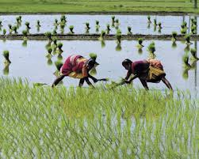
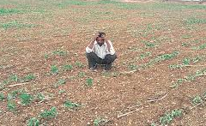
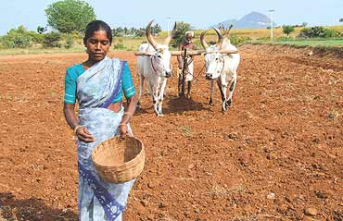

Current status of agriculture in Tamil Nadu
81 lakh farm families
More than 50% area are rainfed
Heavily dependent on monsoon rains
Benefited from both SWM (35%) & NEM (45%)
Rainfall pattern shifted & temp is marking new highs
Agriculture become vulnerable to unpredictable weather
Farmers are in need of weather information in advance
Right advisories at right time will reduce the risk in crop production

Slide 3
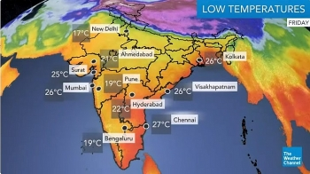
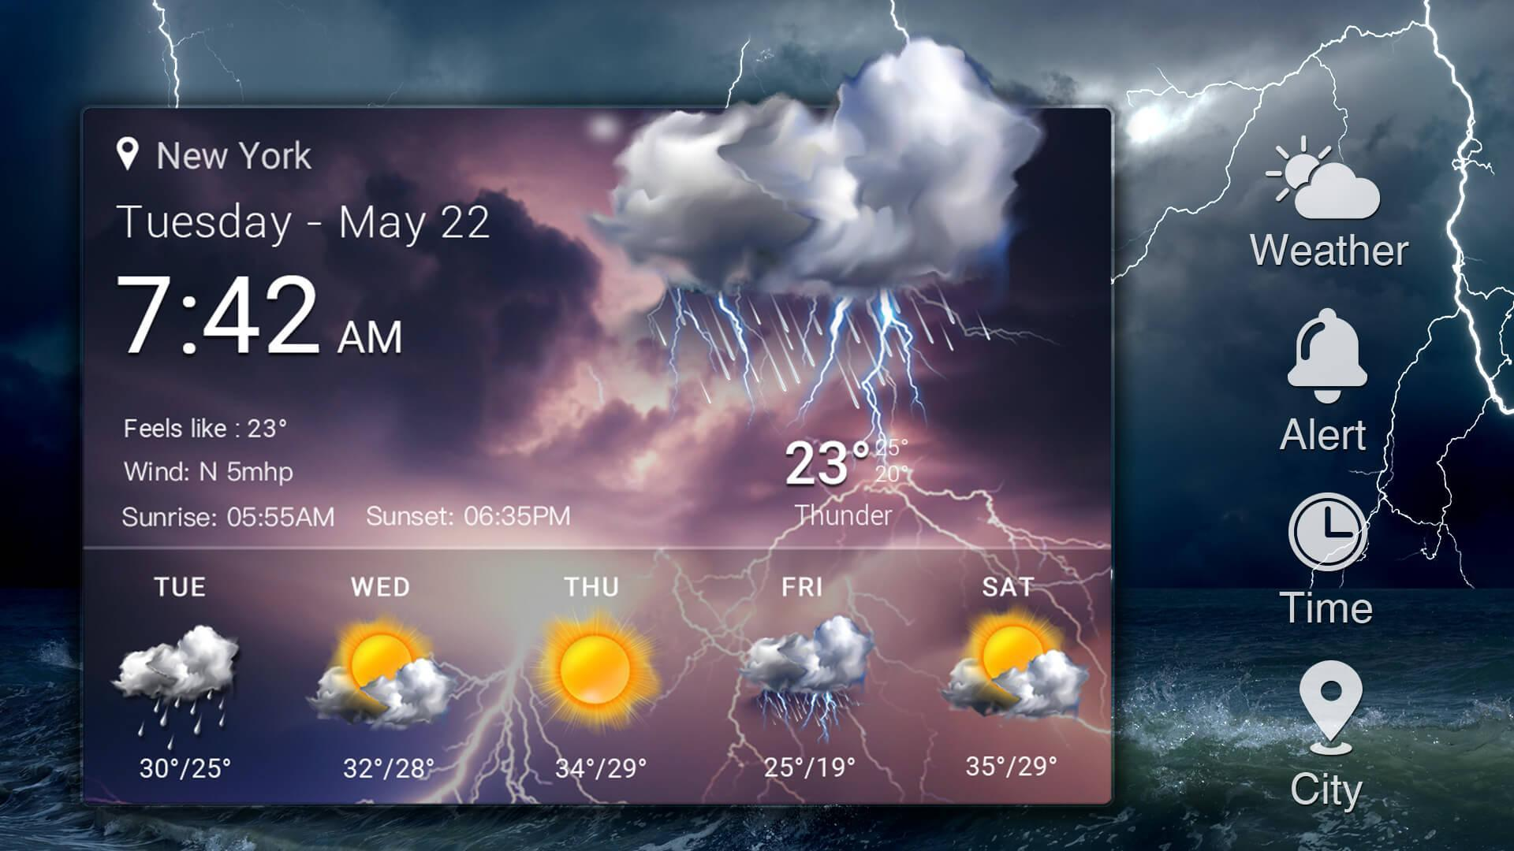
Weather Forecast
Application of science and technology to predict the state of the atmosphere of a given location for a future time.
Weather prediction has been informally for millennia, and formally since at least the nineteenth century.
Weather forecasting involves,
    Collection of quantitative data about the current state
    Scientific understanding of atmospheric processes
    Project how the atmosphere will evolve

Slide 4

Rainfall prediction has prime importance in agrarian country like India where the country's economy is highly depends on agriculture.
Knowledge about the amount, distribution, spatial variability, frequency of occurrence and intensity etc., are important for many practical applications.
Prediction of rainfall in advance with high accuracy would enhance the management of water and other resources
Dissemination of weather information to the farmers in advance will help them to make right farm operations at right time.

Slide 5
Need / importance of forecast
The weather has many social & economic impacts on a place
Among different factors that influence crop production, weather alone explains up to 50 percent of variations
Rainfall is the most important among the required forecasts, which decides crop production in a region and ultimately the country’s economy.
Planning for moisture conservation under weak monsoon and for flood relief under strong monsoon
The recurring crop losses can be minimized if reliable forewarning on the incidence of pest and diseases is given timely based on weather variables.
Help in holding the food grain prices in check through buffer stock operations.

Slide 6
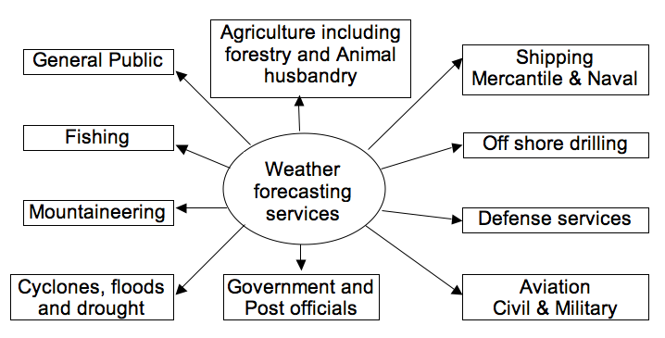
Different weather forecasting services

Slide 7
TNAU - Real Time Weather Display and medium range weather forecast
Website: tawn.tnau.ac.in

Slide 9
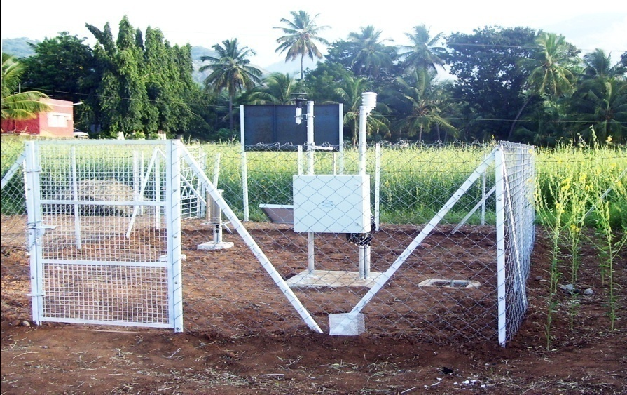
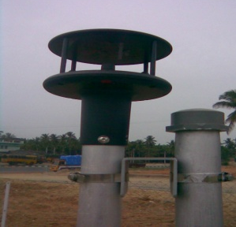
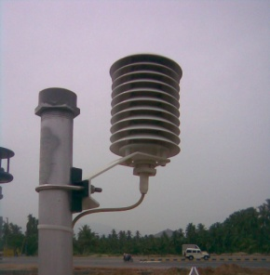
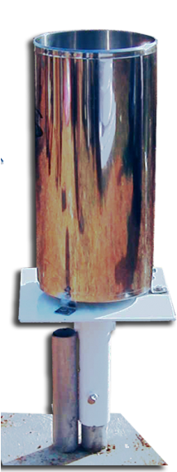
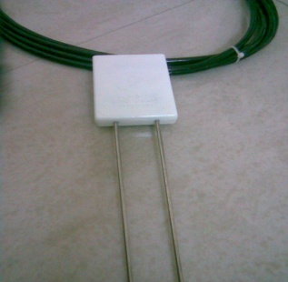
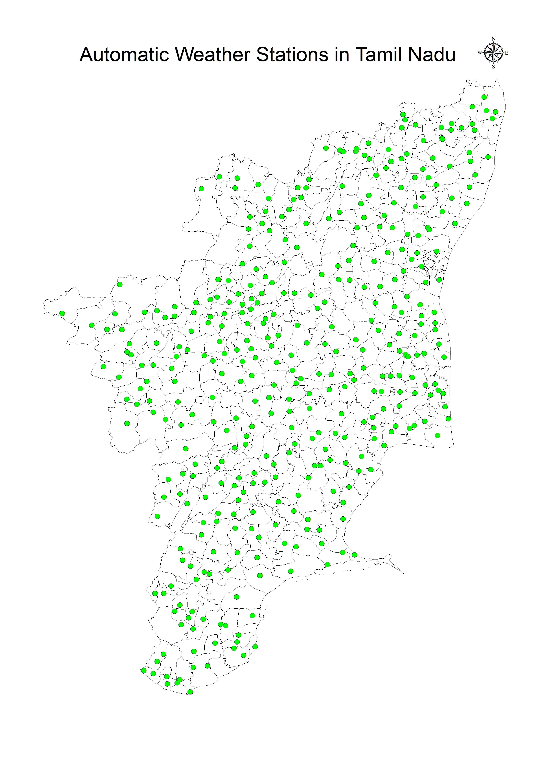
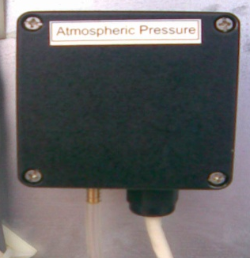
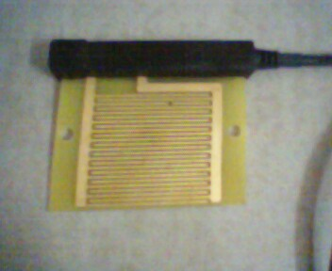
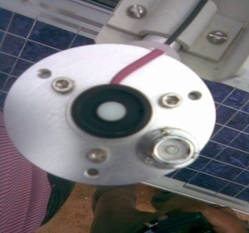

TNAU – Tamil Nadu Agricultural Weather Network
Sensors
Air Temperature
Relative Humidity
Rainfall
Solar Radiation
Wind Direction
Wind Speed
Barometric Pressure
Soil Moisture
Soil Temperature
Leaf Wetness

Slide 10

Types of weather forecast
Now Casting : 0 to 2 hours (2hrs)
Very Short Range : 3-12 hrs
Short Range : 12 hrs to 3 days (72 hrs)
Medium Range : 3 days to 10 days
Extended range : 15 days – present
Long Range : beyond 10 days up to a month or season
Seasonal climate Forecasting

Slide 11

Agencies involved in weather forecast
India Meteorological Department (IMD) – Official forecaster of India
National Centre for Medium Range Weather Forecast (NCMRWF)
  Medium, Long range and Seasonal
Regional Meteorological Centre (RMC)
  Medium range – District level (Tuesday and Friday)
State Agricultural Universities (SAU)
  TNAU – Medium range - Block level (Daily updated)
Commercial & private groups – Skymet, Accuweather
  Location specific – Short range and now casting

Slide 12
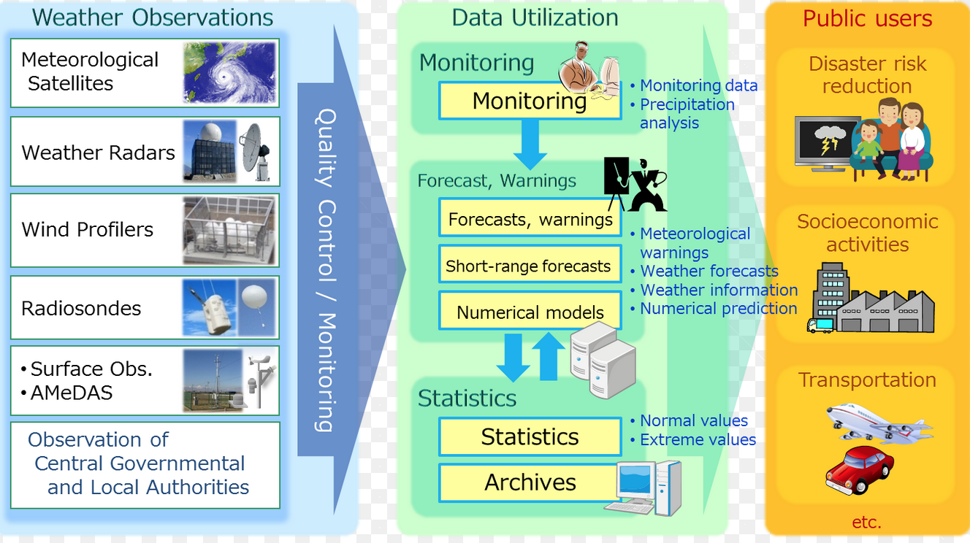
Principles and process of weather forecast

Slide 13

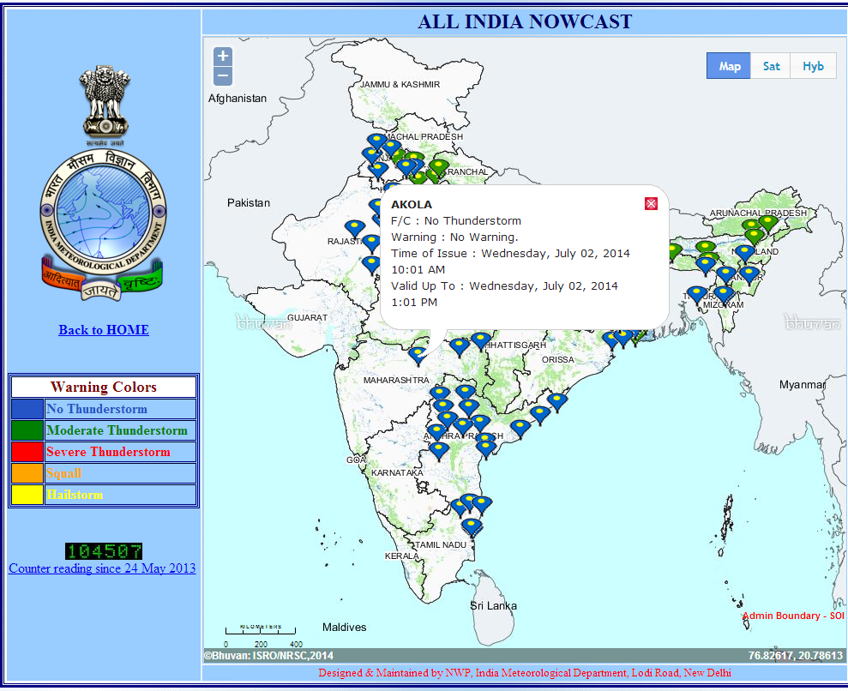
Now casting (2 hours)

Slide 14
Now casting (2 hours)
“Damini” –web app for lightening forecast

Slide 15
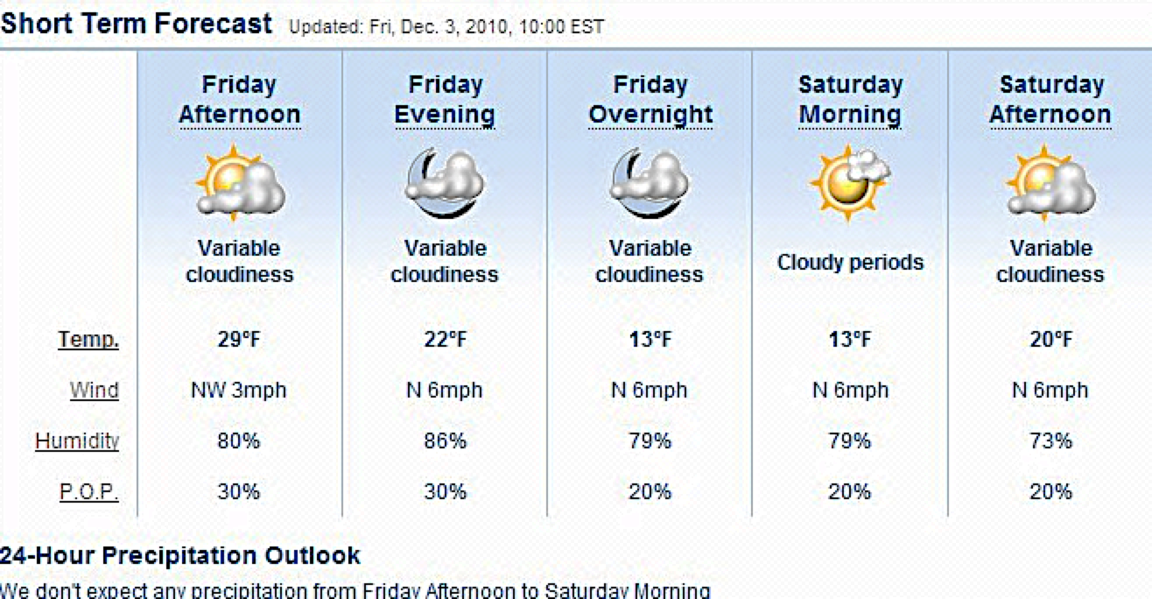
Short range forecasting – 12 to 72 hours

Slide 16
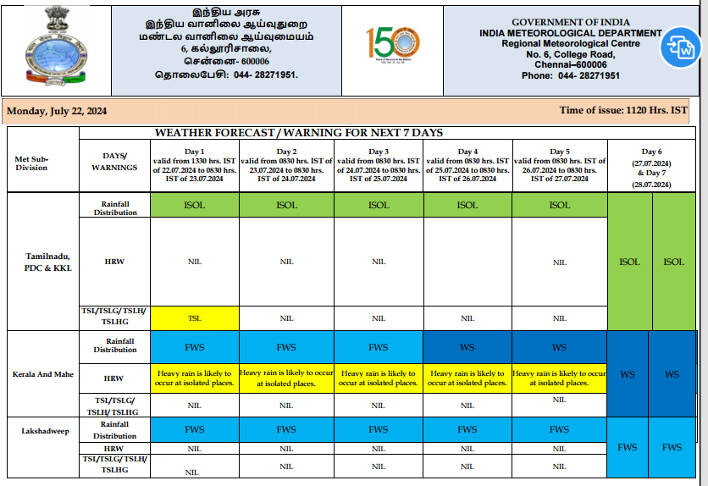

Slide 17
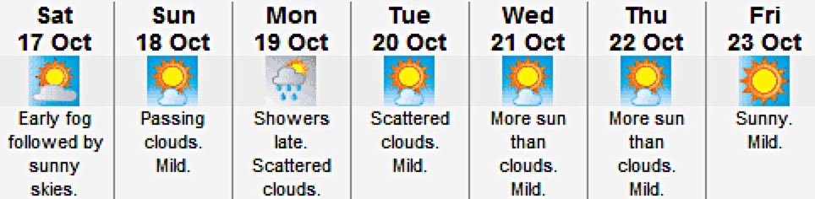
Medium range forecasting – 3 – 10 days

Slide 18
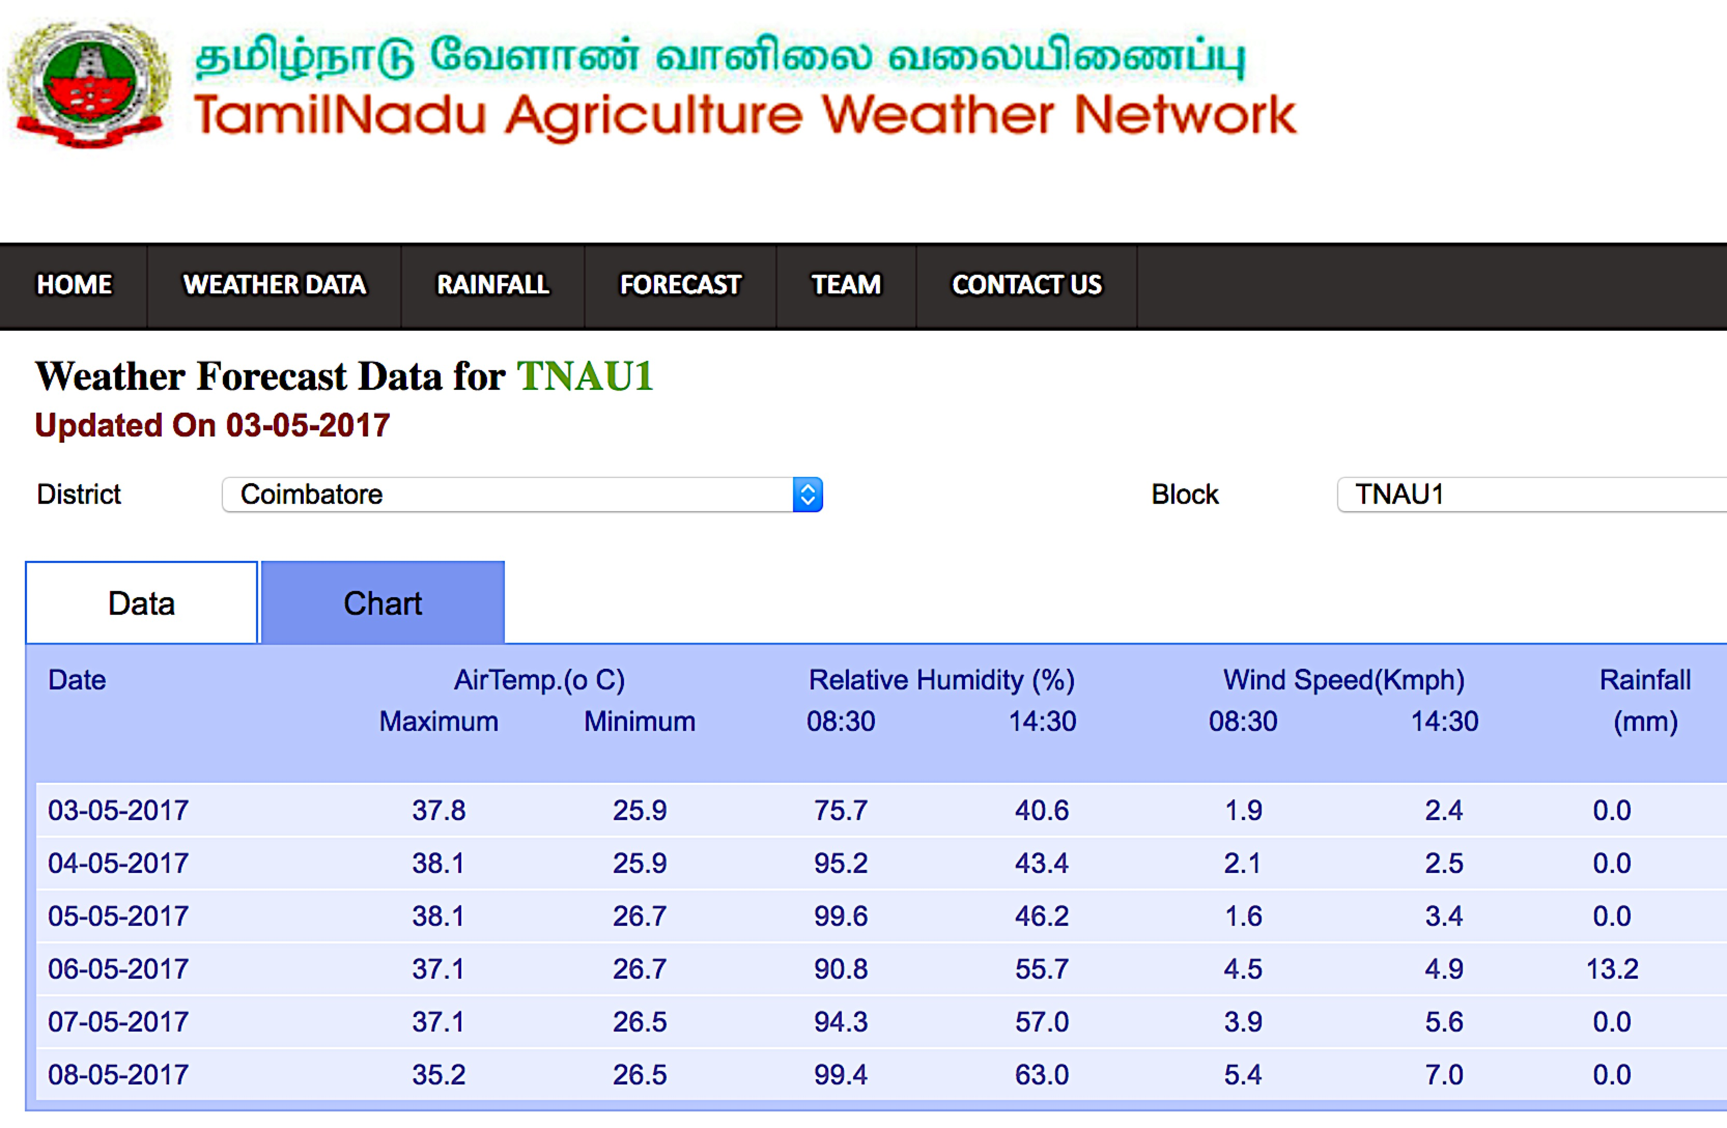
Medium Range Weather Forecasting at TNAU

Slide 19

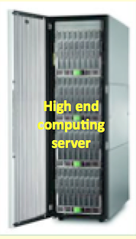


Challenges faced before deployment of forecast
Accurate & timely medium range weather forecast development consumed lots of effort, manpower and time.
  high computing capacity
  faster internet bandwidth
  WRF model could run only in certain specifications
  Identifying suitable microphysics for accuracy
Though automated, troubles in daily data downloading has to be monitored and solved in time to get regular forecast

Slide 20
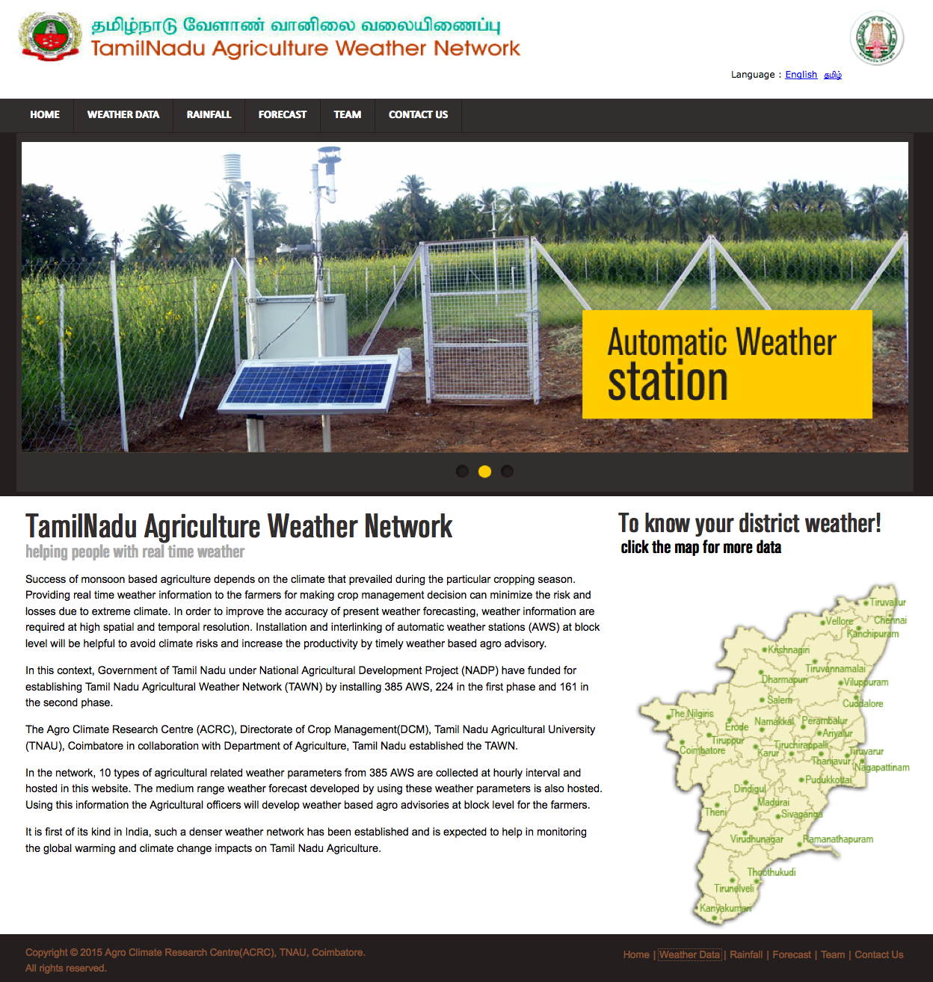




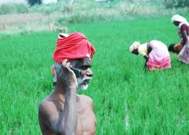
Details of coverage of the targeted population
As the forecast is at block level, is used by Govt. officials
TAWN is a Public domain, approximately 1000 + are daily visiting
Tamil Nadu district Collectors
Dept. of Agricultural officials
KVK and Research stations of TNAU
Contact and lead Farmers
Crop insurance and policy makers
IT professional working in abroad
TNEB power grid system
SMS to 8.47 lakhs farmers
Broadcasting thro’ Radio, TV, news papers & Email

Slide 21
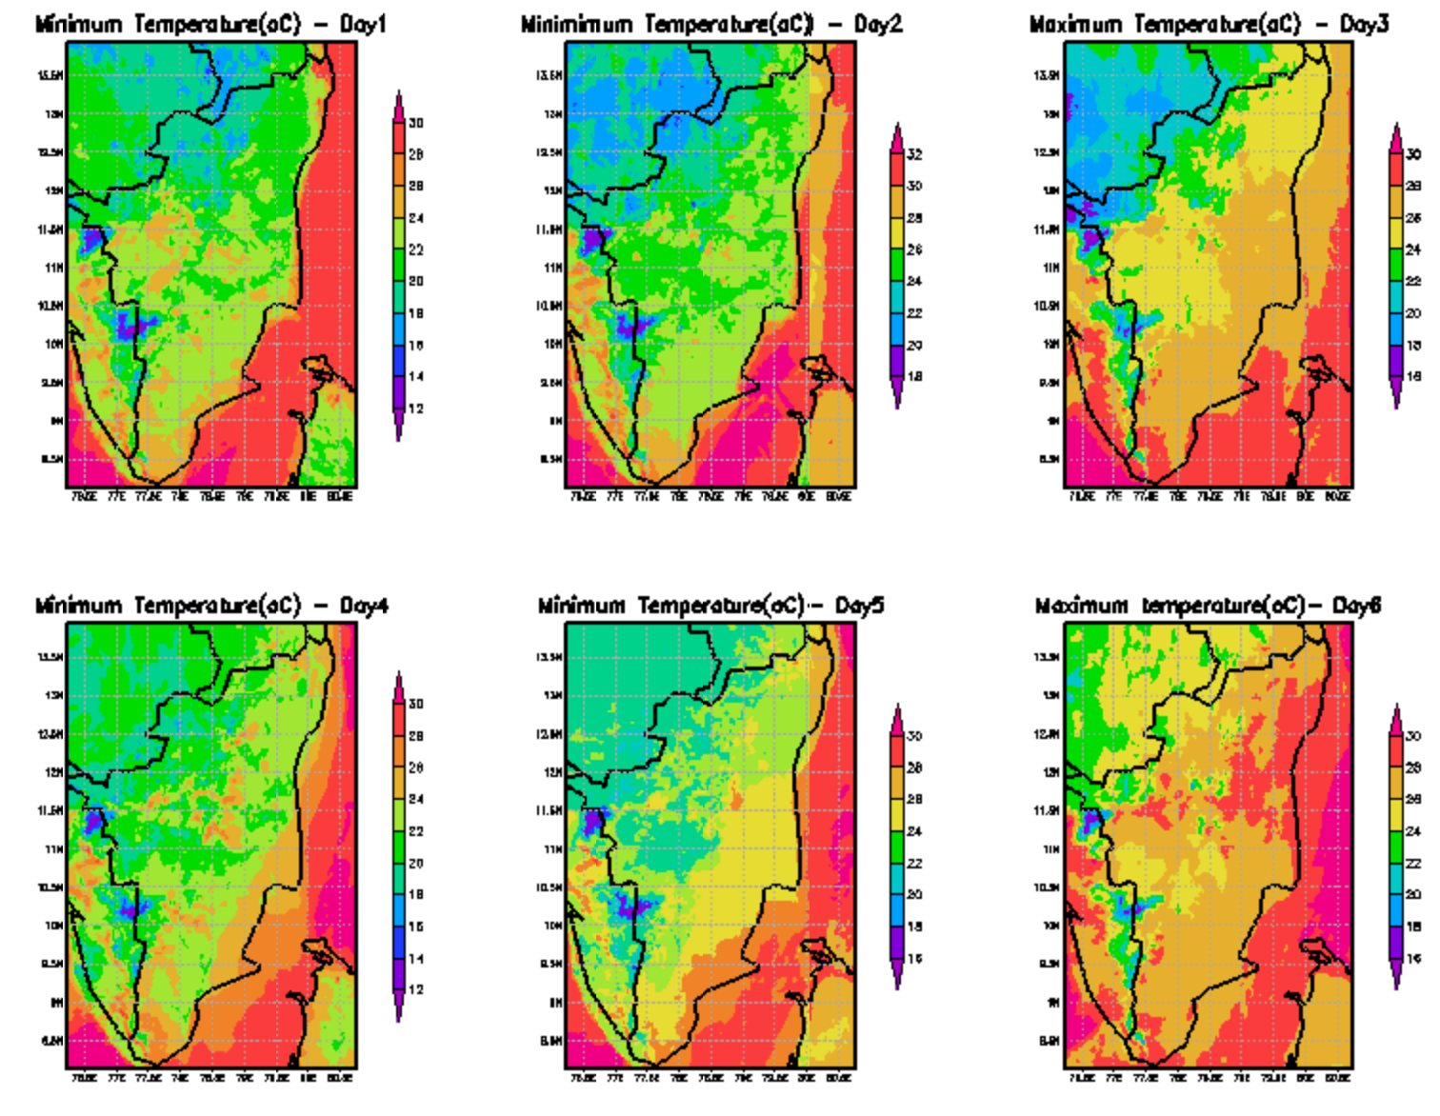
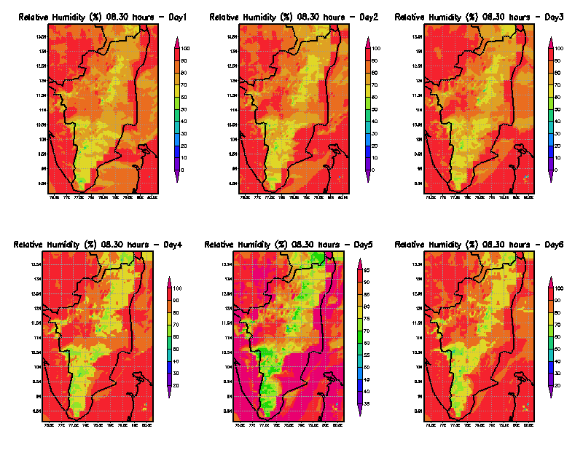
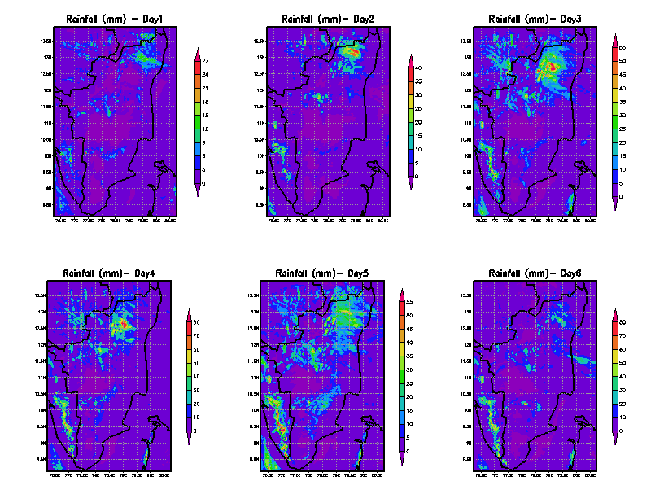
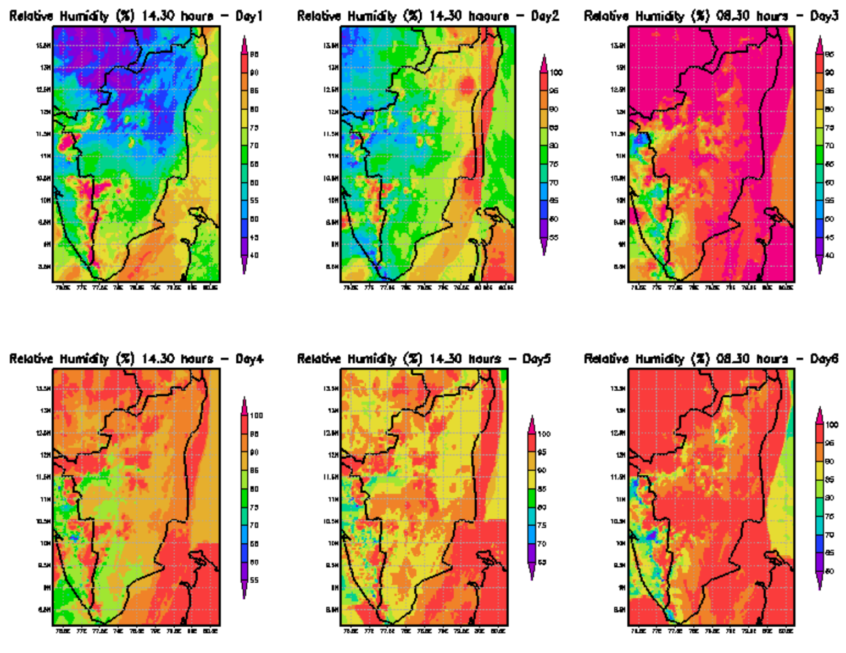
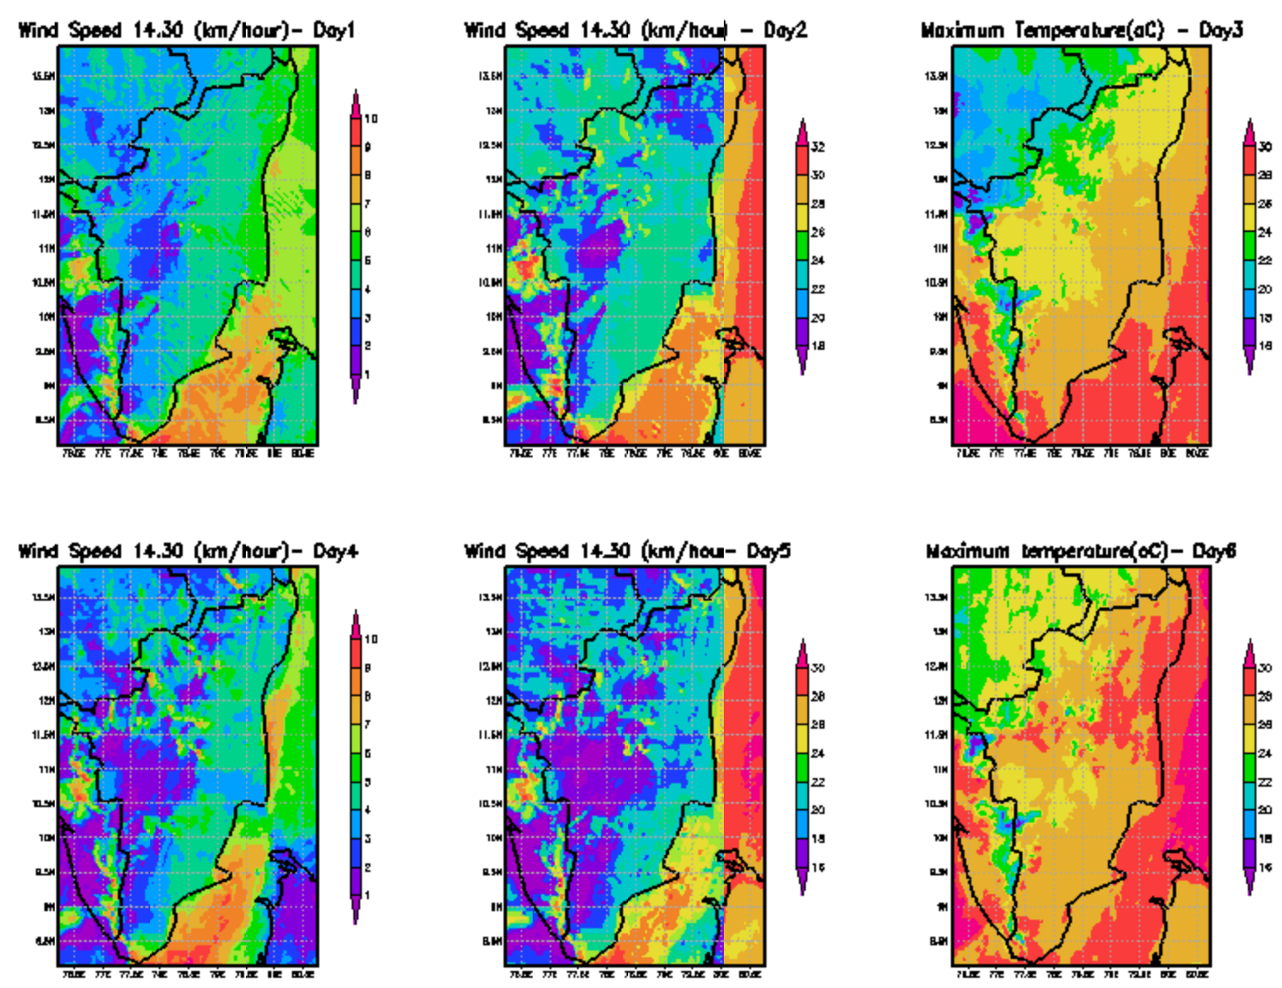
Weather forecast chart
Temp. maximum
Temp. minimum
Rainfall
Relative humidity
Wind speed

Slide 22
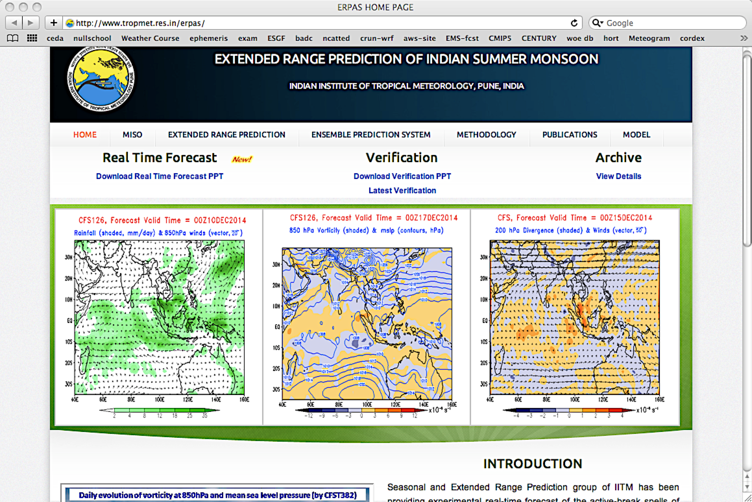
Extended Range Forecast Indian Institute of Tropical Meteorology, Pune

Slide 23
Long range forecasting –10 days / month / season
IMD Forecast division (1988) - 16 parameter power regression model for quantitative forecast and parametric model for qualitative forecast.
Failure in 2002 and then used power regression model with 10 parameter & Linear Discriminant Analysis
Forecast issued in two stages first in April and update in June
From 2007 new statistical forecasting system based on ensemble technique with 8 parameter

Slide 24
Methods of Weather Forecast
Synoptic method
Satellite images
Analogue method
Persistence forecasting method
Trend method
Climatological approach
Numerical Weather Prediction
Statistical method
Ensemble forecast

Slide 25
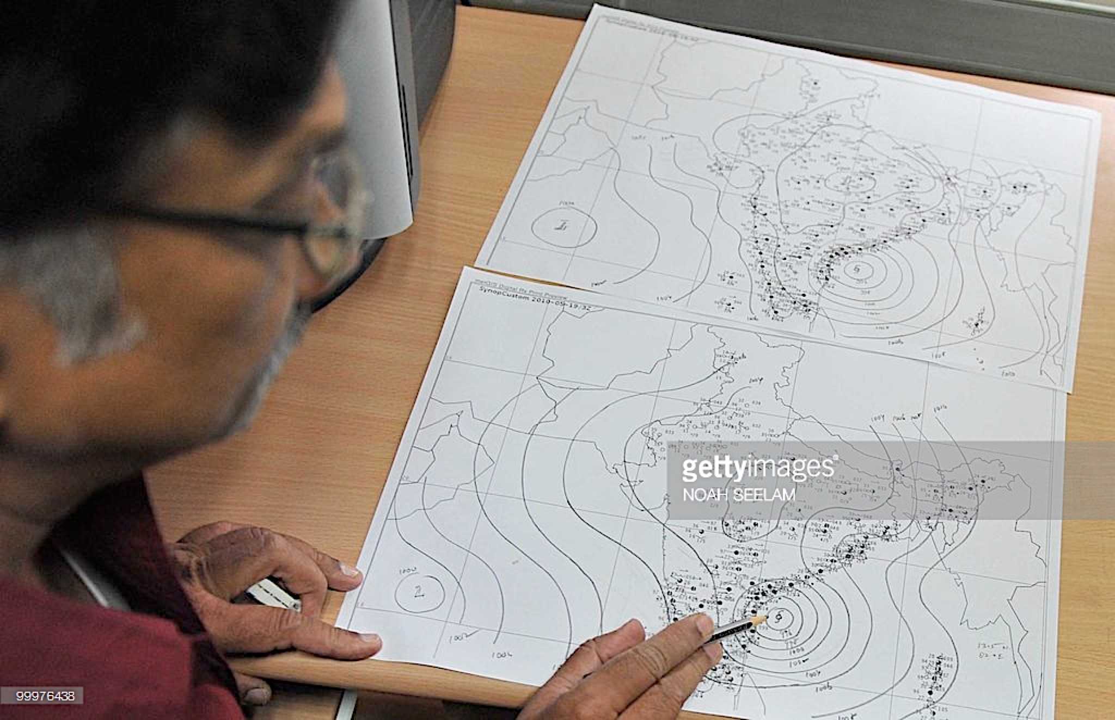
Synoptic method
Synoptic" means observations on a set of meteorological variables measured simultaneously at various locations at specific times.
Drawing the chart of present condition and project the future movement
Accuracy depends on experience of synoptic chart forecaster

Slide 26
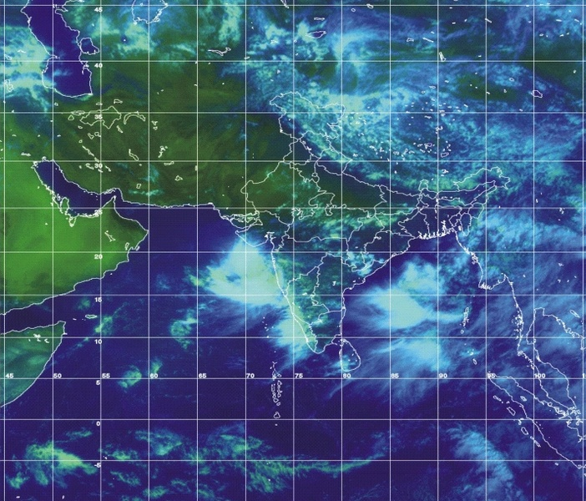
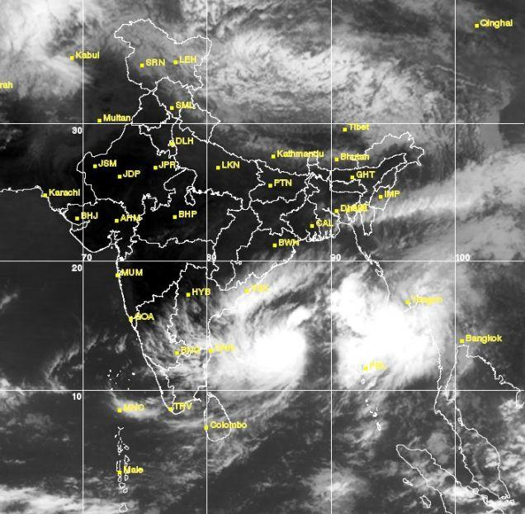
Satellite images
In addition to synoptic charts satellite pictures are also used

Slide 27
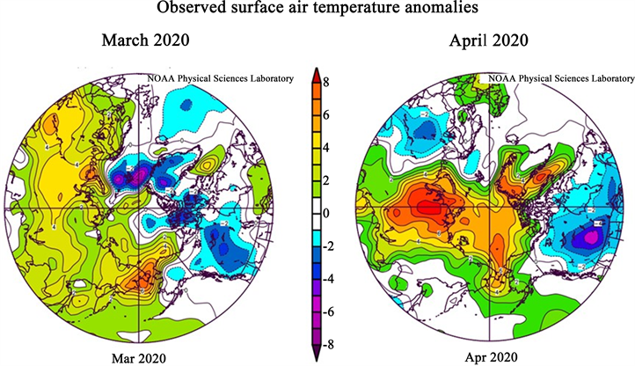
Analogue method
Examining today's forecast scenario and remembering a day in the past when the weather scenario looked very similar (an analog).
Forecasters would predict that the weather in this forecast will behave the same as it did in the past.
This is a difficult technique to use as there is rarely a perfect analog for an event in the future.
also known as pattern recognition.

Slide 28
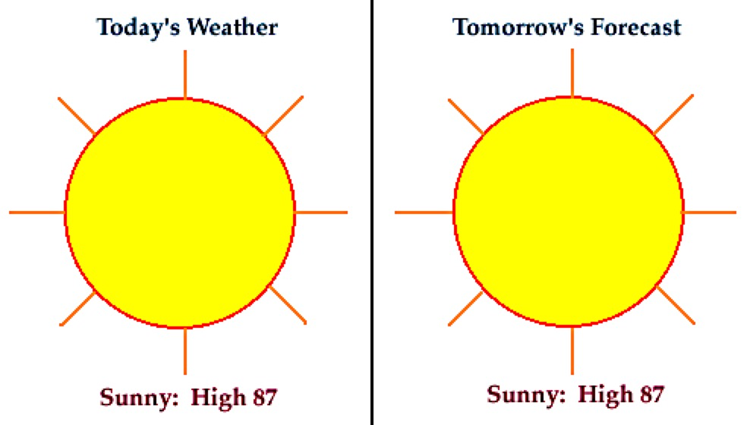
Persistence forecasting
Assumed that the weather in the future will be the same as it is currently and there will be no change to the weather conditions.
Generally good only for short periods of a few hours
Less accurate as the time period lengthens.
If it is raining now, a forecast that it is going to rain for another three hours would be a persistence forecast.
Relies upon today's conditions to forecast conditions tomorrow

Slide 29
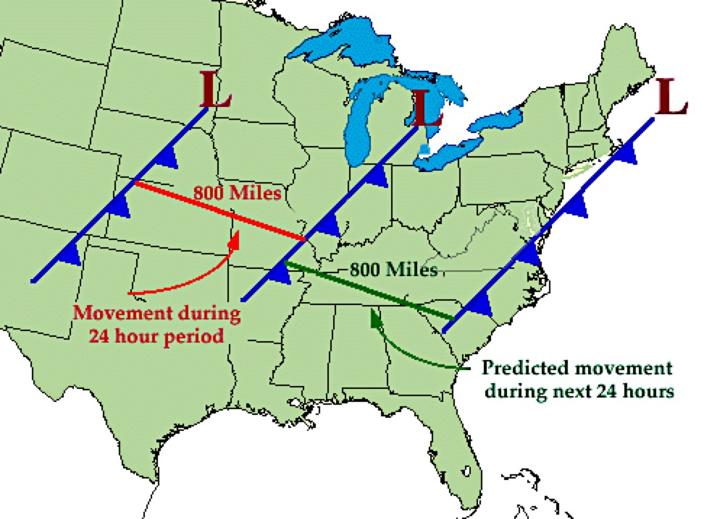
Trend method
Change of weather variables persists into a certain time ahead.
Warming trend or based on the movement of an approaching disturbance continues the same speed

Slide 30
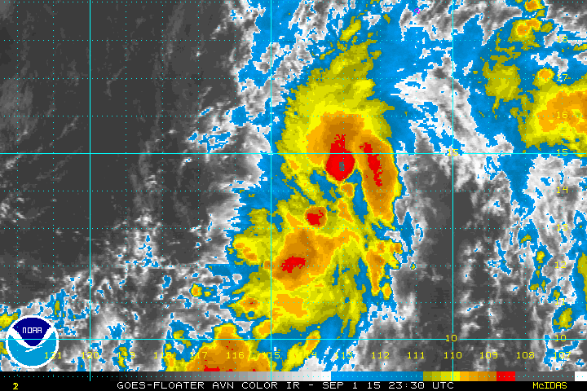
Climatological approach
A simple way of producing a forecast
Averaging weather statistics accumulated over many years to make the forecast.
(Ex.) To predict the weather for Coimbatore on July 4th, we would go through all the weather data that has been recorded for every July 4th and take an average.

Slide 31
Numerical Weather Prediction
Effect of all forces viz. coriolis, pressure gradient, gravitational, frictional and centrifugal which influence the motion of the atmosphere is expressed in terms of equations based on certain laws of physics.
Integrated form of these equations is known as the atmospheric model.
Atmospheric models can be used for predicting the final state of weather through the purely mathematical process
It accounts the current state of the weather in many synoptic stations of a given region.
The NWP technique is used in medium range weather forecasting.

Slide 32
Statistical method
• Used in long range and seasonal forecasts.
• Multiple regression statistical models are used in this method.
• IMD used Auto Regressive Integrated Moving Average (ARIMA) models for predicting Indian monsoon rainfall based on 16 global-land-ocean atmospheric variables.
• Earlier to 2002 IMD used this technique to predict rainfall during SWM well in advance on 25th May every year by IMD.
• After 2003, 8-10 parameter Power Regression model is used.
• It helps the IMD to advance the LRF by 40 days and generate a quantitative forecast update by mid July, which will be useful for contingency planning.

Slide 33
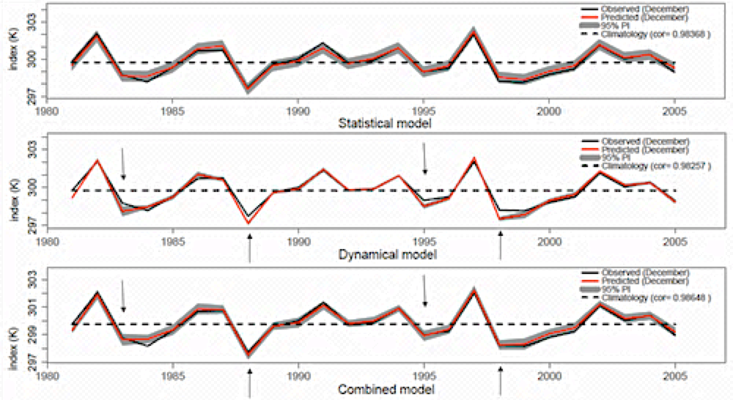
Statistical analysis

Slide 34
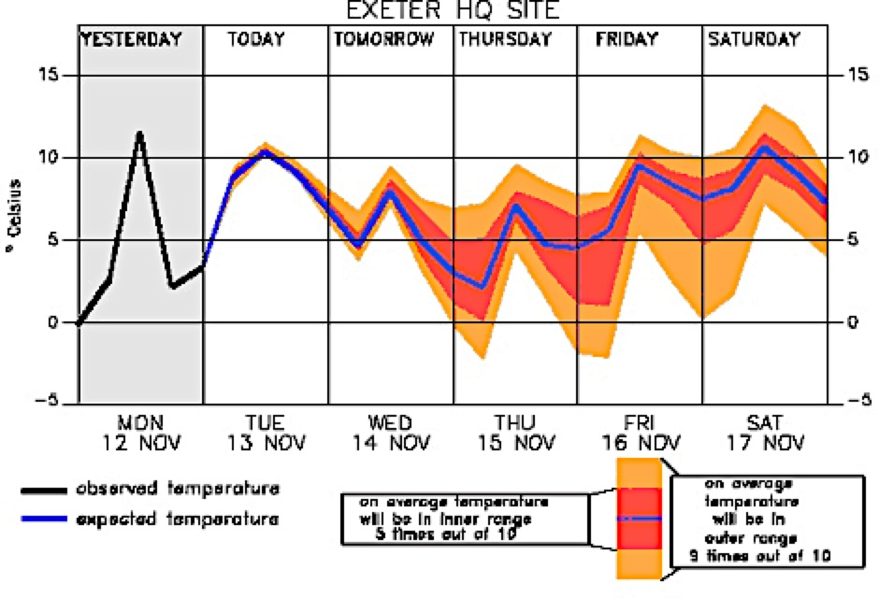
Ensemble forecast
Do a set of calculation with a model using slightly different initial conditions
Use several different models using the same initial conditions
average the model results

Slide 35

Be weather wise..Otherwise..Not wise
Thank you

